Slide 1
The Quest for Digital Preservation
Will a portion of Math History be lost forever?
Steve DiDomenico
Head, Enterprise Systems
Northwestern University Library
steve@northwestern.edu
Linda Newman
Head of Digital Collections and Repositories
University of Cincinnati Libraries
newmanld@ucmail.uc.edu

Slide 2
Today we’ll be talking about:
What is Digital Preservation
Why is it important
Libraries, museums, and other institutions’ recent work in this area
What you (Mathematicians) can do and how you can help
Time for questions

Slide 3
An Informal Survey
Notes:
How many of you have:
Digital data stored on your computer, hard drive, flash drive, or in the cloud, that is important to you?
Have ever lost data before that you couldn’t restore (from such things as accidental deletion, hard drive crash, or you knew the file or email was on your computer but you just couldn’t find it)?
Keep regular backups of your data? In different geographic locations?
Have ever thought about what will happen to your data when you are no longer around to maintain it? (not just your research and email, but even digital family pictures and videos)

Slide 4
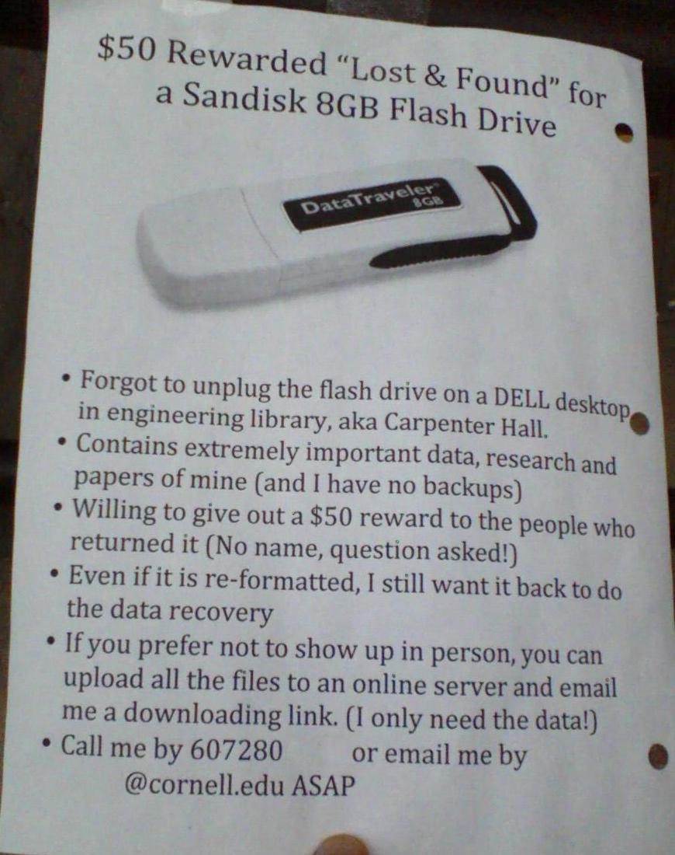
Tweeted in 2012 by Gail Steinhart, Head of Research Services, Mann Library, Cornell University
https://twitter.com/gailst/status/237525591547580416
Notes:
Real-world example of data loss.

Slide 5
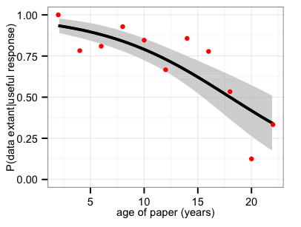
The Availability of Research Data Declines Rapidly with Article Age
“The major cause of the reduced data availability for older papers was the rapid increase in the proportion of data sets reported as either lost or on inaccessible storage media.”
Predicted probability that the research data were extant given a useful response was received
Vines, T. H., Albert, A. Y. K., Andrew, R. L., Débarre, F., Bock, D. G., Franklin, M. T., … Rennison, D. J. (2013). The Availability of Research Data Declines Rapidly with Article Age. Current Biology, 24(1), 94–97. doi:10.1016/j.cub.2013.11.014
Notes:
For papers where authors reported the status of their data, the odds of the data being extant decreased by 17% per year

Slide 6
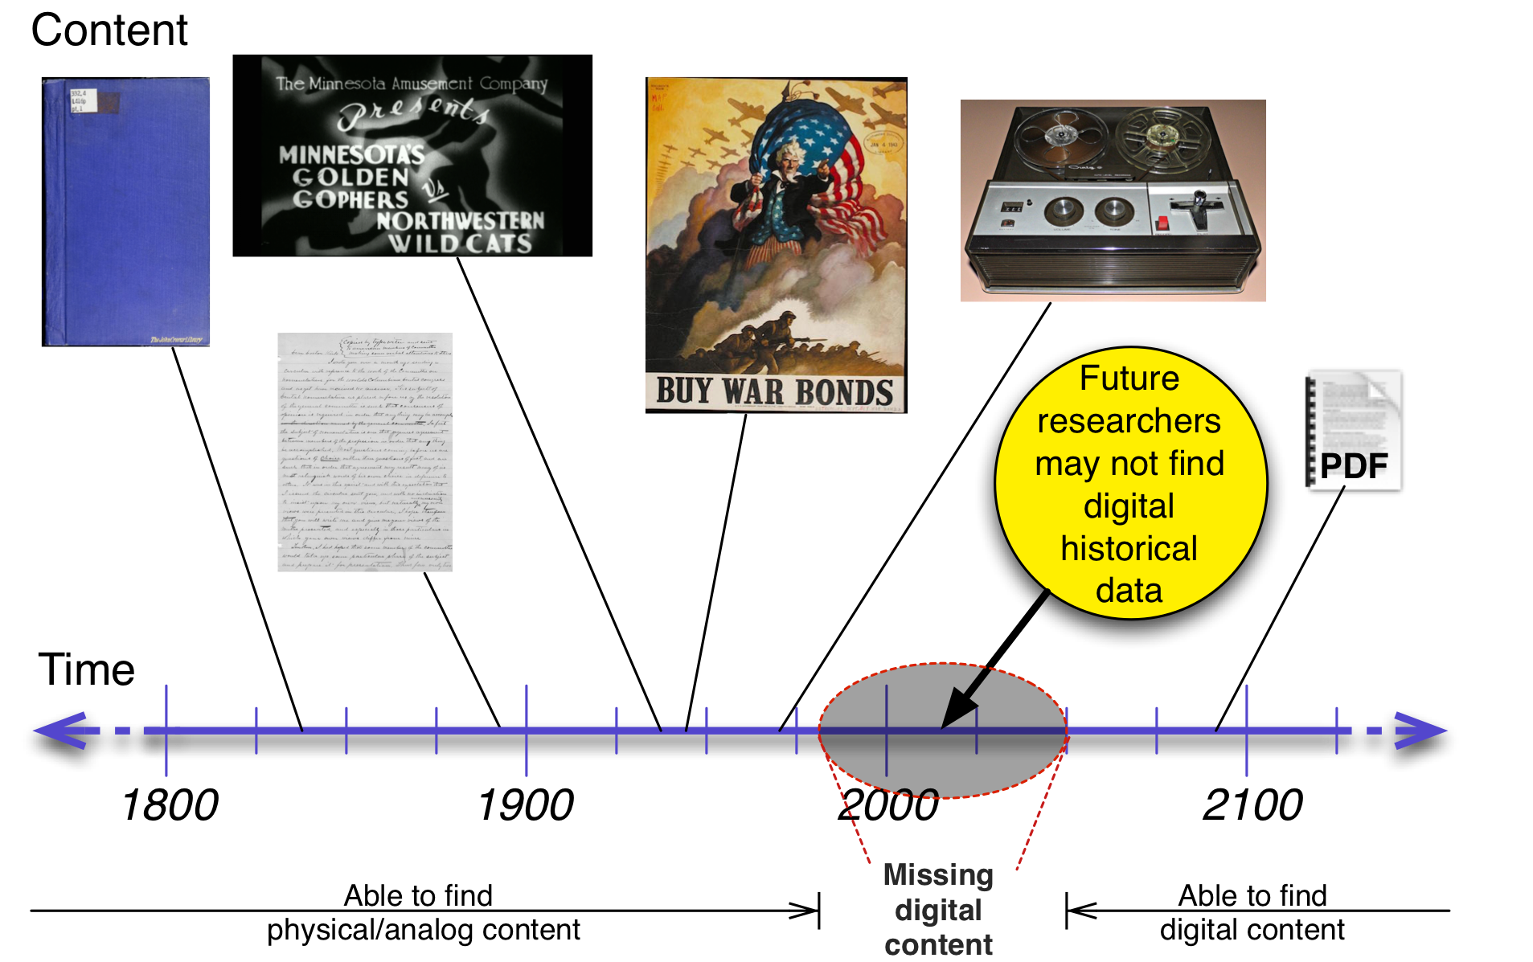
Notes:
important records of scholarship are increasingly ONLY digital

Slide 7
A Library’s mission is to:
Collect and preserve the scholarly record
Provide access to this content
Support the creation of new knowledge
Applies whether materials are in print or digital

Slide 8
Digital Preservation
Some issues with storing digital information include:
Backups — Keeping separate geographic locations for disaster situations
Maintenance (performing fixity checks, test restores)
Versioning
Costs of high-quality storage
Curation: What can we not afford to lose?

Slide 9
Digital Preservation
Digitized physical content: Data where the content originated from a physical object
Examples: scanned books, digitally captured photo of a painting
Issues include:
What quality do we capture at in order to make sure the item is preserved?
What equipment do we use to capture?
How do we note our digitization processes for the future (particularly if there is a problem)?

Slide 10
Digital Preservation
Born-digital content: Data that doesn’t have a physical equivalent
Examples: photos from a digital camera, email, web pages
Issues include:
Storage medium (floppy disks, burned data discs that only last a few years, etc.)
Format — Obsolete formats difficult or impossible to open, may have missing data
Difficult to preserve content on websites, private servers, social media.
There can be a lot of content, hard to determine what to keep

Slide 11
Digital Preservation
For both born-digital and digitized materials:
Can we preserve what we need before it’s too late?
Does metadata exist (or can it be created) so we know the content that we have?
Notes:
We’re further along in terms of processes for capturing physical materials than working with born-digital materials.

Slide 12


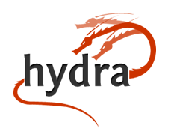

Digital Repository: A preservation system designed to help librarians, curators, and other specialists keep track of and maintain digital information over time. It can also provide users and patrons access to the content.
(In addition to some other other things, such as access controls, APIs for content ingestion, copyright support, and more)
Libraries, museums, and other institutions have created community-developed, open source software such as:
Notes:
Fedora — Digital Repository back-end software
Hydra — Ruby on Rails framework for front-end
Islandora — Drupal framework for front-end
DSpace — Digital Repository software

Slide 13

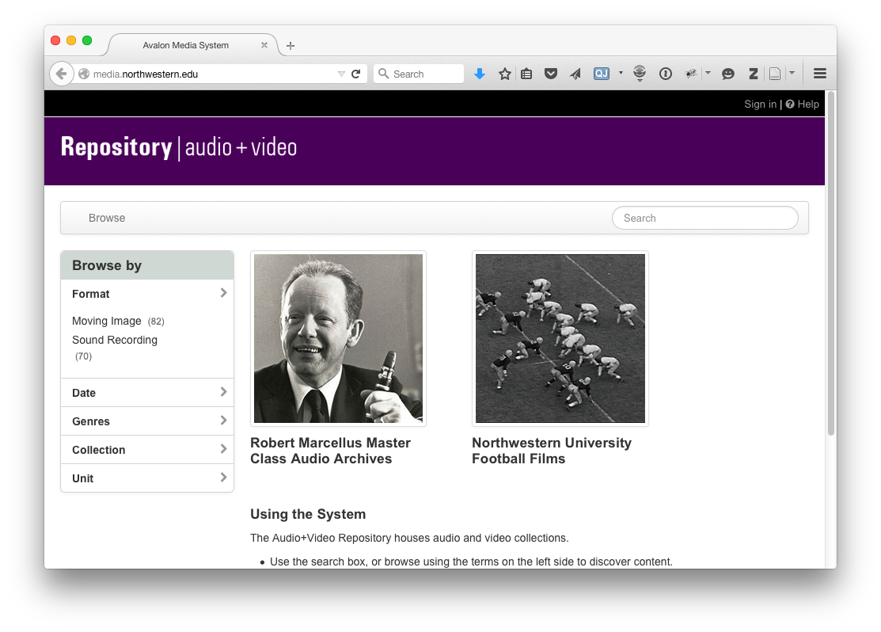

Slide 14
Consortial/Cooperative Preservation Services
LOCKSS
Digital Preservation Network (DPN)
Portico
DuraCloud
APTrust
HathiTrust
Notes:
LOCKSS — Lots of Copies Keeps Stuff Safe — a peer-to-peer network system that allows institutions to use commodity hardware to keep multiple copies of data, geographically dispersed.
Digital Preservation Network — Similar idea as LOCKSS, but instead of a peer-to-peer network, only five institutions store content and copies to each other. Other members upload their data and it’s copied to the other 5 institutions, geographically dispersed.
DuraCloud — A not-for-profit service that provides an interface to upload and replicate content into cloud storage systems, such as Amazon S3, Amazon Glacier, Rackspace, Azure, and the Digital Preservation Network.
Portico — A not-for-profit company that provides data repository services.
APTrust — Academic Preservation Trust .
HathiTrust — Collaborative repositories where their members can place digital data into a single digital preservation system and share the data. APTrust Hosted by the University of Virginia, HathiTrust administered by the University of Michigan and Indiana University.

Slide 15
What can you do
Use Library Services!
  Faculty members: contact your Digital Librarians/Preservation specialists to discuss how to preserve your content
  Publish to Open Access journals
  Researchers: Discover digital resources that have become available
For personal items, make sure you have good backups and metadata (descriptions) of your data

Slide 16
Puzzle #1 - Checksums
Challenge/puzzle #1:
Is there a better hash function – a better checksum algorithm for the digital preservation use case?
Checksums are hashes used to detect errors in data transfer and for authenticity validation.
‘Collisions’ occur when the same checksum is generated for two files that should not match.
Low likelihood of a collision caused by accidental degradation (bit rot)?
High likelihood of a collision caused by malicious alteration? (justifies a cryptographic hash)

Slide 17
Puzzle #1 - Checksums
Checksums & Cryptographic Hashes – an oversimplified history:
1961: CRC (Cyclic Redundancy Check) – not cryptographic
The following checksums are created with cryptographic hash functions (here cryptographic means that it is practically impossible to invert and recreate input data from the hash value). These checksums are less vulnerable to collisions:
1991: MD5 (Message Digest algorithm) – cryptographic but found to be highly vulnerable
1995: SHA-1 – (Secure Hash Algorithm)
SHA-1 still in wide use but NIST directive to US. Agencies to stop using SHA-1 by 2010. Mozilla plans to stop accepting SHA-1 SSL certificates by 2017.
2002: SHA-2 – Less vulnerable than SHA-1.
2012: SHA-3 – also known as ‘Keccak’ developed after 5 year NIST-sponsored contest – not yet in widespread use.

Slide 18
Puzzle #1 - Checksums
Checksums - performance:
CRCs are less complex than the SHA family of cryptographic hash functions.
SHA-2 and SHA-1 are commonly assumed to be slower than MD5 but empirical data is unpublished and inconsistent. A 2014 study tried to address this evidence gap, and found SHA-256 30% slower per gigabyte than MD5.¹
To be secure, hash functions may need to be slow – the faster the hash the more vulnerable it may be to brute force attacks.
For preservation at mass scale, has CPU power kept up with the amount of constant file validation we need, allowing re-calculation, not just comparison of stored values?
Duryee, Alex. “What Is the Real Impact of SHA-256? A Comparison of Checksum Algorithms.” AVPreserve.com, October 2014. http://www.avpreserve.com/wp-content/uploads/2014/10/ChecksumComparisons_102014.pdf.

Slide 19
Puzzle #1 - Checksums
With digital preservation at mass scale, are cryptographic checksums, in addition to robust system security, necessary? (The answer has been considered to be yes, to prevent malicious alteration by bad actors.)
Challenge/puzzle #1:
Is there a better hash function – a better checksum algorithm for the digital preservation use case?

Slide 20
Puzzle #2 - How many copies do we need?
Challenge/puzzle #2:
How many copies do we need to preserve a given amount of data over a specified period of time?
LOCKSS stores 7 copies across 7 geographically dispersed servers.
Academic Preservation Trust uses Amazon S3 (3 copies) and Amazon Glacier (3 copies), with geographic distance between S3 (Virginia) and Glacier (Oregon). Copies are in different ‘availability zones’ with separate power and internet. Amazon claims 99.999999999% (11 nines) reliability for S3 and Glacier in this configuration.³
But are these estimates based on projections and models or empirical studies?
Hardware manufacturers’ estimates of mean time to data loss (MTTDL) may not tell us much about the extent of data loss over a given period of time.⁴
http://media.amazonwebservices.com/AWS_Storage_Options.pdf
Rosenthal, David S. H. “DSHR’s Blog: ‘Petabyte for a Century’ Goes Main-Stream.” DSHR’s Blog, October 6, 2010. http://blog.dshr.org/2010/09/petabyte-for-century-goes-main-stream.html and Greenan, Kevin M., James S. Plank, and Jay J. Wylie. “Mean Time to Meaningless: MTTDL, Markov Models, and Storage System Reliability.” In Proceedings of the 2nd USENIX Conference on Hot Topics in Storage and File Systems. Boston, Mass.: USENIX Association, 2010. https://www.usenix.org/legacy/events/hotstorage10/tech/full_papers/Greenan.pdf.

Slide 21
Puzzle #2 - How many copies do we need?
Greenan et al propose a new measurement – Normalized Magnitude of Data Loss (NOMDL) – and demonstrate that it is possible to compute this using Monte Carlo simulation based assigning failure and repair characteristics to hardware devices drawn from real-world data.³
David Rosenthal has written extensively about the problems with proving that we can keep a petabyte for a century. He has concluded that “the requirements being placed on bit preservation systems are so onerous that the experiments required to prove that a solution exists are not feasible.”⁴ He proposed a bit half-life measurement (the time after which there is a 50% probability that a bit will have flipped), but argues that it is not possible to construct an experiment that proves that a given number of copies of files stored in a particular configuration will keep a petabyte safe for a century.⁵
Greenan, Kevin M., James S. Plank, and Jay J. Wylie. “Mean Time to Meaningless: MTTDL, Markov Models, and Storage System Reliability.” In Proceedings of the 2nd USENIX Conference on Hot Topics in Storage and File Systems. Boston, Mass.: USENIX Association, 2010. https://www.usenix.org/legacy/events/hotstorage10/tech/full_papers/Greenan.pdf.
Rosenthal, David S. H. “Bit Preservation: A Solved Problem?” International Journal of Digital Curation 5, no. 1 (June 22, 2010): 134–48. doi:10.2218/ijdc.v5i1.148. http://www.ijdc.net/index.php/ijdc/article/view/151.
Rosenthal, David S. H. “Keeping Bits Safe - ACM Queue.” ACM Queue 8, no. 10 (October 2010) (October 1, 2010). http://queue.acm.org/detail.cfm?id=1866298

Slide 22
Puzzle #2 - How many copies do we need?
Where does this us when designing digital preservation solutions?
We have general comfort with assumptions that
The more copies of our files the better.
The more independent the copies are from each other the better. (different storage technology, network independence, as well as organizational and geographic independence)
The more frequently the copies are audited the better.
But as the size of the data increases, the time and cost for audits increases, the per-copy cost increases, and the number of storage options that are feasible decrease. If we maximize the number of copies, the frequency of audits and network independence, high costs will force us to preserve much less.

Slide 23
Puzzle #2 - How many copies do we need?
Should librarians and archivists accept a higher level of risk in order to preserve more?
Is it better to preserve more quantity with some data loss than little quantity with unproven projections of no data loss?
Challenge/puzzle #2:
How many copies do we need to preserve a given amount of data over a specified period of time?
A more definitive answer to this question would help us make better informed choices (and get funding).

Slide 24
Puzzle #3 - Format Obsolescence
Challenge/puzzle #3:
Is there a better algorithm that could be used to initiate format preservation actions?
Format obsolescence predictions have not proven to be as dire as previously thought – the web continues to be able to render much earlier content, even for formats no longer in active use.
The importance of open source documentation may greatly increase a format’s chances of being rendered in the future.
Popularity of a format may be a simple test, but popularity can wax and wane quickly and unexpectedly as happened with the Flash video format.

Slide 25
Puzzle #3 - Format Obsolescence
We’ve used tools such as Droid, JHOVE and Apache Tika to identify formats and create metadata about them – leading some practitioners to emphasize preserving those formats we can identify. But one study suggests that browsers still render much of the content these tools fail to identify, so perhaps our format criteria are inadequate.⁶
In some cases, emulation of a software environment could prove to be equally if not more feasible than format migration.
Jackson, Andrew N. “Formats over Time: Exploring UK Web History.” In arXiv:1210.1714 [cs]. Toronto, Canada, 2012. http://arxiv.org/abs/1210.1714.

Slide 26
Puzzle #3
Librarians and archivists would like to know when to take preservation ‘actions’ – to intervene and establish a method of format migration or emulation.
At present we are balancing opinions about format renderability and brittleness without knowing whether factors such as wide-spread use (popularity), self-documentation (open source) and rendering complexity (layers) might be better and possibly more quantifiable predictors.
Challenge/Puzzle #3:
Is there a better algorithm that could be used to initiate format preservation actions?

Slide 27
Conclusion
Data is at risk if it isn’t preserved properly
Talk with libraries at your institution and make sure your research will be found for later generations

Slide 28
Questions?
Steve DiDomenico
Head, Enterprise Systems
Northwestern University Library
steve@northwestern.edu
Linda Newman
Head of Digital Collections and Repositories
University of Cincinnati Libraries
newmanld@ucmail.uc.edu
These slides are available on Slideshare at: http://www.slideshare.net/newmanld/the-quest-for-digital-preservation-will-part-of-math-history-be-gone-forever
A bibliography is available at: http://www.slideshare.net/newmanld/the-quest-for-digital-preservation-mathfest-2015-bibliography

