Slide 1
BearcatGPT Platform (Private / Secure)
Cloudforce NebulaONE on Microsoft Azure Foundry
  Chat Interface (LLM)
  Agent Building and Deployment
  Model Management
  https://nebulaone.ai/

Slide 2
What is an AI Agent?
We can leverage AI MODELS with SYSTEM PROMPTS to use curated
KNOWLEDGE SOURCES to create specialized AI AGENTS.
MODELS
  OpenAI GPT4 – GPT5 including o1 and o3 reasoning
  Open Source – Llama, Mistral, Grok, …
  Capabilities – Assistants/Code Interpreter/Image Creator/Analytics
PROMPTS
  System Prompt – Basic hidden instructions that start every AI interaction.
  User Prompts – Starting points for interacting with the Agent.
KNOWLEDGE SOURCES (Conditional Prompting)
  Files
  Websites
  API / MCP Connections
  Agentic Workflow

Slide 3
Prompting : https://ai.uc.edu/ai-tools/prompt-resources
Section | Purpose | Example
Instruction | What you want the AI to do | "Translate this sentence into French:"
Context | Background or additional information | "This is for a beginner language class."
Input | Data or text for the AI to use | "Sentence: 'Good morning!'"
Format | Desired output style or constraints | "Respond in one sentence."

Slide 4
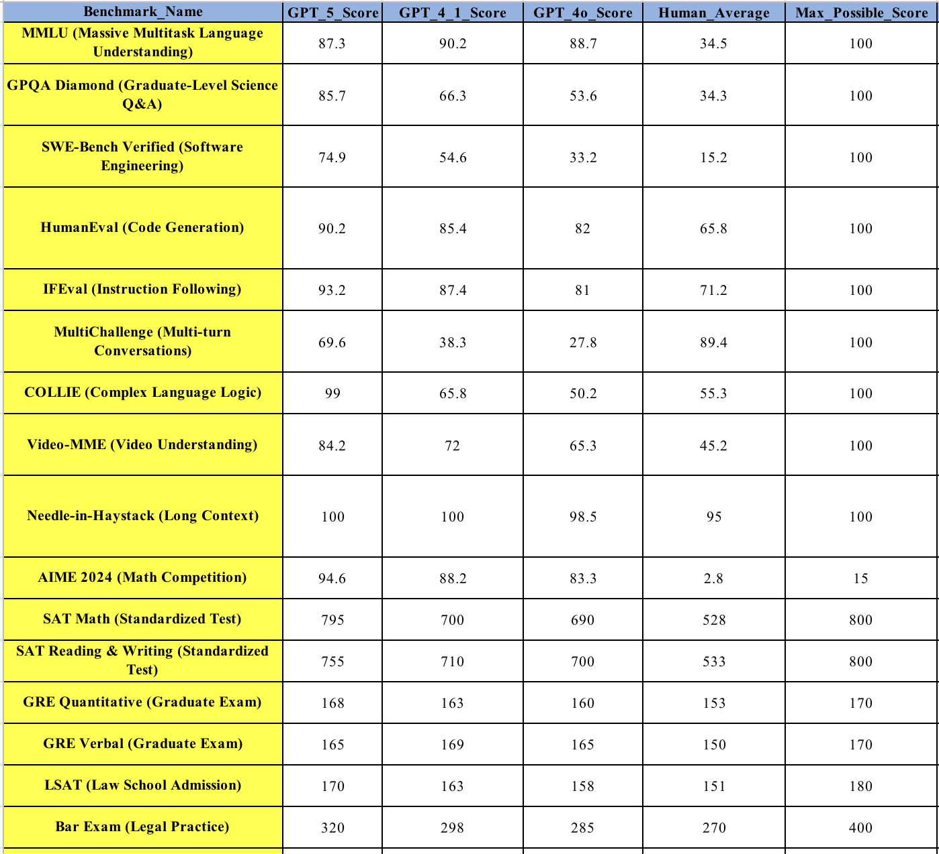
Model Catalog

Slide 5
Knowledge Sources
From Secure to Open
RAG Data
  Folders
  Websites
Training Data
Other Agents (Agentic Workflow)
Other Remote Agents (MCP)
Internet Search

Slide 6
Academic Tasks
File Analysis
Resume Validator
Syllabus Validator
Translation Assistant
Tutoring
Image Classifier
Document Converter
Sanitizer / Anomizer
Catagorizer / Un-Biaser
Accessibility
Course Evaluation
Course Selection
Essay Feedback
Policy Helper
Lecture Generator
Lesson Planning
Information Retrievers

Slide 7

System Agents
Accelerating AI for Impact, Innovation, and Engagement
Bearcat Study Pal & Bearcat Genius
Tutoring and Knowledge assistance guiding students through active engagement using the Socratic method and encouraging critical thinking
Writing tutor providing feedback to students on early drafts of their six core co-op competencies reports
Bearcat Playbook (PAL)
Enhanced Student Feedback
This initiative uses AI to streamline and synthesize student feedback from multiple sources—enhancing learning outcomes, improving feedback quality, and reducing faculty workload in complex, team-based courses.
UC Online PIPI
Instructional design agent for planning, design, and development of undergraduate and graduate-level online courses
Competency Reflection Report Coach
HR CBA Assistant
Agent that answers HR employees' questions about workplace policies, benefits, and procedures as defined in Collective Bargaining Agreements (CBAs)
AI Invoicing
UC’s AI Invoicing pilot automates and streamlines invoice processing in partnership with Accounts Payable, reducing manual effort and accelerating approvals.
Adaptive Phishing Detection
This AI-driven phishing detection initiative leverages a genetic fuzzy system and reinforcement learning to adapt in real time, improving accuracy and strengthening UC’s cybersecurity posture against evolving threats.
Bearcat AIchieve
Bearcat AIchieve is a collaborative AI-powered initiative that boosts student success in high-challenge STEM courses through personalized support, adaptive tools, and real-time engagement—reducing failure rates and improving retention.
Digital Twin
Bearcat Twin is an AI-powered digital twin initiative that integrates academic, engagement, and environmental data to improve student success and inform real-time decisions in campus planning and operations.
AI-powered teammate, coach, and culture-builder helping the Central Admissions team work faster, think bigger, and connect every action to the mission.

Slide 8
Collaborative
AI Use Cases
BearcatGPT Enterprise Wide (Josette Riep) (NebulaONE)
AI for Credential Certification (Molly McDemott-Fallon)
AI for Tutoring (Dr. Valentine Johns) (NebulaONE)
2-Sigma : Med Ed Ecosystem (Laurah Turner) (AWS)
Student Feedback (Paul Gordon)
AI for Library Exhibits (May Chang) (NebulaONE)
Increase Student Engagement with AI (Stacy Jenkins)
AI Powered Accounts Payable Invoice Processing (Erik Sager) (Microsoft)
AI Phishing Detection and Testing (Lohith Srikanth Pentapalli) (Open Source)
AI to find Bias in Curriculum (Palak Shah)
AI for Communication Streamline (Rajh Mehta) (Microsoft)
Bearcat Achieve (Josette Riep)
Bearcat Twin (Josette Riep)
AI Support for Canvas Integration (Jeff Shaffer) (NebulaONE)
UC Power and Energy Optimization (Sid Thatham) (AWS / NVIDA)

Slide 9
BearcatGPT DEMO
  Login
  Dashboard
  Chat Interface
    Export Chat
    Activity Log
  Prompting Exercise
  File Analysis Exercise
  Behind the Scenes (Management)
  Example of Coding Solution

Slide 10
AI General Inquires and Requests
https://forms.office.com/pages/responsepage.aspx?id=bC4i9cZf60iPA3PbGCA7Y7Yw89AXezxLkefG0EDESvRUNE45Q1pHNkU0QTk1N1hYUFVaVjVCOVJBRCQlQCN0PWcu&route=shorturl

Slide 11
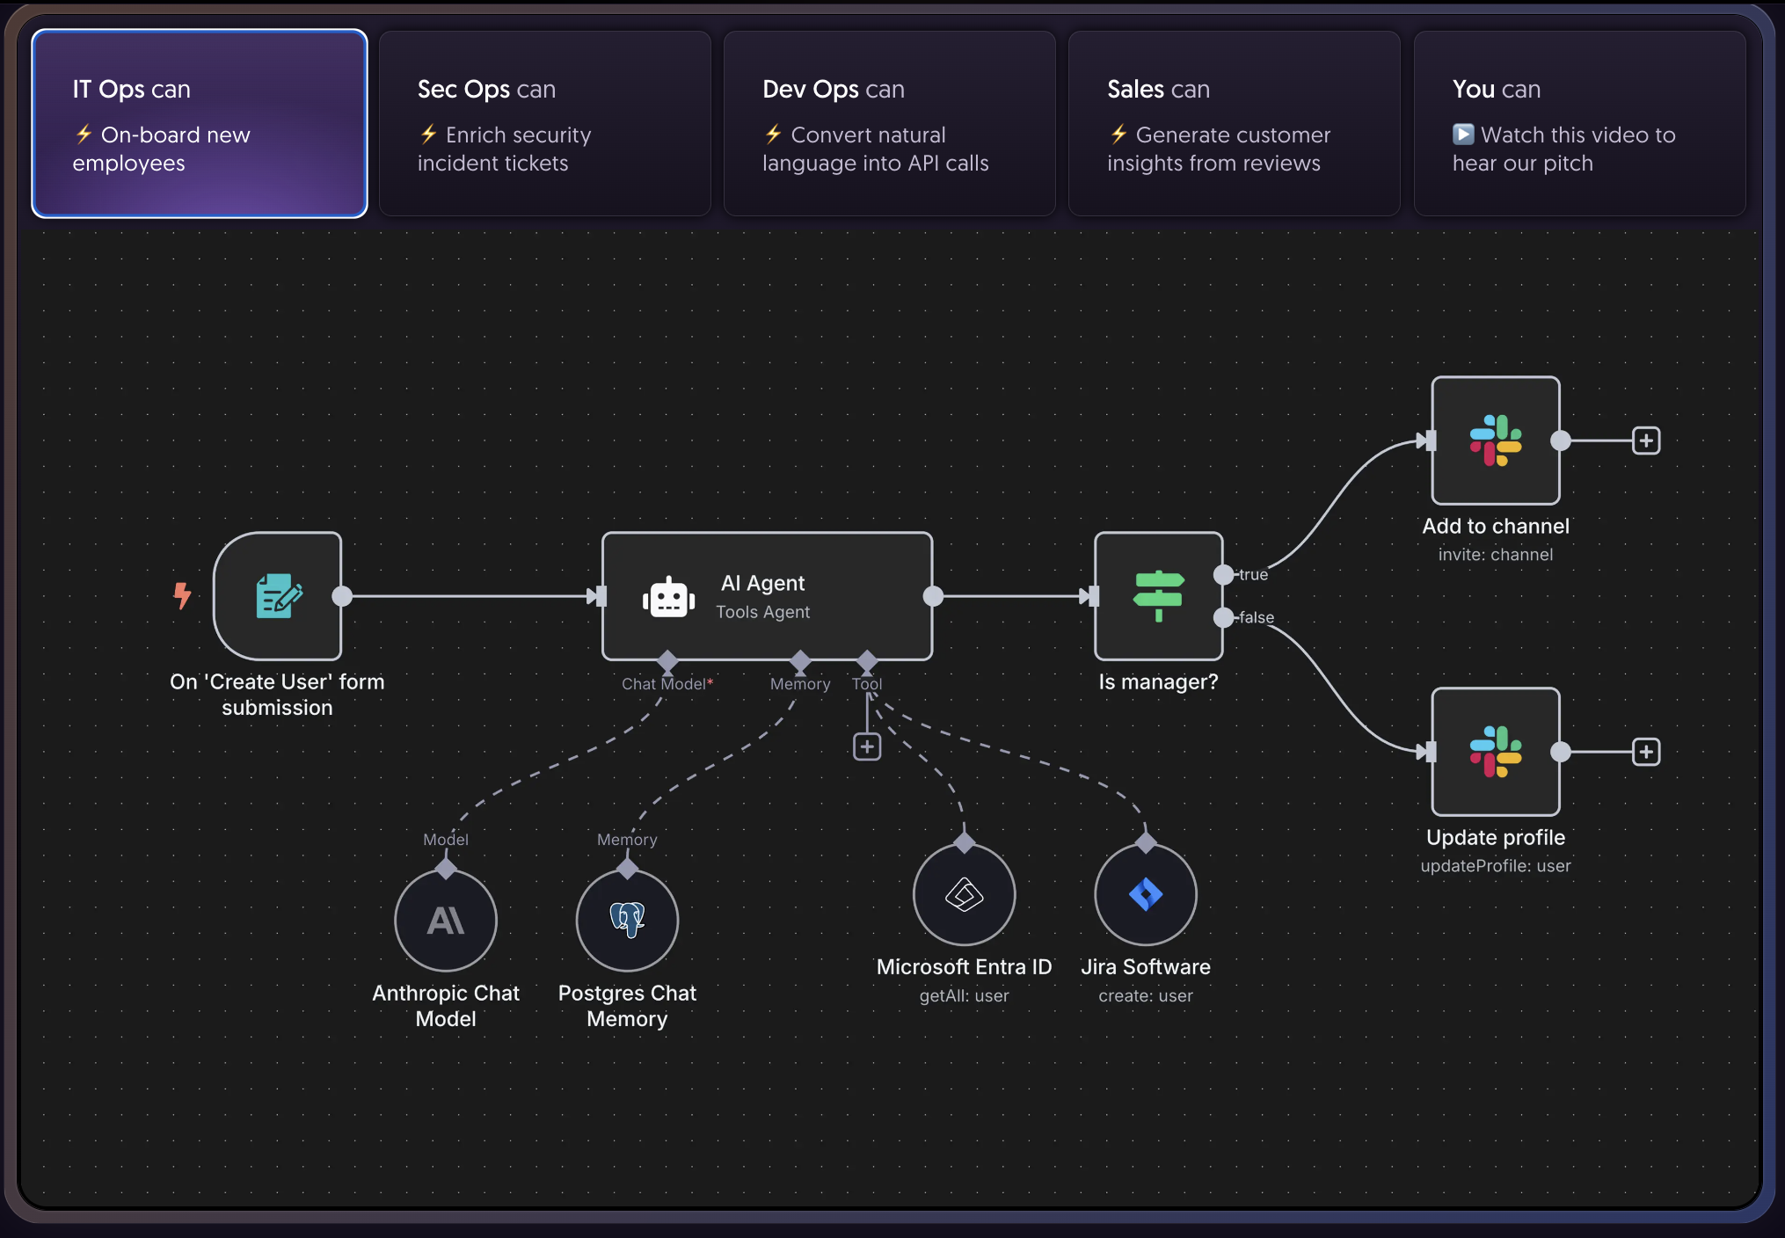
What’s Next?
What are some DTS tasks that you would like AI to do?
n8n.io

