Slide 1
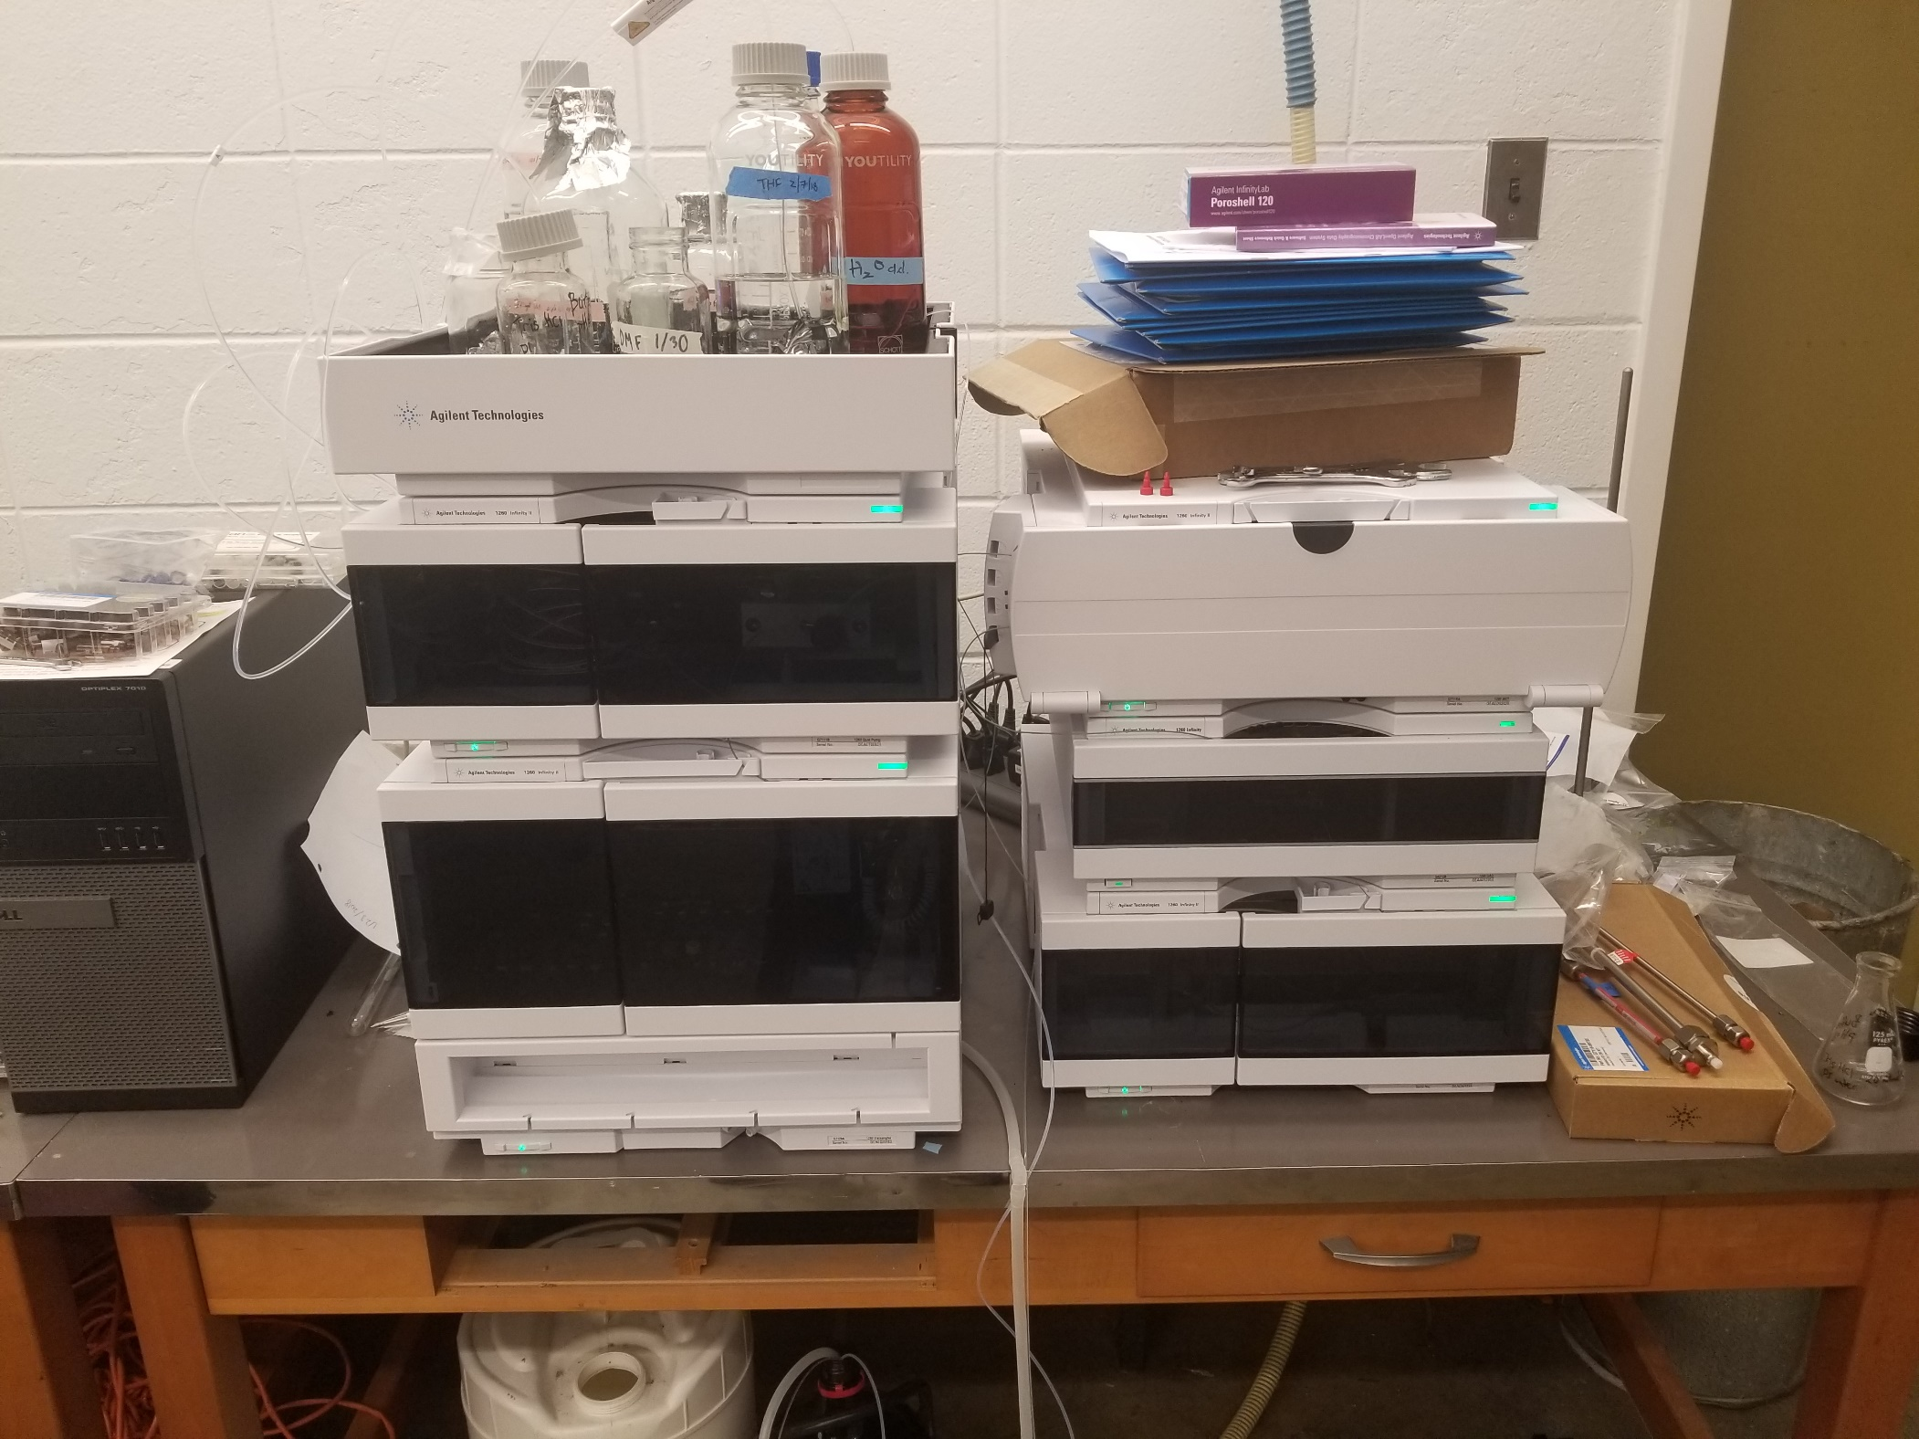
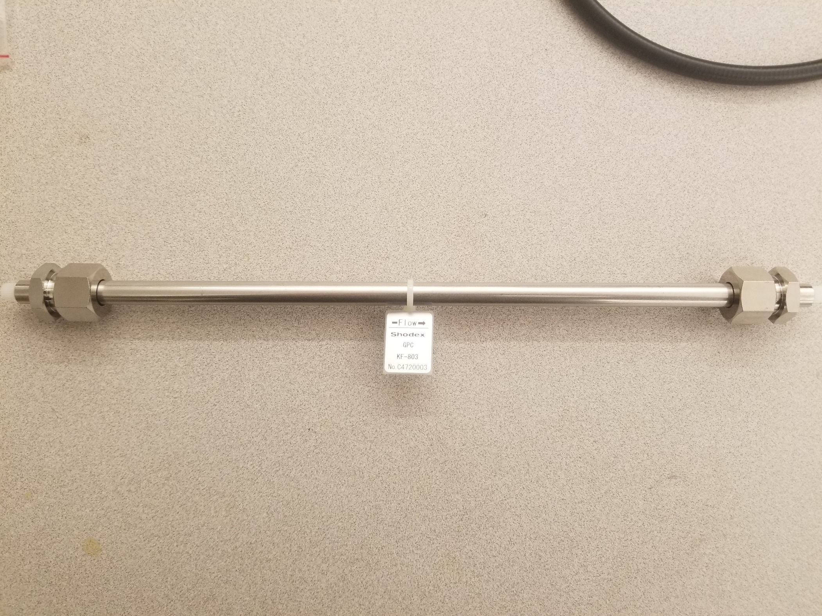
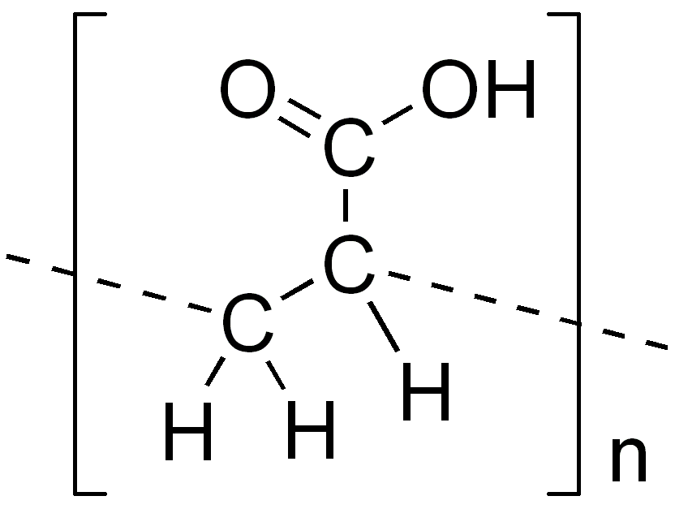
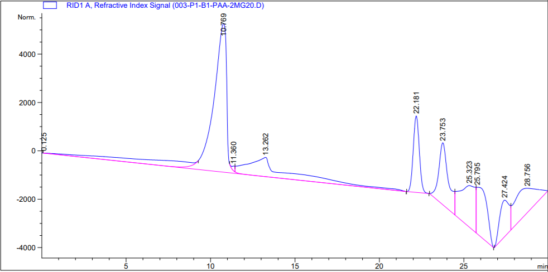
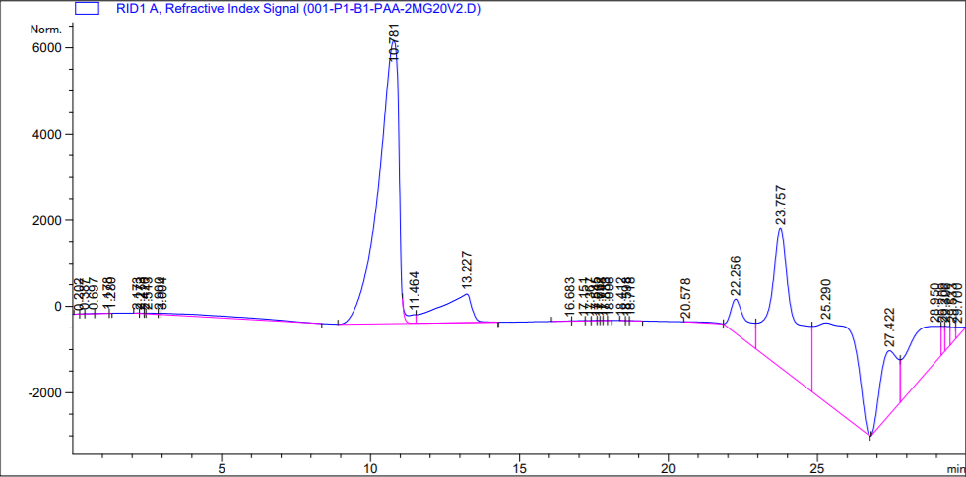
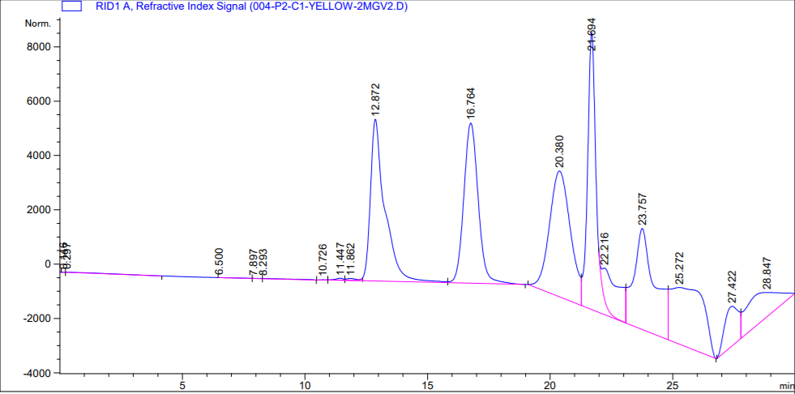
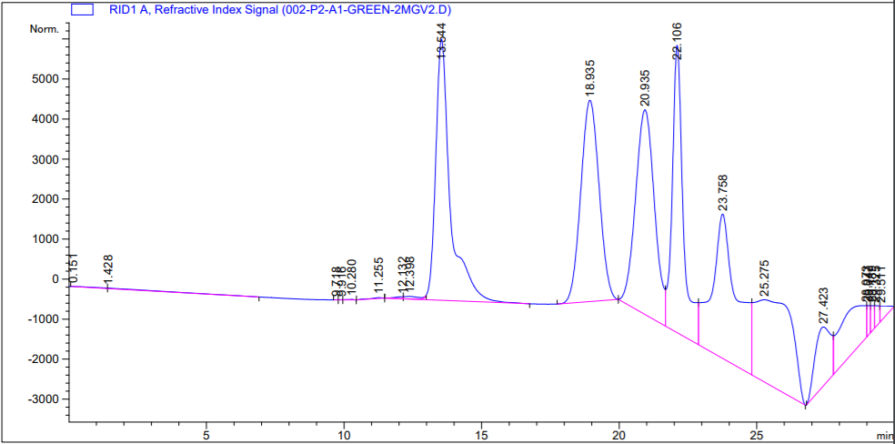
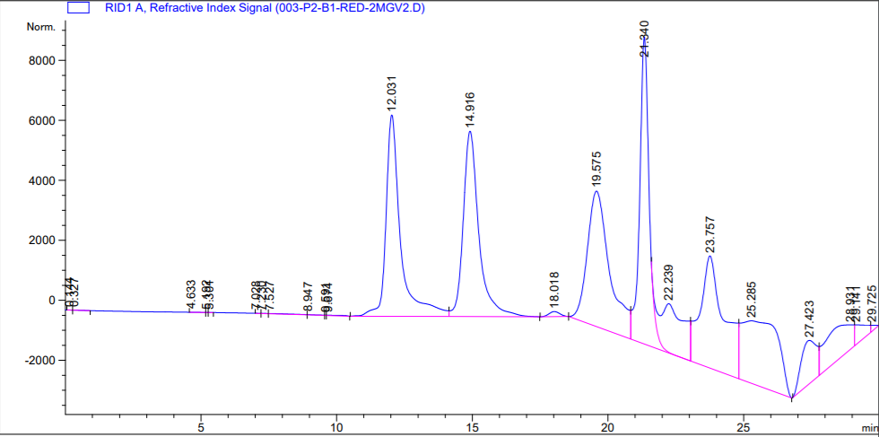
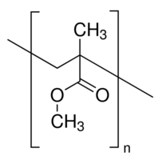
The Characterization of Polymers using High Performance Liquid Chromatography
Mitchell Scowden, Beksultan Midinov, Anh-Lan Ho, Dr. Anne Vonderheide
Background
Calibration Curve
The purpose of this project was to develop a method to characterize polymers using size exclusion chromatography. A polymer is a long chain of repeating subunits. Size exclusion chromatography is used to separate and characterize a mixture of compounds based on their size. Specifically, high performance liquid chromatography coupled with a refractive index detector (RID) was used for this research project. Compounds that have a lower retention time has a higher molecular weight while compounds that have a higher retention time are considered to have a smaller molecular weight. The column in the HPLC used was a Shodex KF-803. Polyethylene glycol (PEG) was used a standard for this method. The mobile phase used was dimethylformamide (DMF), which is a sufficient solvent for polyethylene glycol.
Polyacrylic Acid
Agilent Technologies 1260 Infinity II
Shodex GPC KF-803
Chromatograms
Retention times were taken and plotted on the x-axis along with LogMp (molecular weight) on the y-axis.
The line of best fit was determined and plugged in the retention time of PAA to the line equation, y= -0.1988x + 6.8594.
We then, took 10 to the power of that number and calculated a molecular weight of 52,305 g/mol and 52,016 g/mol for polyacrylic acid.
Molecular Weight of Standards
52,302.5 g/mol
Color Vial | Molecular Weight (g/mol)
Red | 282 1,000 7,000 30,000
Yellow | 194 600 4,000 20,000
Green | 106 400 1,500 13,000
PAA (1st Run)
Conclusion
This method was shown to be an effective way to characterize polymers using PEG as a standard. We decided to ignore any peaks after 22 minutes because we were getting impurities. Poly (methyl methacrylate), otherwise known as P(MMA), was also tested using the same method. P(MMA) is very high in polarity. The known weight of the polymer was 60,500 g/mol. After running the polymer, 23,000 g/mol was calculated to be the molecular weight. This molecular weight shows that certain parameters like polarity needs to be considered when running samples on the HPLC.
52,016 g/mol
4,000 g/mol
600 g/mol
20,000 g/mol
HPLC Parameters
PAA (2nd Run)
Yellow Vial
Mobile Phase | Dimethyl Fluorine (DMF)
Flow Rate | .5mL/min
Injection Volume | 20 microliters
Column Temperature | 37 ° C
Refractive Index Detector Temperature | 37 ° C
Pressure of Column | Around 35 bars
400 g/mol
7,000 g/mol
Poly(methyl methacrylate)
13,000 g/mol
1,500 g/mol
30,000 g/mol
1,000 g/mol
Green Vial
Red Vial

