Slide 1
Thomas Scherz (he/him)
University of Cincinnati
Samvera Virtual Connect 2023
ScholarGPT : Improving Metadata through AI
scholar.uc.edu

Slide 2
Machine Learning
How much / How many? - Regression - Supervised Learning
Which class does this belong to? Classification - Supervised Learning
Are there different groups? Which one does this belong to? Clustering - UnSupervised Learning
Is this weird? Anomaly Detection - UnSupervised Learning
Which option should I choose? Recommendation - UnSupervised Learning

Slide 3
Nature Language Processing (NLP)
Classification,
Keyword extraction,
Named-entity recognition
Encoding
Feature selection
Design a model
Subject Terms (Keyword)
Clustering

Slide 4
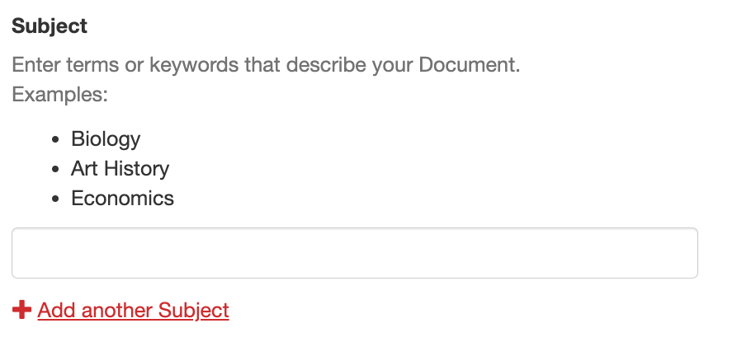
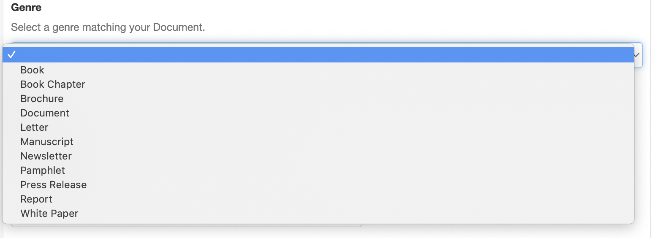
Project Introduction : DEWEY
Subject Terms and Genre

Slide 5
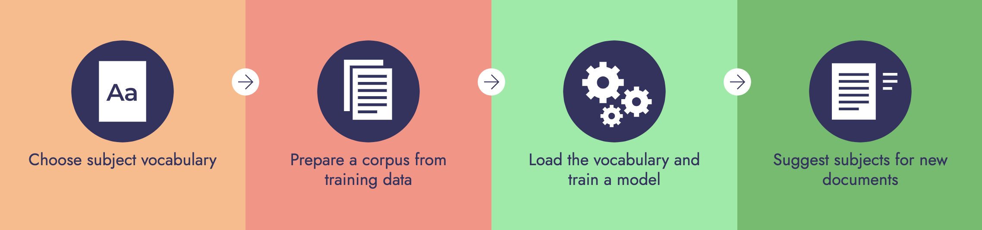
Artificial Intelligence Terms
A Corpus : All text documents in Scholar
A Training Set : is a subset of the corpus, which has been tagged in some way to identify the characteristic you are looking for
A Test Set : collection of documents to be used for trialling the algorithm, to see how successfully it carries out the operation.
An Algorithm : The ‘algorithm’ is simply the tool that looks at each item in the corpus and enables a decision to be made.

Slide 6
Artificial Intelligence Process
Identify
Explore / Analyze / Encode (Codify)
Model
Predict
  Clarity (Makes Sense)
  Original (Novelty)
  Useful
Feedback

Slide 7
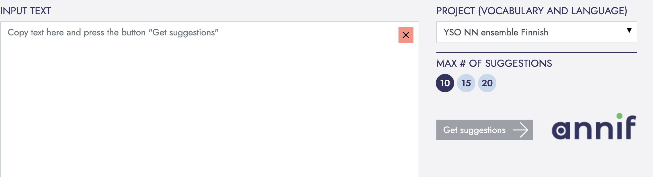
ANNIF (annif.org)
National Library of Finland
Python and Poetry
Interfaces : CLI, API, GUI
Projects (vocabulary, analyzer, backend)

Slide 8
Subject Vocabulary
A subject vocabulary defines the subjects available for automated indexing or classification. Typically, this will be a thesaurus, a classification or a list of subject headings.
TSV, CSV, or SKOS/RDF
Which should I use?
  YSO : https://finto.fi/yso/en/
  LOC : https://id.loc.gov/download/
  Unesco : https://skos.um.es/unescothes/

Slide 9
Analyzer (Pre-processing)
Analyzers are used to pre-process, tokenize and normalize text.
Annif supports many analyzers:
  simple analyzer
    The simple analyzer only splits text into words and turns them all into lowercase.
  snowball analyzer
    The snowball analyzer additionally performs stemming. It takes a language name as parameter,
  simplemma analyzer
    The simplemma analyzer performs simple rule-based lemmatization for many languages.
  voikko analyzer
    The voikko analyzer performs lemmatization for Finnish.
  spacy analyzer
    The spacy analyzer performs lemmatization for many languages.

Slide 10
Back End
TF-IDF: The TF-IDF (Term Frequency-Inverse Document Frequency) backend uses a statistical method to weight words in a document based on their frequency and relevance to the document.
fastText: The fastText backend is a deep learning model that is designed to handle text classification tasks.
Omikuji: The Omikuji backend is a probabilistic method that uses the Naive Bayes algorithm to classify documents.
MLLM: The MLLM (Maximum Likelihood Language Model) backend is a probabilistic method that models the probability of a document given its classification category.

Slide 11
Back End (Continued)
STWFSA: The STWFSA (Suffix Tree Weighted Finite State Automaton) backend is a method that uses a combination of suffix trees and finite state automata to represent and process text.
YAKE: The YAKE (Yet Another Keyword Extractor) backend is a text mining algorithm that identifies keywords and keyphrases in documents
SVC: The SVC (Support Vector Classifier) backend is a popular machine learning algorithm that can be used for text classification tasks.
Fusion/Ensemble backends: These backends combine the results of other backends to generate a final classification result.
PAV: The PAV (Pool Adjacent Violators) backend is a method for constructing monotonic classification models.

Slide 12
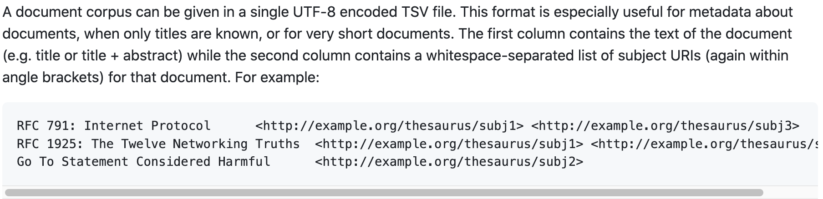
Training Set
Training set needs to match your vocabulary
Internal v External
Copyright / Ownership
Size

Slide 13
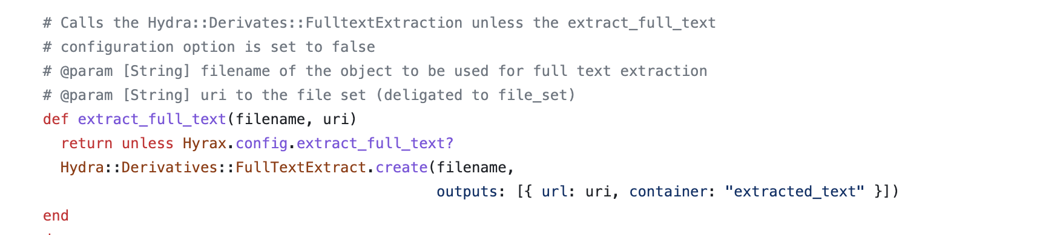
Hyrax Integration (hydra-derivatives)
hyrax/app/services/hyrax/file_set_derivatives_service.rb
POST to ANNIF (API)
Ingest / Rake / Mailer
Gemify?

Slide 14
Citations
https://liberquarterly.eu/article/view/10732
https://github.com/scherztc/dewey
https://github.com/NatLibFi/Annif
https://github.com/NatLibFi/Annif/wiki/Subject-vocabulary-formats
https://github.com/jimfhahn/Annif-tutorial/tree/master/data-sets
https://www.academia.edu/79038462/Automatic_Assignment_of_LCSH_Combining_Classification_and_Extraction
https://github.com/uclibs/ai-project

