Slide 1
Redesigning BrowseEverything
Samvera Connect 2019
Thomas Scherz
Randall Floyd
Christina Chortaria
James Griffin

Slide 2
BrowseEverything
Samvera Core Component
Rails Engine
Permits users to select files (or directories) for repository ingestion
Supports multiple file/directory sources
  File System
  Google Drive
  Dropbox
  Amazon S3 Buckets
  Box

Slide 3
BrowseEverything
Did not offer a 1.0.0 release until March 2019
In use by many production Samvera repositories
Problem: Maintaining drivers for cloud storage providers
  Many cloud providers have different APIs
  Feature requests submitted for organizations are provider-specific
  How to define an API for a cloud provider?
Before these challenges can be discussed, we will explore the Driver API

Slide 4
BrowseEverything: Driver API
The Driver API wraps cloud provider clients
Let us review the code base for drivers!
  Base driver
  Amazon S3 driver
  Google Drive driver
Drivers are inconsistent
  Some cloud clients require OAuth2 authorization
  Cloud clients search directories/folders
This needs to change
Notes:
This will be a brief code read led by Thomas Scherz, and should address the following points:
Review the 1.0.0 driver structure
Review the provider-specific code
Led the attendees to the conclusion that the code base must be rearchitected

Slide 5
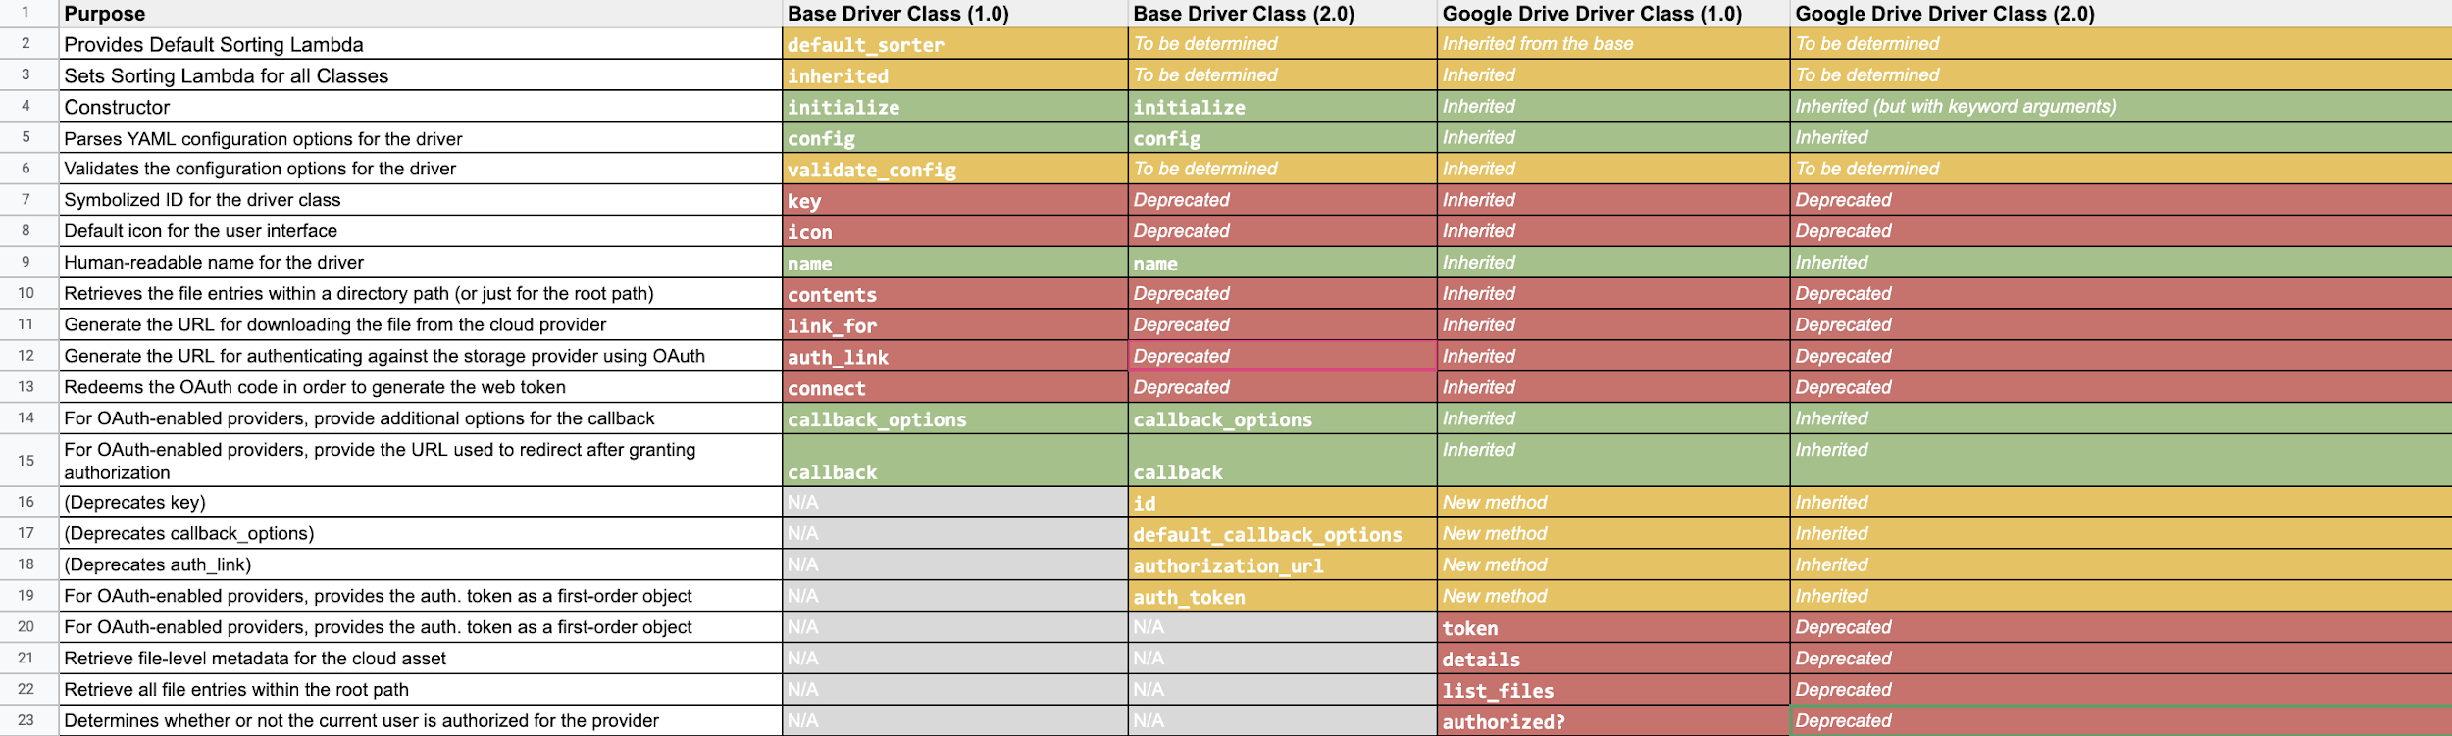
BrowseEverything: Driver API
We started prototyping API changes in supporting Google Drive
Analysis
Notes:
This will be a brief code read led by Thomas Scherz, and should address the following points:
Review the 1.0.0 driver structure
Review the provider-specific code
Led the attendees to the conclusion that the code base must be rearchitected

Slide 6
BrowseEverything: Rearchitecting APIs
Drivers need an API specification
But there were also other requirements
  User Interface improvements
  Legacy jQuery Plugin dependencies
  jQuery binding to server-rendered partial HTML
Are there other approaches?
  Can Rails Controllers just serve JSON data instead?
Notes:
This should aim to identify that restructuring the drivers alone is not enough.
There are significant limitations in using jQuery, it is bound to the DOM
Using server-rendered HTML partials are difficult to adjust
It would be better to just retrieve raw data from the Rails Controller

Slide 7
BrowseEverything: Rearchitecting APIs
REST
  Representational State Transfer (REST)
  URL path structure combined with HTTP methods to define an API
    GET “reads” an object
      GET https://institution.edu/repo/rest/v1/books/1
    POST “creates” an object
      POST https://institution.edu/repo/rest/v1/books
    PATCH “updates” an object
      PATCH https://institution.edu/repo/rest/v1/books/1
    DELETE “deletes” an object
      DELETE https://institution.edu/repo/rest/v1/books/1
Notes:
This should aim to identify that restructuring the drivers alone is not enough.
There are significant limitations in using jQuery, it is bound to the DOM
Using server-rendered HTML partials are difficult to adjust
It would be better to just retrieve raw data from the Rails Controller

Slide 8
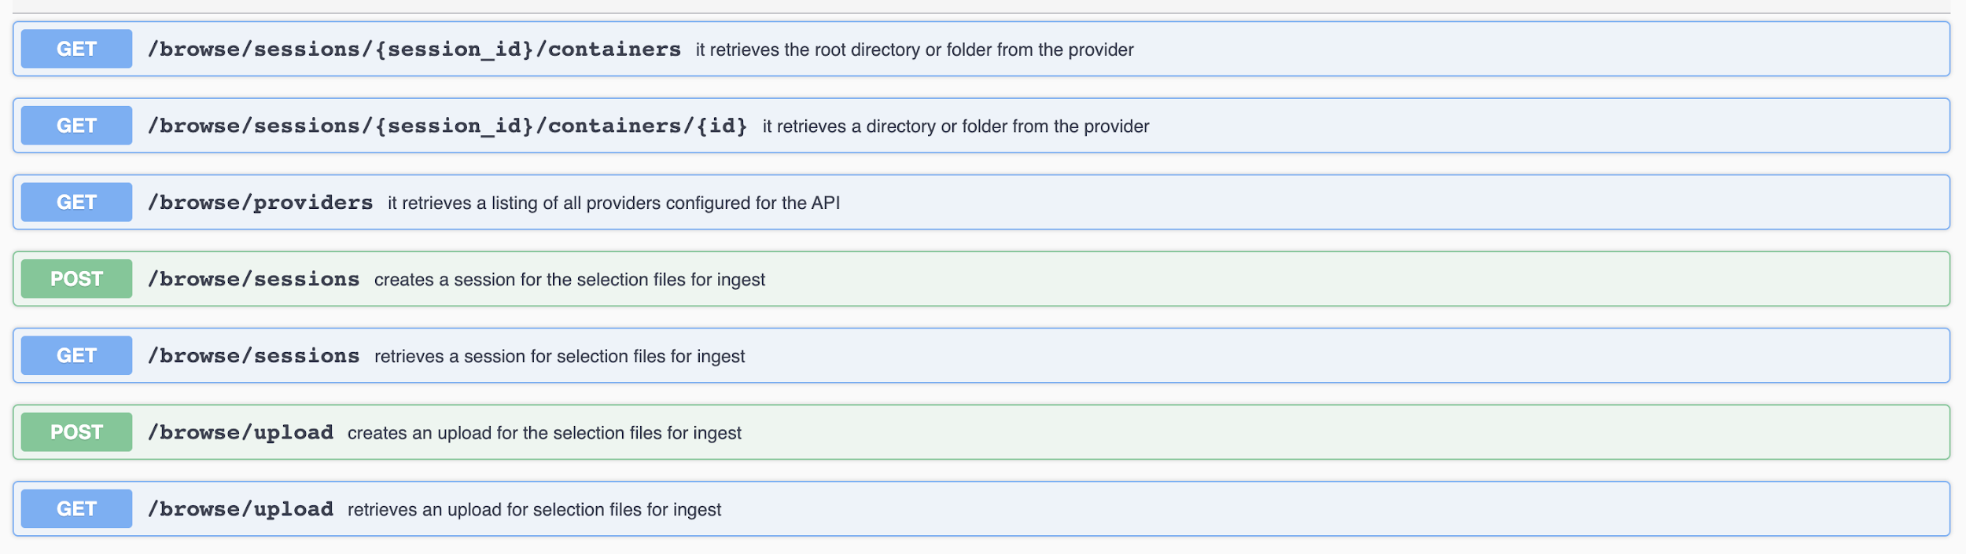
BrowseEverything: Rearchitecting APIs
Swagger
  Really, OpenAPI
  Documents the RESTful API and HTTP methods
  Gems and other libraries build upon Swagger utilities
Notes:
This should aim to identify that restructuring the drivers alone is not enough.
There are significant limitations in using jQuery, it is bound to the DOM
Using server-rendered HTML partials are difficult to adjust
It would be better to just retrieve raw data from the Rails Controller

Slide 9
BrowseEverything: Rearchitecting UI
How does one consume data from our RESTful API?
With Rails release 6.0.0, Webpack is supported for JavaScript assets
  Without Sprockets, using ES6 or TypeScript with Node.js packages becomes easier
BrowseEverything developers can also explore jQuery alternatives
  Angular?
  Vue?
  React?
  Nothing at all?
Notes:
(This might need to be scaled back for time)

Slide 10



BrowseEverything: Rearchitecting UI
Prototyping
  After a spike, React with Redux was chosen
React
  JavaScript user interface framework
  Logically groups a user interface into “components”
  Oriented towards modularity
  Supported by a major company
  Competing only with Vue for dominance
Redux
  React is not concerned with fetching data from the server
  Redux provides these features
  Support for integrating React and Redux is mature
Notes:
There were concerns due to the churn in JavaScript framework adoption

Slide 11

BrowseEverything: Web Components
React is still an investment in a framework
  Will we need to abandon React in the future?
Solution: Web Components
  https://github.com/w3c/webcomponents
  Web Components are not tied to frameworks
  We can build a UI from a collection of Web Components
  that can be reused in different frameworks (or no framework)
  Still, developing them requires adoption of some Web Component
  library or toolset
Notes:
Randall: (Introduces Web Components)
So we want to continue to emphasize and reiterate the amount of consideration that is being given in the design to not lock ourselves or implementors into a monolithic UI that is A.) hard to support as things come and go in the ever shifting Javascript landscape; and B.) does not provide easy way to change what the component is composed of, or what it is composed with.
Speak to slide…
The most obvious solution available to us now

Slide 12
BrowseEverything: Stencil
Stencil is one such library that can help us create Web Components for use as custom elements anywhere
  From Ionic Framework Team
It is a compiler that takes things like the Virtual DOM, TypeScript and JSX and generates standards compliant Web Components
We want to compose the main B-E UI out of smaller reusable granular Web Components
  For example, a Stencil Web Component for the ByteStream row in B-E is being prototyped
Notes:
Randall: (Introduces Stencil)

Slide 13
BrowseEverything: Stencil
Can Stencil Web Components, React, and Redux be integrated?
  Yes, with caveats: each framework has their own quirks for direct integration of a Stencil Web Component
  Ability to compile to popular frameworks as output targets is a work in progress
But Material-UI, a React UI framework, makes composition using Web Components even easier
  Material-UI allows you to replace the root node of most of their components via a property
Notes:
Randall:
So we’ve heard about the emerging implementation of a React Redux application that interfaces with the BE API, so the question becomes...

Slide 14
BrowseEverything: Stencil
We can pass a Material-UI container a B-E Web Component like:
<div>
...
<StyledChildResourceTree
...
<ListItem // A Material-UI component
variant="contained"
color="secondary"
component="bytestream" // From collection of BrowseEverything components
onClick={this.handleClickAuthButton}
...
/>
/>
</div>
Notes:
Randall:
So instead of a standalone React component to represent file object rows, we could instead have a very thin bytestream component that you import/pass a component of choice into.

Slide 15
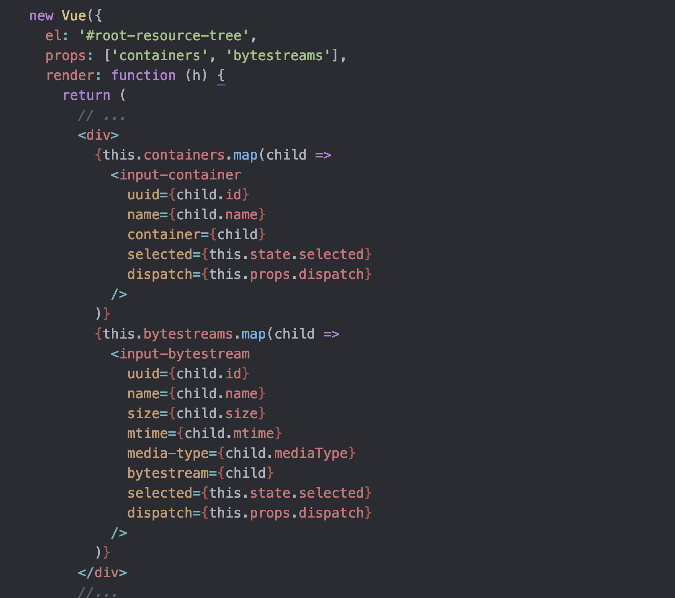

BrowseEverything: Stencil
Can Stencil Web Components be used outside of React and Redux?
Vue.js
Notes:
Randall:
Absolutely. In fact, you don’t have to use any other framework at all. Once components are compiled, they can be imported and used as a custom element anywhere. So if the default implementation of React/Redux/Material-UI isn’t for you, then you can still reuse the granular components that make up the B-E UI.

Slide 16
BrowseEverything: Stencil
Stencil is still evolving and growing
Use of Stencil in high-profile services, like Apple Music Web Beta, shows viable product and vibrant community
  https://twitter.com/stenciljs/status/1169719595508408320?s=19
Better React and Angular integration is coming
  They are working on open sourcing their bindings to those so that you can compile to native React/Angular components
  https://twitter.com/jthoms1/status/1176941324123201542?s=19
Notes:
Randall Floyd will speak for this slide

Slide 17
BrowseEverything: Prototyping
Progress on this has been slow...
Steadily prototyping of 2.0.0 and React/Redux frontend is underway
We will now demonstrate the prototype

Slide 18
BrowseEverything: Forthcoming
Hooking into Hyrax will be supported
To be determined: JavaScript dependencies
  Webpack? Sprockets?
  CDN?
  Static asset?
Better user experience
  James is at fault for this (sorry)
A11y and i18n
  These were not priorities, but should be
Community CfP
  Maybe a community sprint?

Slide 19
BrowseEverything: Questions?
Q & A

Slide 20
Redesigning BrowseEverything
Thank you for your attention!
Please join us using:
#browse-everything
BrowseEverything Interest Group

