Slide 1
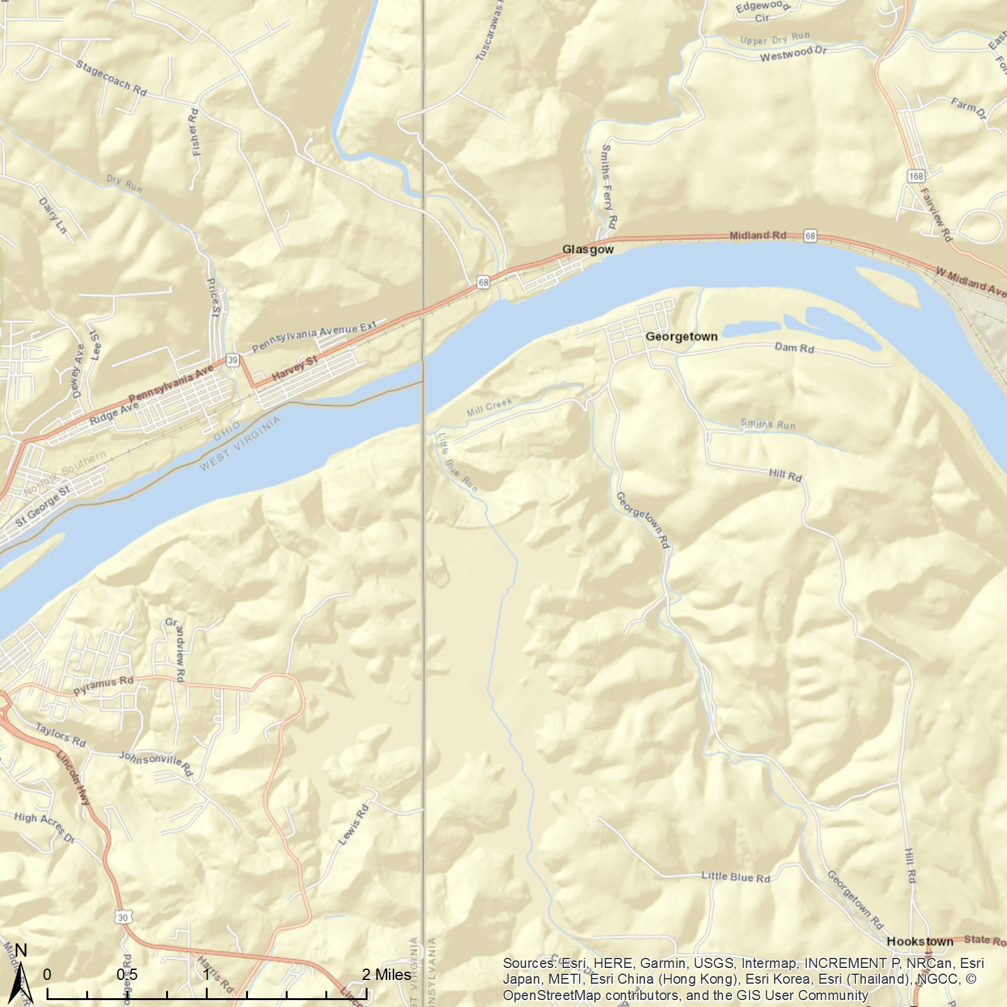
No data were collected between Nov. 2009 and May 2011.
East Elementary School
East Liverpool, OH
ATSDR Standard
1417 Etruria St,
East Liverpool, OH 43920
WHO Standard
EPA Standard
The monthly average of the manganese (PM10) in the air was collected by a monitor at East Elementary School from Aug. 2009 to Jan. 2012. If you want to explore more, please visit our website: https://med.uc.edu/eh/research/projects/cares.
Airborne Manganese (PM10)
Monthly average
ATSDR Standard
WHO Standard
EPA Standard

Slide 2
No data were collected between Nov. 2009 and May 2011.
East Elementary School
East Liverpool, OH
ATSDR Standard
1417 Etruria St,
East Liverpool, OH 43920
WHO Standard
EPA Standard
The monthly average of the manganese (PM10) in the air was collected by a monitor at East Elementary School from Aug. 2009 to Jan. 2012. If you want to explore more, please visit our website: https://med.uc.edu/eh/research/projects/cares.
Airborne Manganese (PM10)
Monthly average
ATSDR Standard
WHO Standard
EPA Standard

