Slide 1

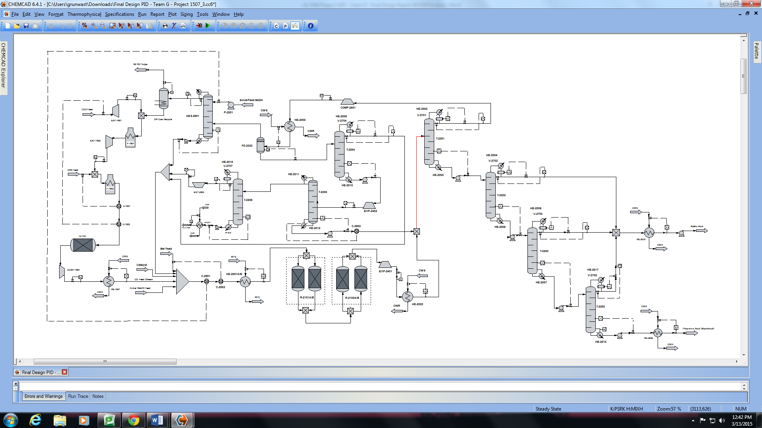
Synthesis of Acetic Acid Via CO2-CH4 Reformation and Carbonylation of Methanol
Team G – Stephan Grunwald, Devin Metzger, Sean Buchanan, Christopher Kleiman
Group I.H. – Jeremy Clark, Steve Dickman, Andrew Hinton, and Tim Schafermeyer
Scope Definition & Design Basis
The purpose of the project was to design and evaluate the economic feasibility of the production of Acetic Acid utilizing an available CO₂ feed.
The recommend design must meet the following:
Production of 250,000 lb/hr of Acetic Acid (AcOH).
There must be no emissions of CO₂ from the process.
Initial Design Considerations
The production of acetic acid utilizing the available CO₂ stream consisted of two primary reactions, i.e. methane reformation and methanol (MeOH) carbonylation.
Reformation:
Conversion of CH₄ vs. CO₂ reactant cost minimization of CO₂ utilization.
Catalysts selection to minimize coke formation, cost, and to maximize CH₄ conversion. Comparison of Ru, Ni, Pd & different supports
Various CO₂/CH₄ molar feed ratio and effect on coke formation and conversion.
Reactor Temperature effects on conversion
Reactor Pressures effect on conversion
Carbonylation:
Catalyst, promoter and co-catalyst choices impacted CO utilization, reaction conditions and process economic feasibility
Any catalyst/co-catalyst must be recycled completely or nearly completely as to mitigate environmental risk and economic impact
Catalyst choice also had large influence water gas shift reaction (WSGR), a major side reaction
CO₂ could not be released from process, therefore the WGSR needed to be limited
Presence of water in reactor necessary to ensure no drying out of catalyst
Major by-products were propionic acid and acetaldehyde
Product separation and purification to achieve desired purity
Key Streams: Products and Feeds
Design Strategy
Future Work
Feed Streams
Reformation of CH₄
Carbonylation of MeOH
The following are recommendations made by the design team that would further improve the process feasibility. These changes came after the process design was finalized and should be considered for any future process development.
Consideration of multiple reactors to allow for online catalyst regeneration
Examine the need for a CO₂ purge to limit the presence and potential build up of nitrogen and hydrogen
Further study the reaction kinetics of the reformation reactor and detail the effects of catalyst degradation on the system
Conduct further research on the catalyst (IrI₃) to fully understand solubility, effectiveness, and age pattern
Reevaluate holding periods of materials to follow industry standards to better gauge storage requirements
Additional research on material selection to ensure proper material usage for equipment throughout the system
Conduct scale up studies to examine the byproduct reactions and determine their actual presence in the system
Examine the design of an Emergency Relief System that can properly treat flushed gasses in times of emergency
Examine the effects of CO₂ internal transfer fees and AcOH pricing on economic returns
Stream | CH₄ | CO₂ | MeOH
Rate: lb/hr | 39,000 | 82,500 | 147,000
Determination of the reaction conditions involved the selection of the temperature, catalyst, pressure, and CO₂/CH₄ feed ratio
Catalysts investigated included those of noble metals Ru, Ni, and Pd in which all will form carbon deposits overtime leading to catalyst deactivation
Catalyst selected was Ni due to its relatively lower cost than the other noble metals and lower degree of coking that Pd
Reaction temperature, pressure, and CO₂/CH₄ feed ratio were simulated by Sun et. Al, where these parameters were optimized individually to maximize the conversion of CH₄ through the iteration of the parameters described
Reaction conditions selected for the optimized process of a Ni-Al₂O₃ supported catalyst, 1472ºF, 14.7 psig and CO₂/CH₄ feed ratio or 2/1
Optimized reaction parameters produced X_{CH4} conversion, CO + H₂ productivity, and CO/H₂ product ratio of 97.64%, 1.41 and 1.26, respectively
Major MeOH carbonylation processes considered: Cativa™ and Monsanto
Monsanto process catalyzed by Rhodium (Rh, cost ≈ $1,175/troy oz) at OP conditions of 425 – 855 psig, 302 – 392°F and ≥ 10 wt% water
  CO utilization ≈ 84%
Cativa™ (chosen) process catalyzed by Iridium (Ir, cost ≈ $575/troy oz) and methyl iodide (MeI) at OP conditions of 200 psig, 347 - 392°F and ≈ 4.5 – 5.5 wt% water
  CO utilization ≥ 94%
  30% lower overall CO₂ emissions
MeI soluable in feed MeOH/water mixture and allowed for feed to be used as absorbing liquid to recover co-catalyst MeI
Ir catalyst soluable in MeI, therefore was recovered with MeI
Feed costs reduced via MeOH, CO, CO₂ and methane recycle
AcOH product lost by initial separation recycled and recovered to product during MeOH purification
Enough propionic acid produced to justify purification and sale
Product Streams
Stream | Acetic Acid | Propionic Acid | Purge Stream
Rate: lb/hr | 254,000 | 200 | 126,000
Catalyst Load
Stream | Methyl Iodide Co-Catalyst | Iridium Catalyst
Load: lb/hr | 345,000 | 1,400
Economics
The Total Capital Investment for the recommended process is about $145 million.
The annual incremental costs and utility costs are $90 million and $62 million, respectively, when at full capacity.
When at capacity, the annual raw material costs are found to be $221 million and waste water costs are $23 million.
A 10-year ROI of 15% was used to determine a minimum required selling price of $436/ton for acetic acid.
The payback period is roughly 3.67 years.
References
[1] Jane H. Jones, Platinum Metals Rev., The CativaTM process for the manufacture of acetic acid. Science Direct [Online] 2000, 44, 3, 94.
[2] Jian Sun; Joel DesJardins; John Buglass; Ke Liu, Int J Hydrogen Energ: Noble metal water gas shift catalysis: Kinetics study. Science Direct [Online] 2005, 30, 1259.
[3] Department of Chemical Engineering, Auburn University, Design of a Process for the Production of Fuels and/or Chemicals from Hydrocarbon Feedstocks. http://wp.auburn.edu/eden/wp-content/uploads/2012/03/4470_Project_ Description-2013.pdf (accessed January 2015).
[4] Seider, W.D.; Seader, J.D.; Lewin, D.R.; Widagdo, S. Product and Process Design Principles: Synthesis, Analysis, and Evaluation, 3rd Edition, John Wiley & Sons.

