Slide 1
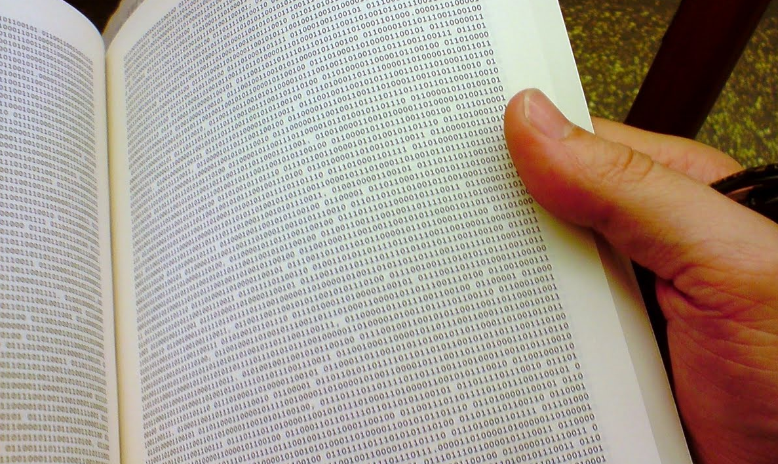
Using APIs for Non-Programmers
Greg Janée
University of California, Santa Barbara
gjanee@ucsb.edu
These slides at: https://tinyurl.com/api-howto
Notes:
Image: Justin Gohde, 2008, http://thebinarybookstore.blogspot.com/2008/11/about-binary-book-store.html

Slide 2
Why?
Lots of APIs available!
  Repository systems, publication/preprint systems, museum catalogs, ...
  https://www.programmableweb.com
Get information not otherwise available
Get information in compute-friendly form
Prelude to automation
It’s now possible!

Slide 3
Outline
Terminology
Basic process
Three methods
  web browser
  curl
  swishy desktop application
How to interpret API documentation
Handling paging of results
Further steps

Slide 4
Terminology
Parts of a URL
  protocol://server/path?query#fragment
  https://www.google.com/search?q=aardvark#result2

Slide 5
Terminology
Parts of a URL
  protocol://server/path?query#fragment
  https://www.google.com/search?q=aardvark#result2

Slide 6
Terminology
Parts of a URL
  protocol://server/path?query#fragment
  https://www.google.com/search?q=aardvark#result2

Slide 7
Terminology
Parts of a URL
  protocol://server/path?query#fragment
  https://www.google.com/search?q=aardvark#result2

Slide 8
Terminology
Parts of a URL
  protocol://server/path?query#fragment
  https://www.google.com/search?q=aardvark#result2

Slide 9
Terminology
Parts of a URL
  protocol://server/path?query#fragment
  https://www.google.com/search?q=aardvark#result2

Slide 10
Terminology
Parts of a URL
  protocol://server/path?query#fragment
  https://www.google.com/search?q=aardvark#result2
HTTP verbs
  GET – 99% of time
  POST – form submission

Slide 11
Terminology
Parts of a URL
  protocol://server/path?query#fragment
  https://www.google.com/search?q=aardvark#result2
HTTP verbs
  GET – 99% of time
  POST – form submission
Query formatting
  param1=value1&param2=value2&...
  q=drosophila&type=dataset

Slide 12
Basic process
Construct a URL
  Basic access point + request
Get back something readable
  JSON nowadays
  But maybe XML, CSV, other text format
View JSON
“REST” or “RESTful” API

Slide 13
Example: determining a DOI’s registrar
DOI identifiers uniquely identify publications, datasets, ...
  10.3886/ICPSR36422
  doi:10.3886/ICPSR36422
  https://doi.org/10.3886/ICPSR36422
Multiple registration agencies
  Crossref, DataCite, mEDRA, ...
Crossref API
  GET https://api.crossref.org/works/[doi]/agency
  GET https://api.crossref.org/works/10.3886/ICPSR36422/agency

Slide 14
Method 1: web browser
Visit URL
Copy/paste JSON into JSON viewer
  search for “JSON viewer”

Slide 15
Method 2: curl
Standard command line tool
Lots of options
> curl 'http://api.crossref.org/works/10.3886/ICPSR36422/agency'
{"status":"ok","message-type":"work-agency","message-version":"1.0.0","message":{"DOI":"10.3886\/icpsr36422","agency":{"id":"datacite","label":"DataCite"}}}
>

Slide 16
Method 3: Postman
Free desktop application
https://www.postman.com

Slide 17
Example 2: art museum
Metropolitan Museum of Art API
  Documentation at https://metmuseum.github.io
  API endpoint: https://collectionapi.metmuseum.org
Task: find highlight vases
Notice how Postman formats query parameters
  Manually, use https://ascii.cl/url-encoding.htm
If POST request is required
  Don’t use URL query parameters
  Use body
  Use form-data or x-www-form-urlencoded option
  Enter query parameters

Slide 18
Example 3: preprint archive
EarthArXiv preprint, hosted by OSF
  Documentation at https://developer.osf.io
  API endpoint: https://api.osf.io/v2
Task: find papers on geomorphology
Note paging links at bottom of JSON

Slide 19
Further study: automation
Needed to, for example, obtain information on all Met vases
Library Carpentry lesson on web scraping
  https://librarycarpentry.org/lc-webscraping/
  N.B.: automating API calls = web scraping, but vastly easier

