Slide 1


From Hail, Hydra to
The Samvera Way

Slide 2
Attributes of an Open Source Community
Contributions welcomed.
Documentation
Minutes
Writing Test
Publicly Available Code
Interest Groups

Slide 3
Welcome to Hydra
Red, Yellow, Green Choice
IRC Chat
Managers / Developers
Bathtub Beer (Geography)
The Hydra project began in 2008 as collaboration between three universities to create a “Fedora application kit.”

Slide 4
Hydra Philosophy
So what is the Hydra philosophy? Or maybe that should be philosophies…
Hydra is about building a open framework rather than a closed application. It is designed so that adopters can each have their own design mix of features; variation is part of the plan.
Hydra provides software designed to make a developer’s life easier.
Hydra invests time and resources into collaborative, community working. Whilst we support all sorts of distance communication, we know from experience that there is no substitute for quality face-to-face meetings.
Hydra encourages new adopters and so organizes (and encourages others to organize) training and workshops.
Hydra believes in openness and transparency in all it does: code, designs, discussions.
Hydra Partners are committed to contributing back to the project: code for the core, documentation, design patterns and more.
Hydra designs for re-use.

Slide 5
Working Code Wins
Pull Request Welcome.
Test Driven Development
Peer Review
Technical Network of Experts
Design for re-use.
Framework not an application
Design Pattern
  PCDM
  Works / Collections / Lists / Objects

Slide 6
Opionated Software
Opinionated Software Some examples of highly opinionated software include Ruby on Rails, AngularJS and Ember. These software packages share the common characteristics of making certain tasks simple to the developer by following the already predesigned path, sometimes referred to as the “Golden Path”.
Opinionated software usually is quicker to master once the assumptions are understood.

Slide 7
Silent Consensus
Silence Is Agreement: We agree that silence on decisions is agreement. The facilitators and other participants cannot read our minds. If it appears that the group is reaching a consensus on an issue, if no one voices disagreement, it is assumed that all are in agreement.

Slide 8
Go far or go quick
If you want to go far, go together.
If you want to go quick, go alone.
Hydra also means a really excellent group of people who have helped shepherd my projects along the way. The men and women of the Hydra community are some of the best and brightest in the library technology world. Each of them brings their own experiences and knowledge to discussions that we have about the kinds of problems we collectively face.

Slide 9
Standards
Rdf – Sematic Web
Blacklight – Search Interface
Fedora – Relationship Manager
LDP / LOD – Linked Data Protocol
Ruby
Rails
Solr - Indexing

Slide 10
Super Stars
There are some real super stars in the community and they all conduct themselves in an very professional and inclusive manner. The manner in which things are corrected is in line with creating a better product. There isn’t a sense of the best technical people needing to prove themselves. Generally speaking, people are continually encouraging other to contribute back.

Slide 11
The Un-Conference
Boot Camps
Developer Congresses
Multi-institutional Sprints
http://catalog.rockhall.com/
Hydra / Samvera Connect
LCDX
Code4Lib
OR
https://samvera.atlassian.net/wiki/spaces/samvera/pages/405210633/Samvera+Connect+Meetings

Slide 12
One Body Many Heads
Apache 2 License
Solution Bundles

Slide 13
Governance
All developers must have a Contributor Licence Agreement in place before the Project will accept code from them, and all new code is subject to a peer review process.
COMMUNITY SOURCED SOFTWARE
The Samvera Community has multiple open Interest and Working Groups managing the community itself and contributing at various levels to the development of its outputs.

Slide 14
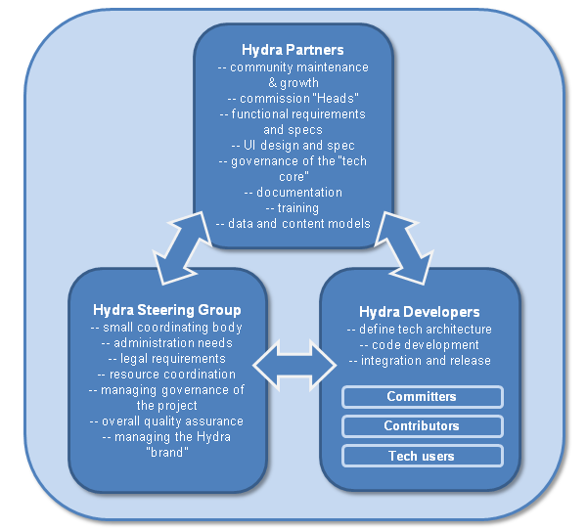
Governance

Slide 15
Samvera 2017
Samvera means ‘togetherness’ in Icelandic, and espouses the value of working together to create solutions that address shared challenges.
The software embraces open, international standards, where possible. The community adheres to acknowledged “best practice” for software design and development, learning from each other without duplicating effort.

Slide 16
Ensure Participation
The Samvera Community takes the inclusion of everyone who wishes to participate very seriously. A Code of Conduct and Anti-Harassment Policy has been published, and a community group of Samvera Helpers provides an email address and individual contact points where any behavior that is not in keeping with Samvera’s principles can be flagged for attention and action. This approach is applied within both the physical and virtual channels through which community members interact.
The continuing need to find ways of enabling under-represented groups within our wider sector to participate in Samvera’s work is an ongoing responsibility of the Samvera Partners.

Slide 17
Code of Conduct
Expectations for Respectful Communication
The Samvera Community is dedicated to providing a welcoming and positive experience for all its members, whether they are at a formal gathering, in a social setting, or taking part in activities online. The Samvera Community welcomes participation from people all over the world and these community members bring with them a wide variety of professional, personal and social backgrounds; whatever these may be, we treat colleagues with dignity and respect.
Community members communicate primarily in English, though for many of them this is not their native language. We therefore strive to express ourselves simply and remember that unnecessary use of jargon and slang will be a barrier to understanding for many of our colleagues. We are sensitive to the fact that the international nature of the community means that we span many different social norms around language and behaviour and we strive to conduct ourselves, online and in person, in ways that are unlikely to cause offense.
Samvera conversations are often information-rich and intended to generate discussion and debate. We discuss ideas from a standpoint of mutual respect and reasoned argument.

Slide 18
Anti-Harassment Policy
The Samvera Community does not tolerate harassment in any form. Sexual or discriminatory language and imagery is not appropriate for any event venue, including talks, or any community channel such as Slack-based chat rooms or mailing lists.
Harassment includes: offensive verbal comments related to sex, gender, ethnicity, nationality, socioeconomic status, sexual orientation, disability, physical appearance, body size, age, race, religion; sexual or discriminatory images in public spaces; deliberate intimidation; stalking; harassing photography or recording; sustained disruption of talks or other events; inappropriate physical contact; and unwelcome sexual attention.
Participants asked to stop any harassing behavior are expected to comply immediately.
We expect participants to follow the Code of Conduct and Anti-Harassment Policy at all meeting venues, meeting-related social events, community gatherings, and online communication channels. Participants violating the Code of Conduct or Anti-Harassment Policy may be sanctioned or expelled at the discretion of the Incident Response Team in accordance with the Samvera Code of Conduct Incident Response Manual (PDF).

Slide 19
Reporting Harrassment
Reporting Harassment and Code of Conduct Violations
If you are at a conference or other event, find the on-call Samvera Community Helpers (email) who should be wearing an identifiable Samvera Community Helpers badge or a rainbow lanyard. If you can't find any of these, there will be other staff available to help if the situation calls for immediate action.
If you are in the Samvera Community Slack, contact one of the Samvera Community Helpers via direct message. You can direct message the Community Helper of your choice by clicking the + next to Direct Message and typing in their name.
Read more about How to Report a Code of Conduct Violation and what you can expect in the process.
We value your participation in the Samvera Community and your support in keeping it a safe, welcoming, and friendly space for fellow participants!
Code of Conduct Incident Response
Reports of Code of Conduct or Anti-Harassment Policy violations will be addressed by the Incident Response Team, which consists of trained and vetted Community members who follow a detailed Incident Response Manual.
Samvera event organizers, Response Team members, and Community Helpers can be identified by their name badges. These volunteers can help participants contact hotel/venue security or local law enforcement, provide escorts, or otherwise assist those experiencing harassment to feel safe for the duration of the event.

Slide 20
Sanctions
Participants asked to stop any offending behavior are expected to comply immediately. Incident Response Team members will follow the Response Manual process and may take any action they deem appropriate, including warning the offender, expulsion from the Samvera event, or banning the offender from a chatroom or mailing list.
Specific sanctions may include but are not limited to:
  Warning the offender to cease their behavior and that any further reports will result in other sanctions
  requiring that the offender avoid any interaction with, and physical proximity to, the incident reporter for the remainder of the event
  early termination of a talk that violates the policy
  not publishing the video or slides of a talk that violated the policy
  not allowing a speaker who violated the policy to give (further) talks at the event
  immediately ending any event volunteer responsibilities and privileges the offender holds requiring that the offender not volunteer for future Samvera events (either indefinitely or for a certain time period)
  requiring that the offender immediately leave the event and not return
  banning the offender from future events (either indefinitely or for a certain time period)
  Notifying the offender’s institution or organization that the violation has occurred
  banning the offender from any (or all) Samvera Community channels
  publishing an account of the offending event as outlined in the Incident Response Manual

Slide 21
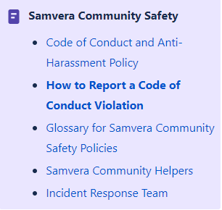
Samvera Community Safety

Slide 22
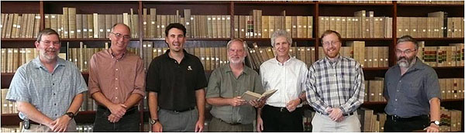
Original Partners 2008

Slide 23
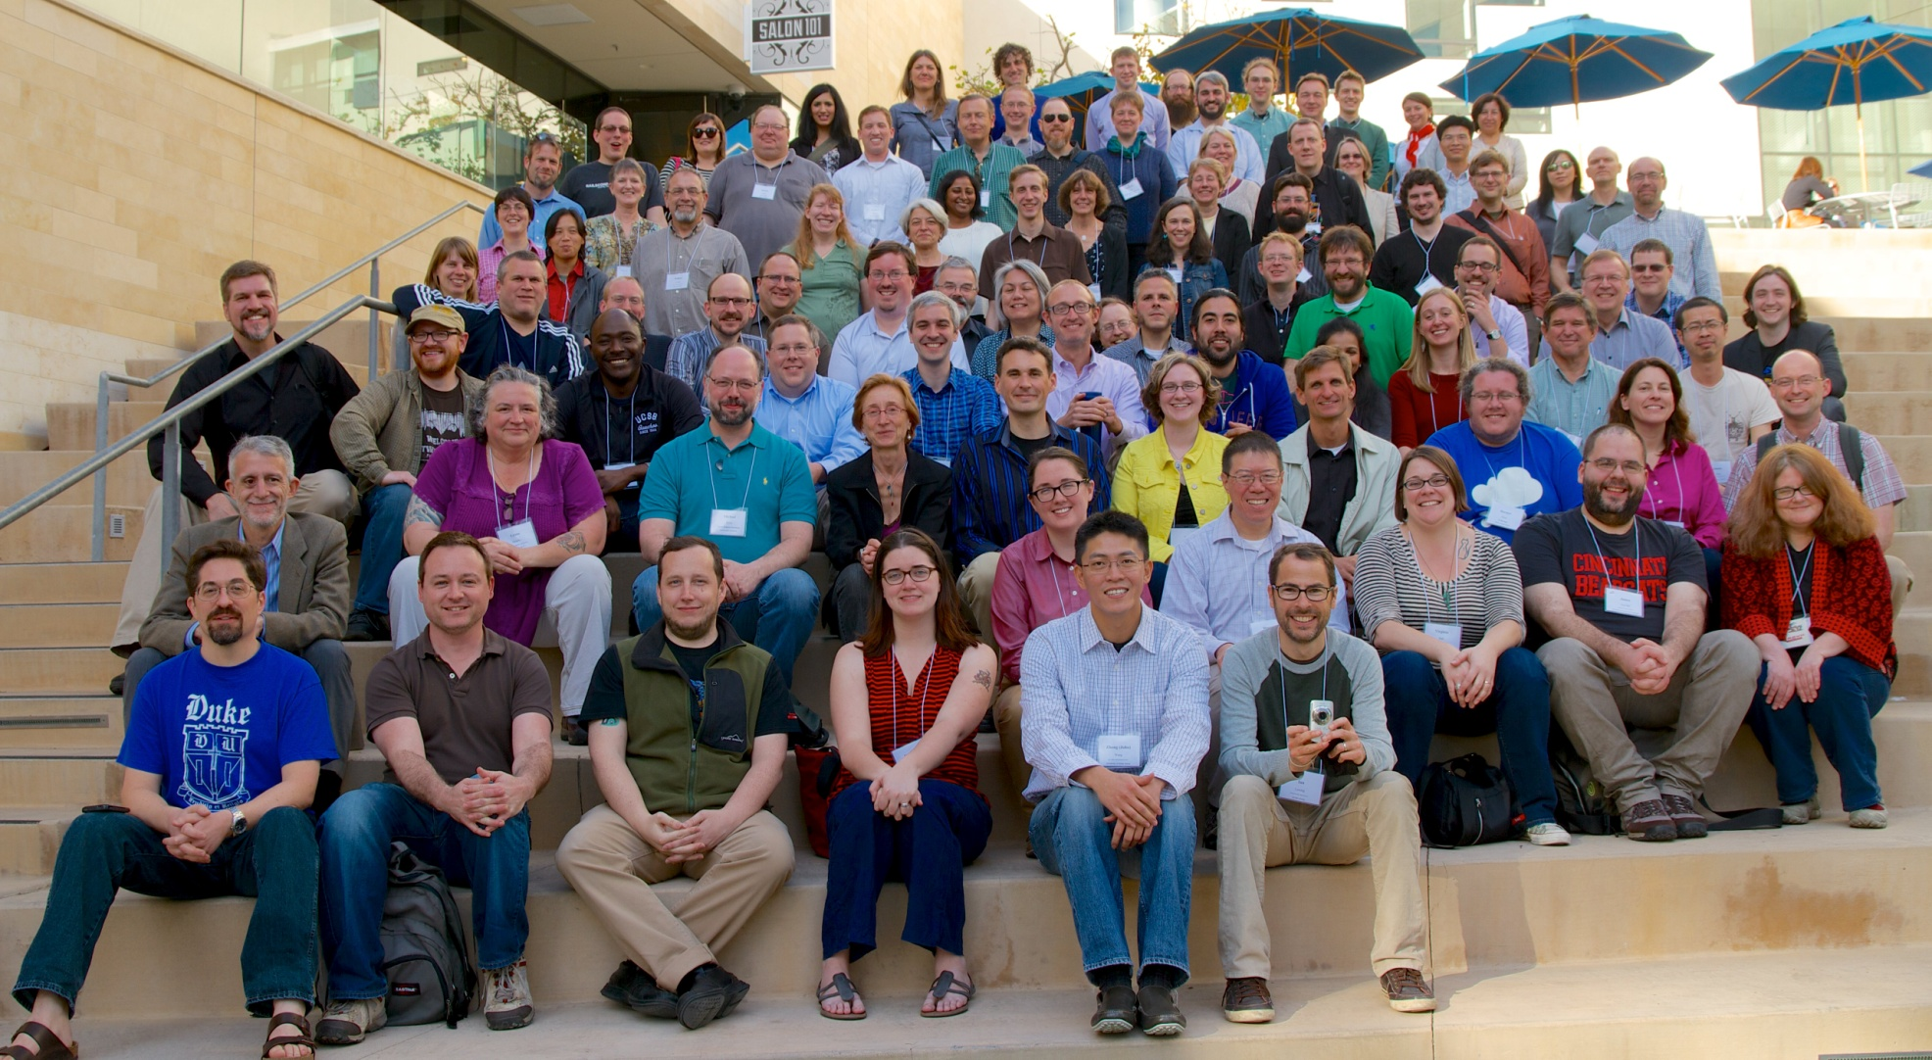
Hydra Connect 1 2014 https://www.flickr.com/photos/bigdpix/sets/72157640059349396/

Slide 24
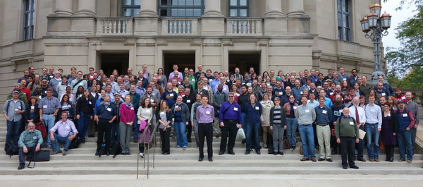
Hydra Connect 2 2014
Cleveland
https://www.flickr.com/photos/bigdpix/sets/72157640059349396/with/12109775915/

Slide 25
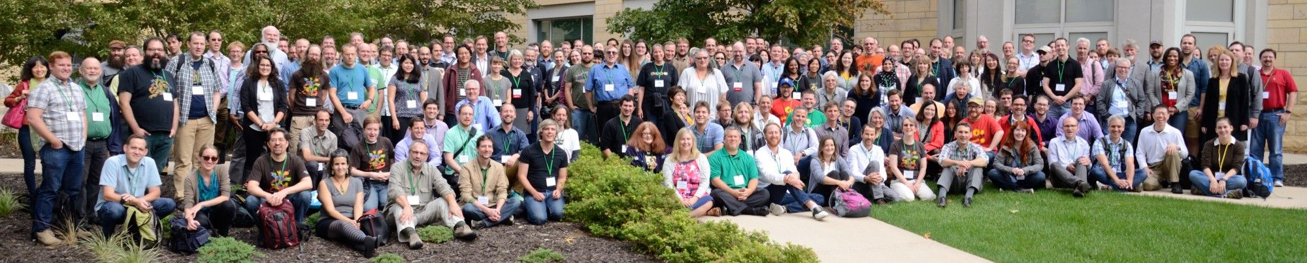
Hydra Connect 3 2015
Minneapolis
https://samvera.atlassian.net/wiki/spaces/samvera/pages/405210633/Samvera+Connect+Meetings

Slide 26
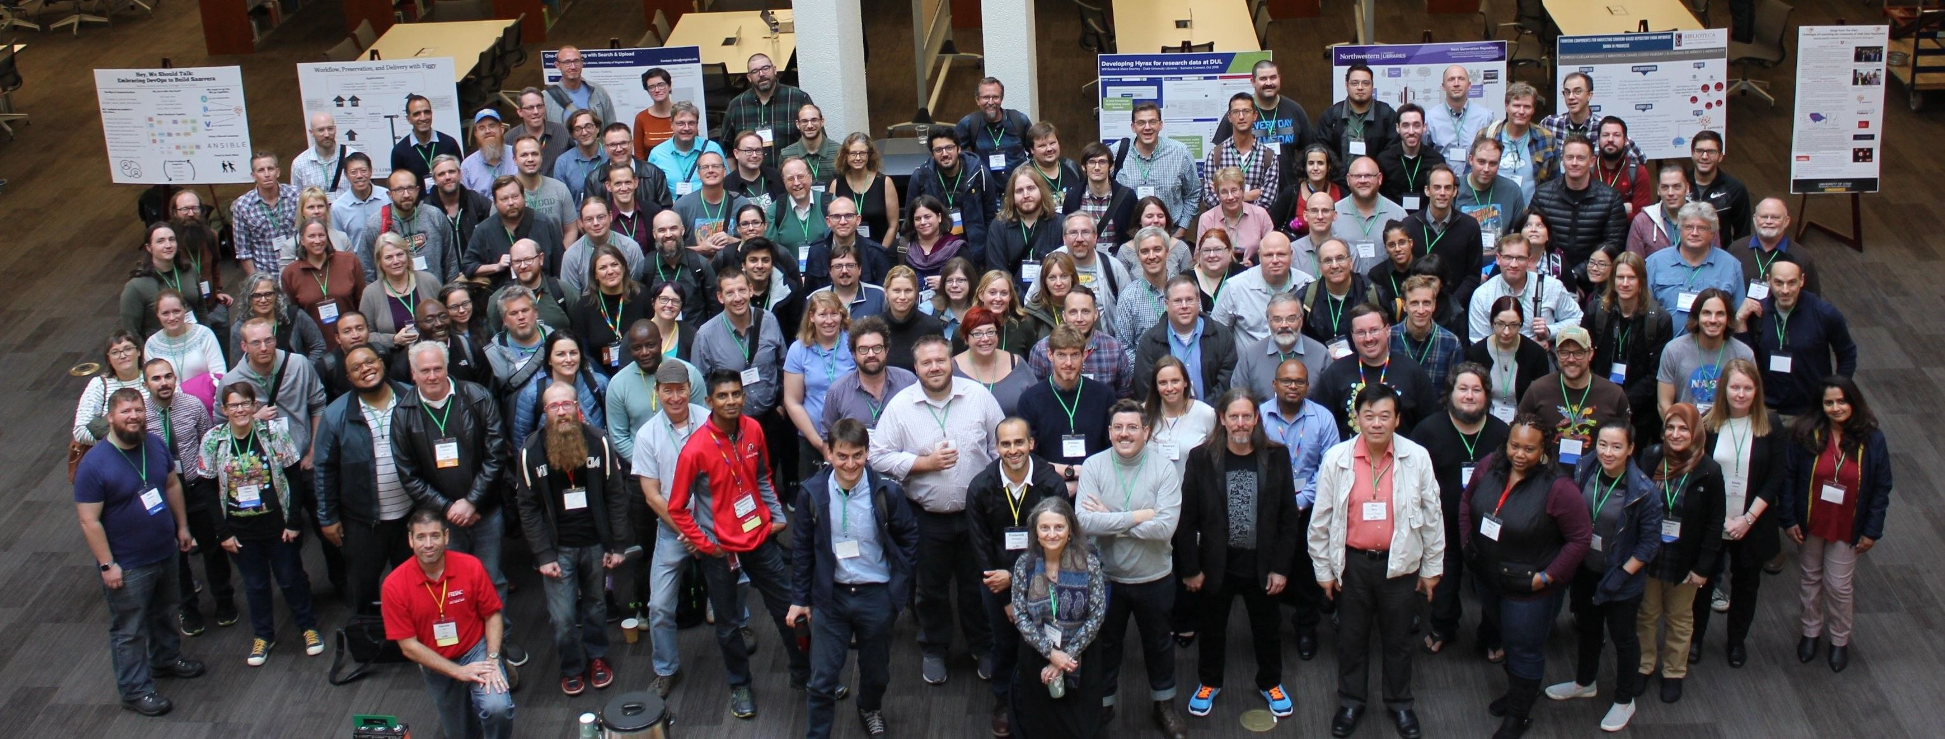
Samvera Connect 2018
University of Utah
https://samvera.atlassian.net/wiki/spaces/samvera/pages/405210633/Samvera+Connect+Meetings

Slide 27
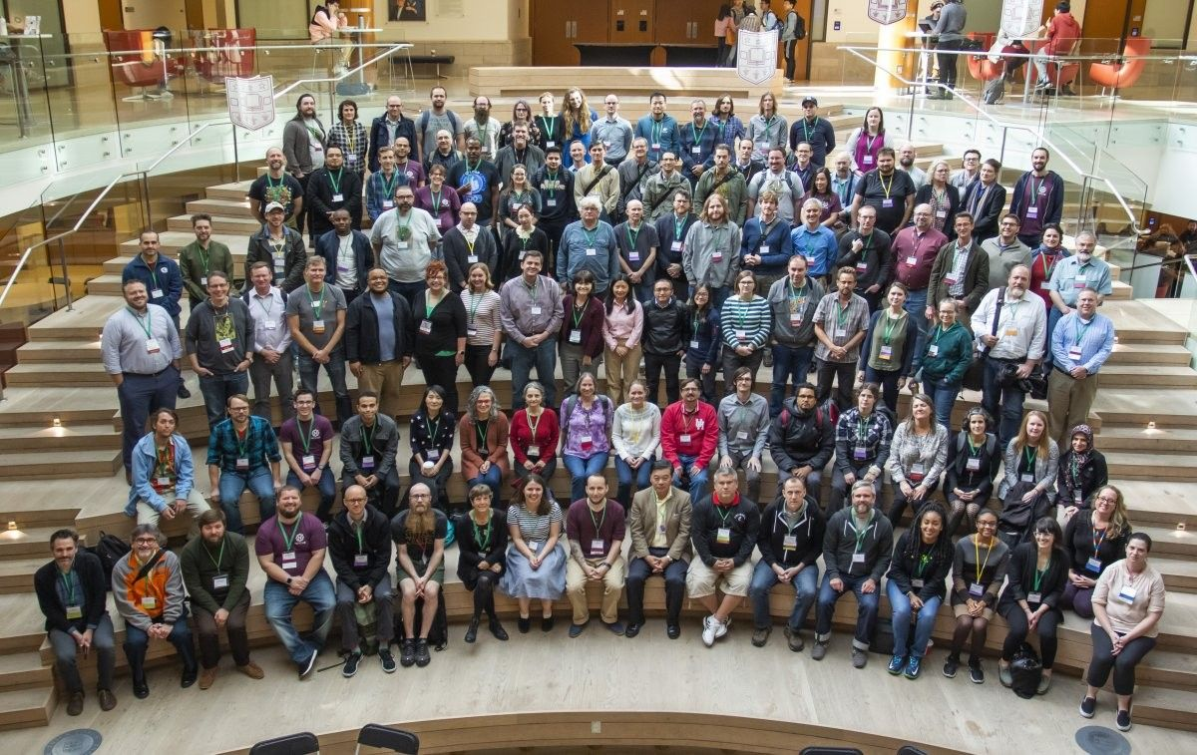
Samvera Connect 2019
https://samvera.atlassian.net/wiki/spaces/samvera/pages/405210633/Samvera+Connect+Meetings

Slide 28
Samvera Virtual Connect
Samvera Virtual Connect (SVC) is an opportunity for Samvera Project participants to gather online to touch base on the progress of community efforts at a roughly halfway point between face-to-face Samvera Connect meetings.
2016 - 2022

Slide 29
Intro
Name
Institution
Pronouns
Visual Description
Tribute to Native Lands
Notification of Recording

