Slide 1
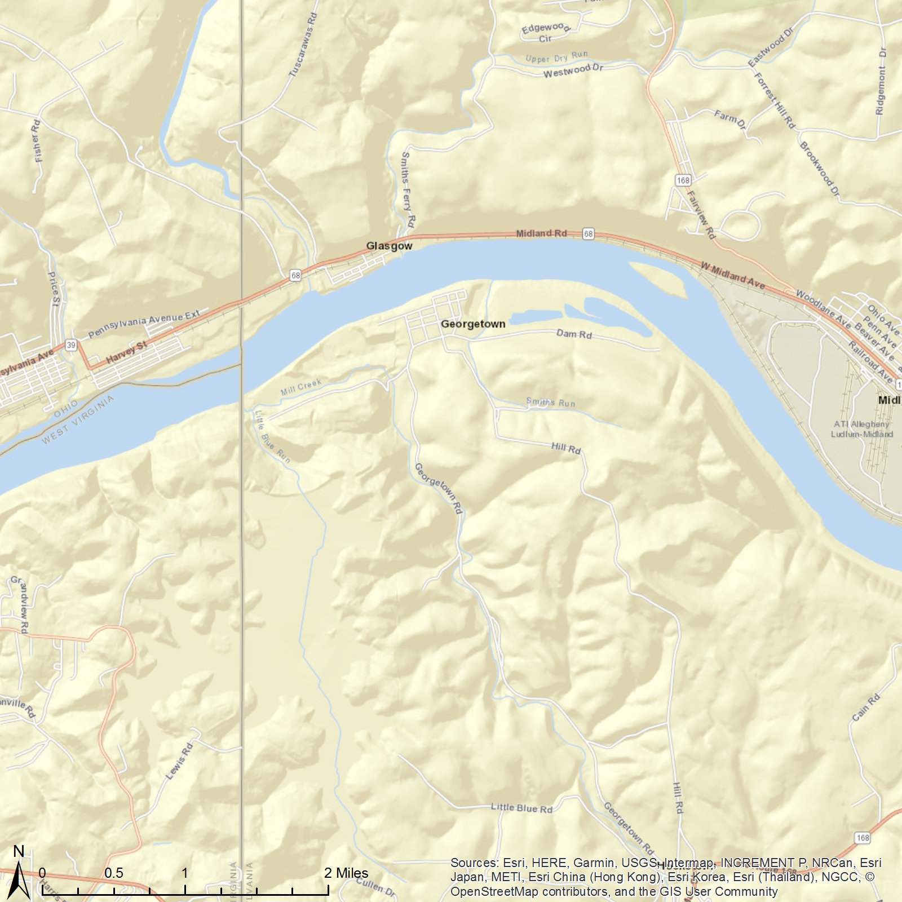
Water Treatment Plant
East Liverpool, OH
2220 Michigan Ave,
East Liverpool, OH 43920
No data were collected between Oct. 2009 and May 2011.
ATSDR Standard
WHO Standard
EPA Standard
The monthly average of the manganese (PM10) in the air was collected by a monitor at Water Treatment Plant from Jan. 2009 to Dec. 2017. If you want to explore more, please visit our website: https://med.uc.edu/eh/research/projects/cares.
Airborne Manganese (PM10)
Monthly average
ATSDR Standard
WHO Standard
EPA Standard

Slide 2
Water Treatment Plant
East Liverpool, OH
2220 Michigan Ave,
East Liverpool, OH 43920
No data were collected between Oct. 2009 and May 2011.
ATSDR Standard
WHO Standard
EPA Standard
The monthly average of the manganese (PM10) in the air was collected by a monitor at Water Treatment Plant from Jan. 2009 to Dec. 2017. If you want to explore more, please visit our website: https://med.uc.edu/eh/research/projects/cares.
Airborne Manganese (PM10)
Monthly average
ATSDR Standard
WHO Standard
EPA Standard

