Slide 1
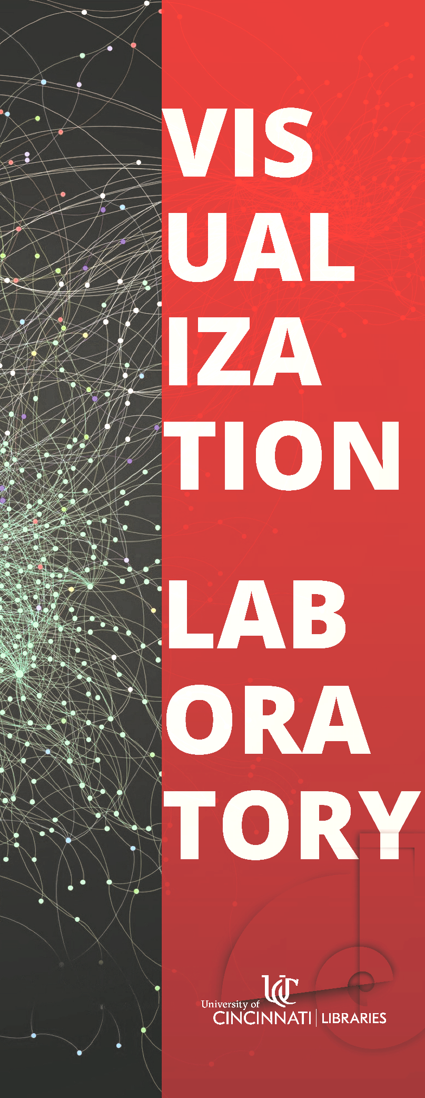

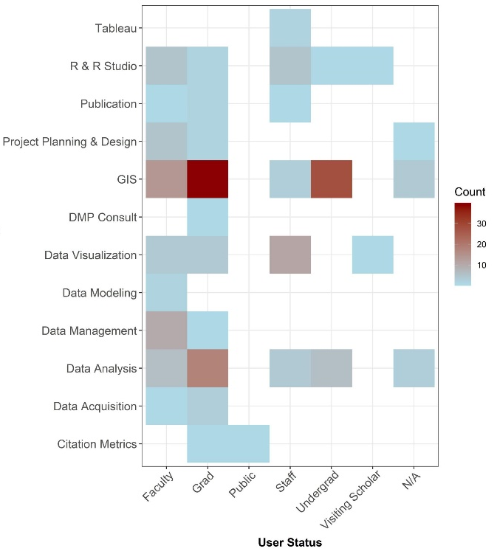
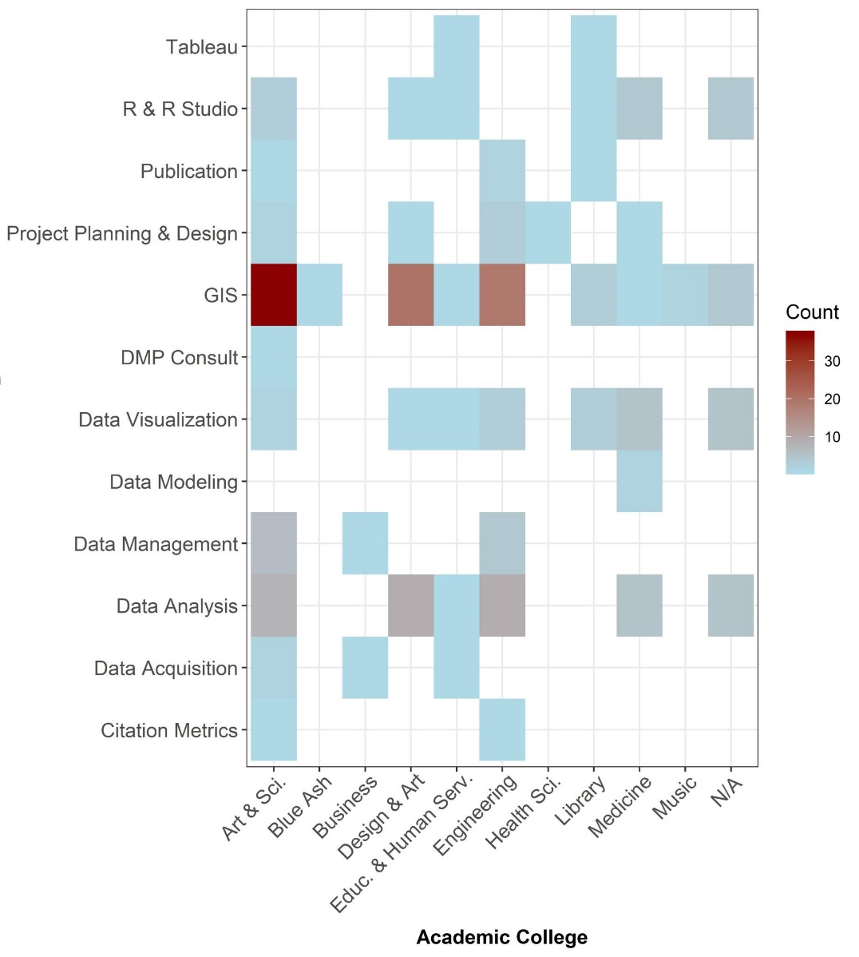
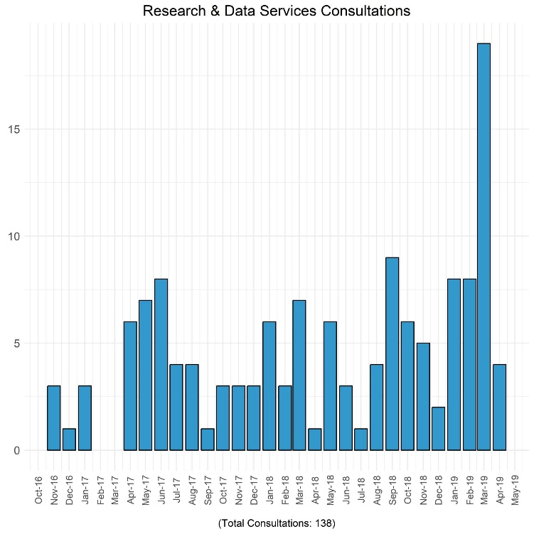
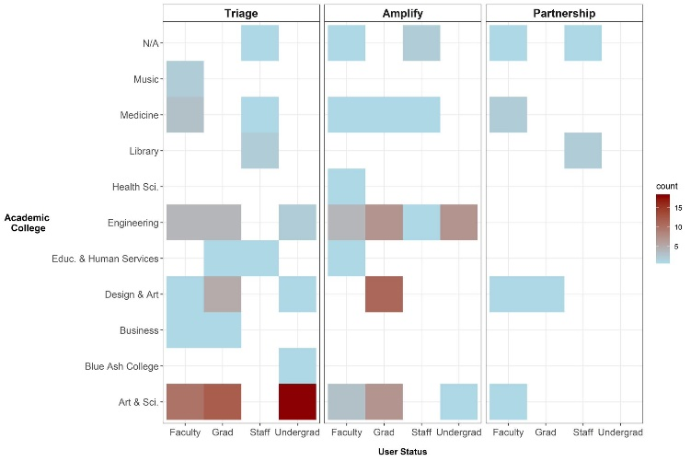
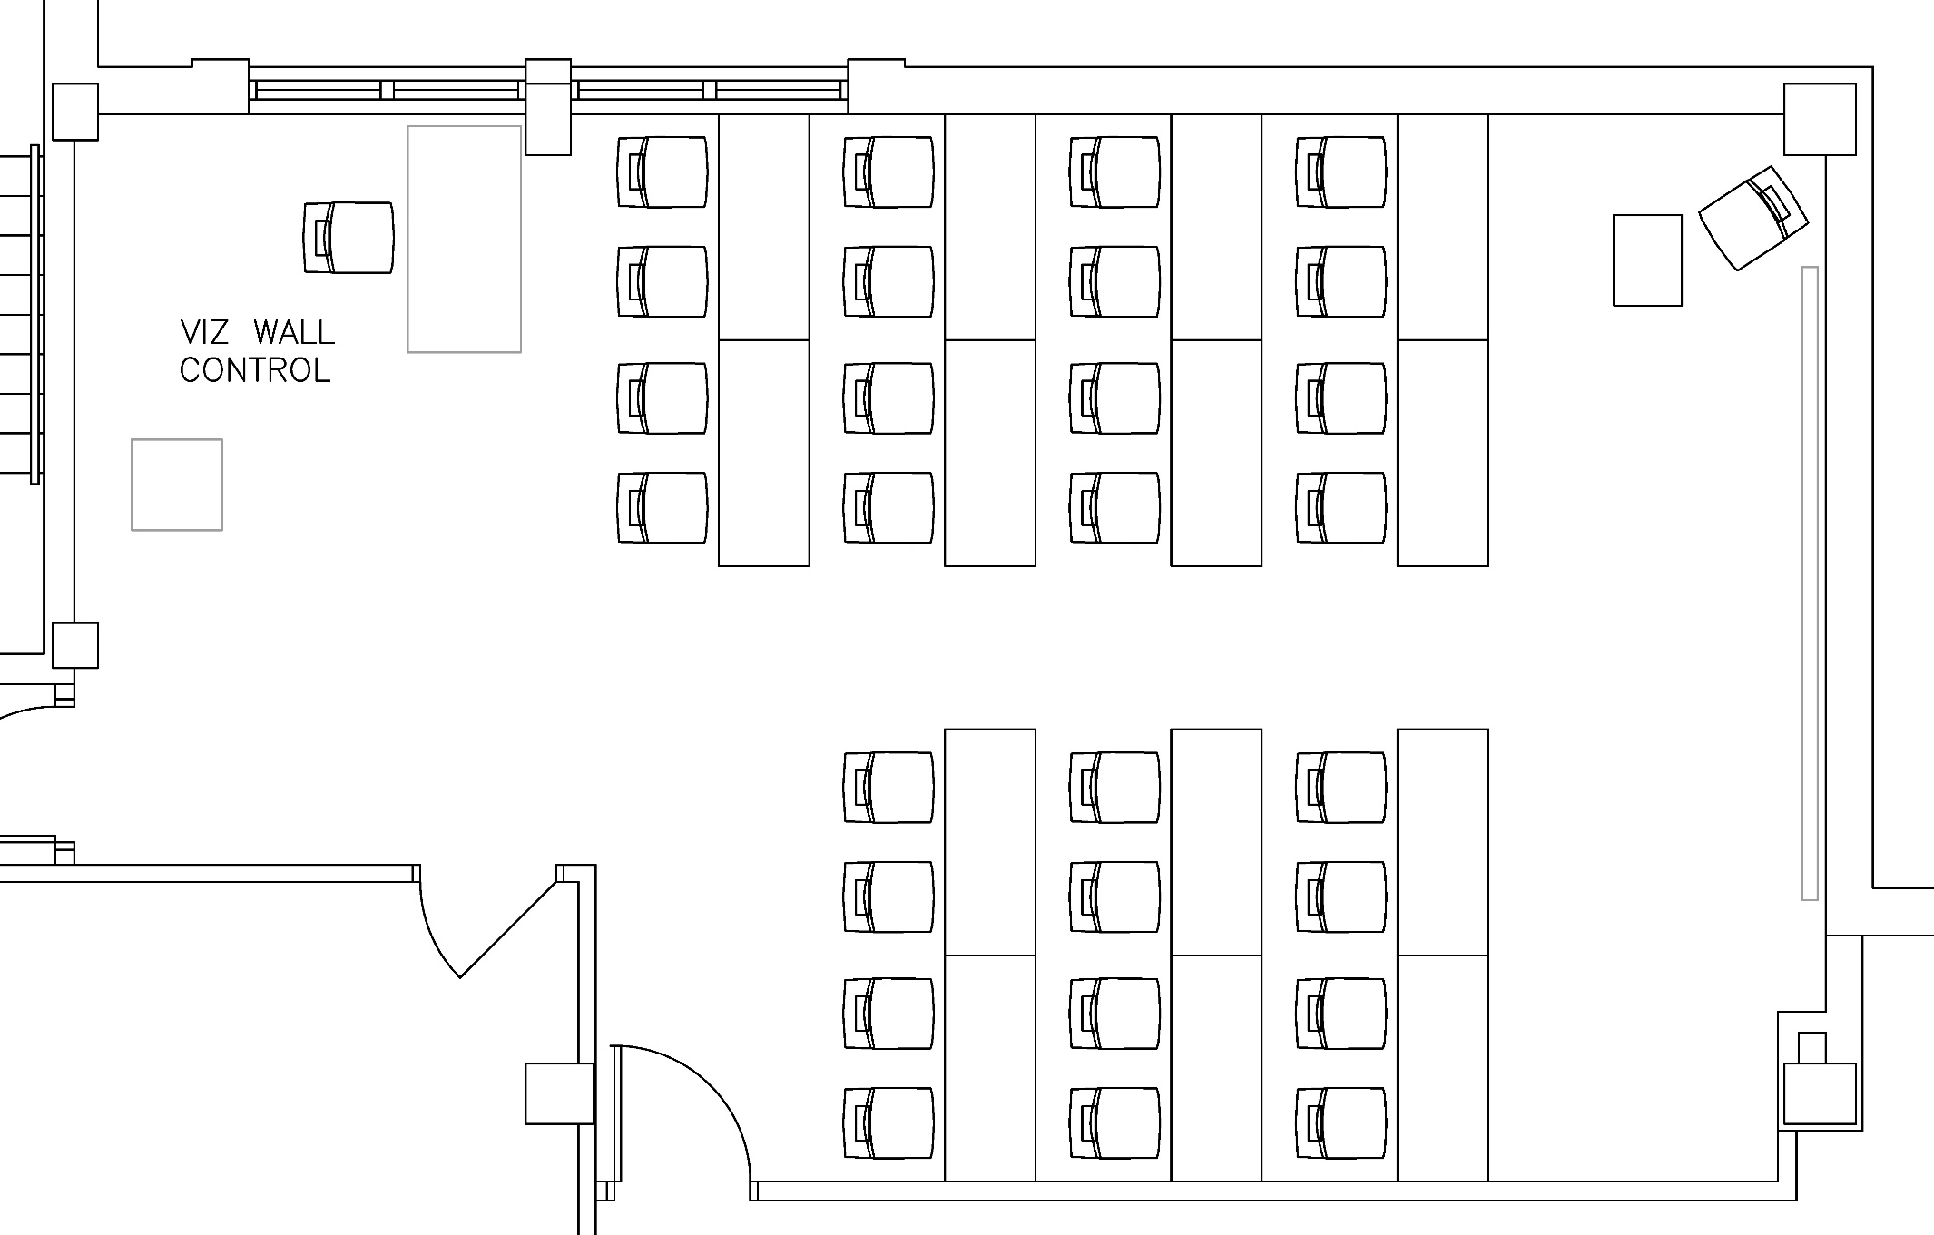
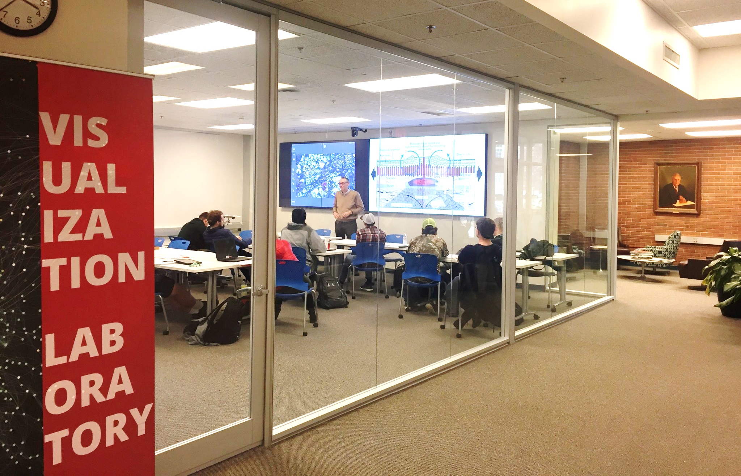
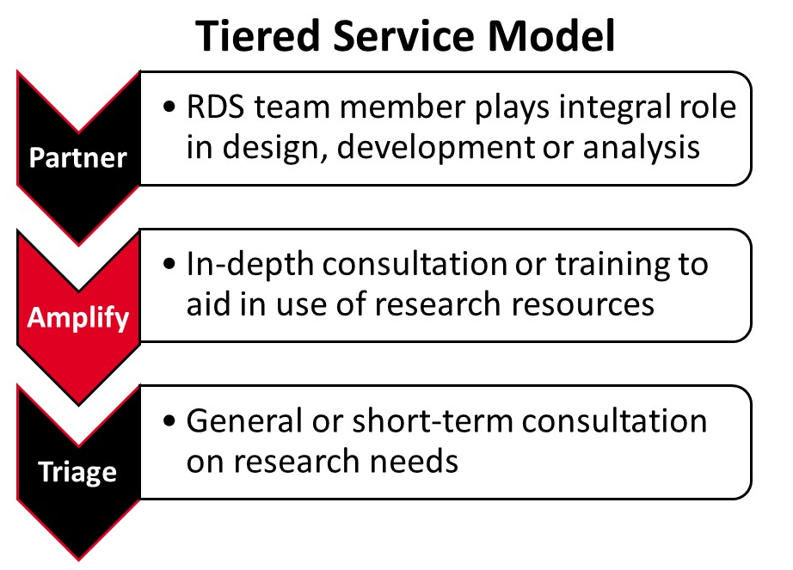
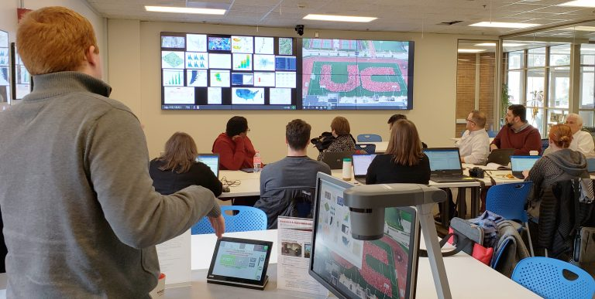
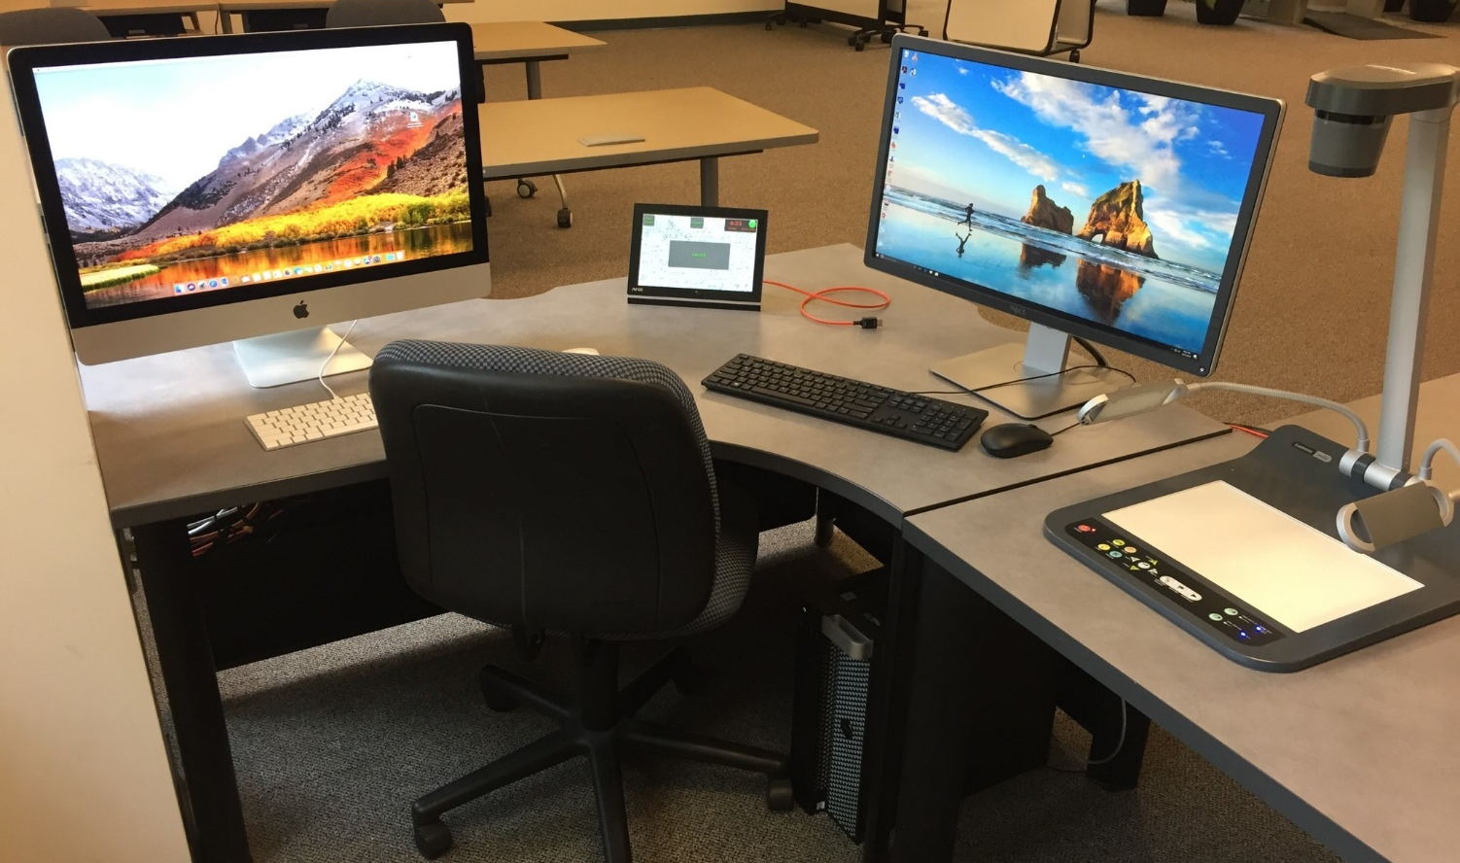
SLA 2019 Conference: Cleveland, Ohio
Plotting Our Future: The UC Visualization Laboratory & Services Model
Ted Baldwin, MLS - Director, Science & Engineering Libraries, Ted.Baldwin@uc.edu
Richard Johansen, PhD - Data Visualization Specialist, Research & Data Services
Background
The University of Cincinnati Libraries’ Research & Data Services (RDS) unit began in 2015 with roots in STEMM disciplines and a focus on broad researcher services. RDS expanded its spaces and scope of services in Spring 2018 to include a Visualization Laboratory (housed in a science library) and a Data Visualization Specialist position.
Objectives
Based on our experience in planning and implementation, we aim to 1) highlight lessons learned in creating a visualization laboratory and related services and 2) show early impact and reach of RDS efforts. We will also reveal some future plans for RDS including greater integration into data visualization and data analysis initiatives of the university.
Early Impact of the Viz Lab and RDS Services
Consultations per month, 2016-present
Heat maps: consulting activity by topic per 1) user groups and 2) UC academic colleges
Heat map: consulting activity by service tier to user groups
Visualization Laboratory (Viz Lab)
Partner space to Data & GIS Collab and Informatics Lab (Health Sciences Library).
Open for walk-in use when not reserved. No lock on lab door. Located adjacent to main library entrance.
Tiered service model. Consultants include: informationists, professional staff, expert graduate students.
Early uses: RDS’ Data & Computational Science Series, semester courses (Optical Mineralogy, Spanish), web conferences, departmental and team meetings.
Good practices & lessons learned: Gather stakeholder input often (e.g., touchscreen capability, height of screens, screens at floor level), Keep it simple (easy to use, minimal training), tie planning to existing programs and use cases (data science initiatives), offer distinctive features (e.g., multi-input, ultra-high resolution).
Located in Geo-Math-Physics Library (Braunstein Hall)
Capacity:
30 (tables)
42 (no tables)
Visualization Wall Technology
16’ wide x 4.5’ high
8 screens (4 x 2): Ultra HD Monitors (16.5M pixels), 4K capable
Multi-input: Mac/PC controller stations, HDMI, Solstice Pod
Display modes: full screen, 2 half-screens, half + 4 small
Software (open source focus): Gephi, QGIS, OpenRefine, Orange, etc
Future Plans & Collaborations
“Screen saver” highlighting research, Steelcase “huddle” whiteboards
Distributed “office hours” in college locations
Pedagogy - Center for Enhancement of Teaching & Learning (CET&L)
Research - Digital Scholarship Center, Office of Research
Academic programs - e.g., video game design courses, Data Science research cluster
Grant partnerships – research grants (e.g., NASA), internal grants (faculty development)
guides.libraries.uc.edu/VizLab

