Slide 1

Welcome to the 5th annual UC

Slide 2
Introduction to UC Data Day
Logistics and Housekeeping
  Session is being recorded
  Unless presenting, please mute your audio and turn off video
Introduce yourself via Chat
  Sign-in your Name/University/Department in the chat to say hello
Questions
  Post in Chat at any time
  Moderators will answer directly in chat or ask presenters during the Q&A sessions

Slide 3
Introduction to UC Data Day
Accessibility
  We are providing ASL interpretation for this event.
  You can spotlight by searching for the ASL interpreters by name:
    AM Jessica Minges or CSD 1
    PM Jessica Frye or Jessica Minges
  Closed Captions will be added to the video after the event.
Code of Conduct
  The UC Data Day organizing committee aims that UC Data Day will be a welcoming event for all participants and strive to create an environment where all attendees feel comfortable to participate fully in all Data Day activities without any fear of harassment or discriminatory behavior.
  Please be kind, respectful, and courteous to other participants.
  The hosts of the event reserve the right to remove anyone engaging in behaviors counter to the intentions of UC Data Day from the event.

Slide 4
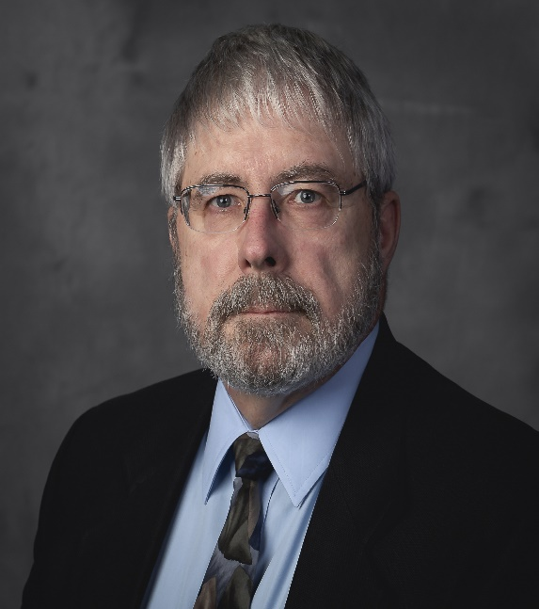
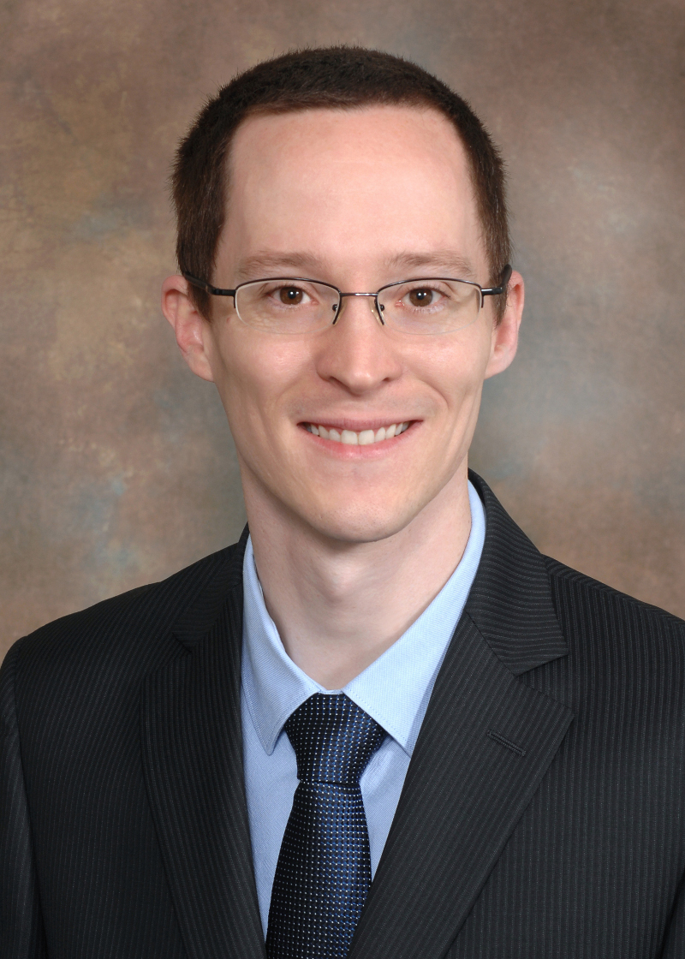
Power Session 1
HPC Next – Intro to modern HPC and computing/analysis tools for Research and Education
Introduction to Advanced Research Computing (ARC) facility
https://research.uc.edu/arc
Workshop
Login using account provided
Raise (zoom) hand if problems logging in
George Turner
Kurt Roberts

Slide 5
What’s Next?
  10:30 AM to 12:00 PM | Power Session - Text Mining & Natural Language Processing (Digital Scholarship Center)
  Separate registration required
  12:00 PM -1:30 PM | Break for Lunch
  1:30 PM - 1:35 PM | Introduction to Data Day: Amy Koshoffer
  1:35 PM – 1:45 PM | Data Day Welcome: Xuemao Wang
  1:45 PM to 2:15 PM | Keynote: Glenn Ricart, “Smart runs on Data - A Day In Our Digital Future – The Intersection between Data and Humans"
  2:15 PM to 3:45 PM | Interactive Panel The technology - data driven changes in future of work, healthcare, education, and resilience
  3:45 PM to 4:00 PM | Wrap-up/ Closing Session: Jane Combs

Slide 6
Welcome to the 5th annual UC

Slide 7
Introduction to UC Data Day
Logistics and Housekeeping
  Session is being recorded
  Unless presenting, please mute your audio and turn off video
Introduce yourself via Chat
  Sign-in your Name/University/Department in the chat to say hello
Questions
  Post in Chat at any time
  Moderators will answer directly in chat or ask presenters during the Q&A sessions

Slide 8
Introduction to UC Data Day
Accessibility
  We are providing ASL interpretation for this event.
  You can spotlight by searching for the ASL interpreters by name:
    AM Jessica Minges or CSD 1
    PM Jessica Frye or Jessica Minges
  Closed Captions will be added to the video after the event.
Code of Conduct
  The UC Data Day organizing committee aims that UC Data Day will be a welcoming event for all participants and strive to create an environment where all attendees feel comfortable to participate fully in all Data Day activities without any fear of harassment or discriminatory behavior.
  Please be kind, respectful, and courteous to other participants.
  The hosts of the event reserve the right to remove anyone engaging in behaviors counter to the intentions of UC Data Day from the event.

Slide 9
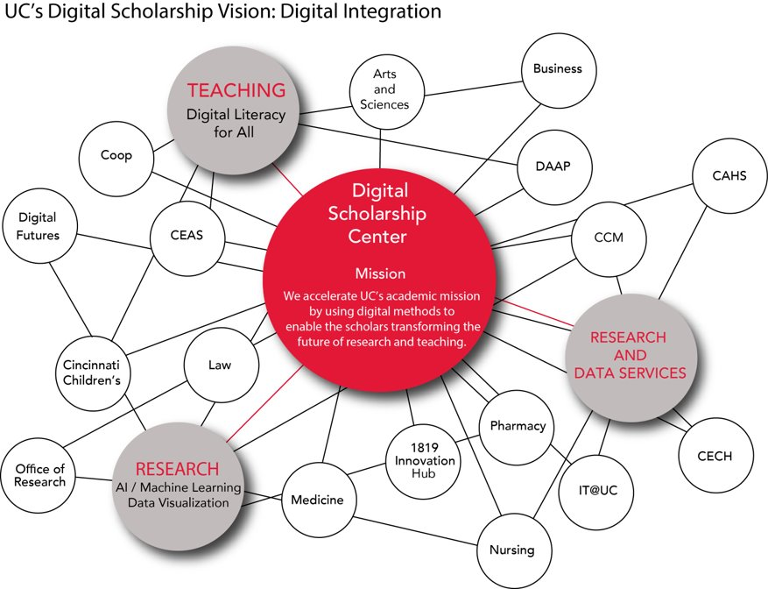
UC Digital Scholarship Center
Mellon Digital Integrator (One of six worldwide, projects with nine colleges):
  Move between silos and cross wires across the university.
UC Digital Futures Anchor Team
AI + Data Visualization on Large Datasets from any discipline – numbers, text, images, video.
We translate between disciplines that rarely interact - connect subject experts with technical expertise.
https://dsc.uc.edu/

Slide 10
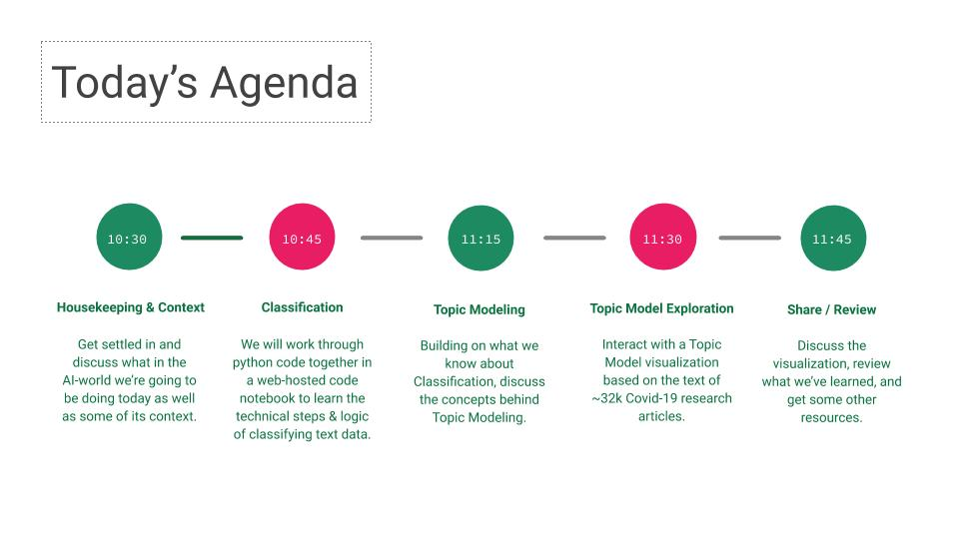
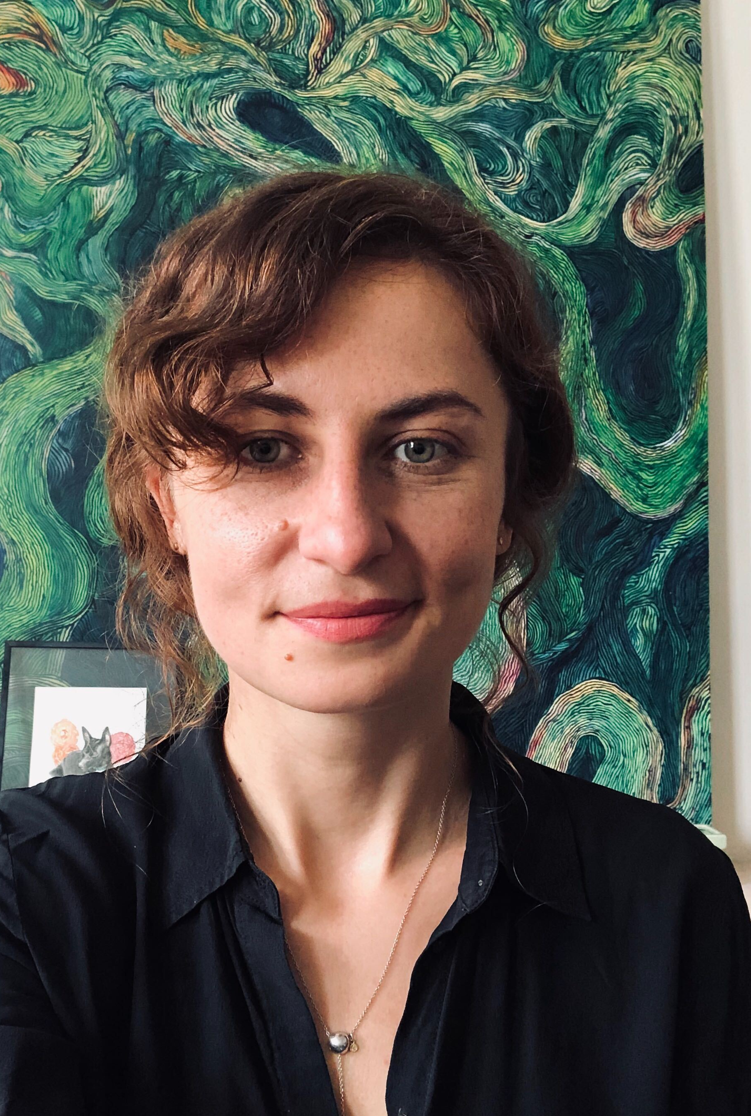
Power Session 2
Text Mining & Natural Language Processing
Erin McCabe

Slide 11
What’s Next?
  12:00 PM -1:30 PM | Break for Lunch
  See you at 1:30pm
  1:30 PM - 1:35 PM | Introduction to Data Day: Amy Koshoffer
  1:35 PM – 1:45 PM | Data Day Welcome: Xuemao Wang
  1:45 PM to 2:15 PM | Keynote: Glenn Ricart, “Smart runs on Data - A Day In Our Digital Future – The Intersection between Data and Humans".
  2:15 PM to 3:45 PM | Interactive Panel - The technology - data driven changes in future of work, healthcare, education, and resilience.
  3:45 PM to 4:00 PM | Wrap-up/ Closing Session: Jane Combs

Slide 12
Welcome to the 5th annual UC

Slide 13
Introduction to UC Data Day
Logistics and Housekeeping
  Session is being recorded
  Unless presenting, please mute your audio and turn off video
Introduce yourself via Chat
  Sign-in your Name/University/Department in the chat to say hello
Questions
  Post in Chat at any time
  Moderators will answer directly in chat or ask presenters during the Q&A sessions

Slide 14
Introduction to UC Data Day
Accessibility
  We are providing ASL interpretation for this event.
  You can spotlight by searching for the ASL interpreters by name:
    AM Jessica Minges or CSD 1
    PM Jessica Frye or Jessica Minges
  Closed Captions will be added to the video after the event.
Code of Conduct
  The UC Data Day organizing committee aims that UC Data Day will be a welcoming event for all participants and strive to create an environment where all attendees feel comfortable to participate fully in all Data Day activities without any fear of harassment or discriminatory behavior.
  Please be kind, respectful, and courteous to other participants.
  The hosts of the event reserve the right to remove anyone engaging in behaviors counter to the intentions of UC Data Day from the event.

Slide 15
Afternoon Agenda
  1:30 PM - 1:35 PM | Introduction to Data Day: Amy Koshoffer
  1:35 PM – 1:45 PM | Data Day Welcome: Xuemao Wang
  1:45 PM to 2:15 PM | Keynote: Glenn Ricart, “Smart runs on Data - A Day In Our Digital Future – The Intersection between Data and Humans”
  2:15 PM to 3:45 PM | Interactive Panel The technology: data driven changes in future of work, healthcare, education, and resilience.
  3:45 PM to 4:00 PM | Wrap-up/ Closing Session: Jane Combs

Slide 16
Audience Participation
Introduce yourself via Chat
  Put your Name/University/Department in the chat to say hello
Give us your Three Words (anonymous)
  https://bit.ly/UCDataWords
  What three words do you think UC should focus on when thinking about the future of data?

Slide 17
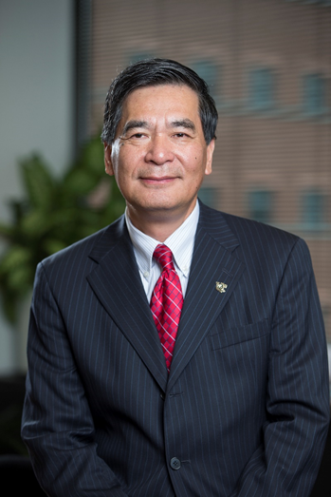
UC Data Day Welcome
Xuemao Wang
Vice Provost for Digital Scholarship
Dean and University Librarian
University of Cincinnati Libraries

Slide 18
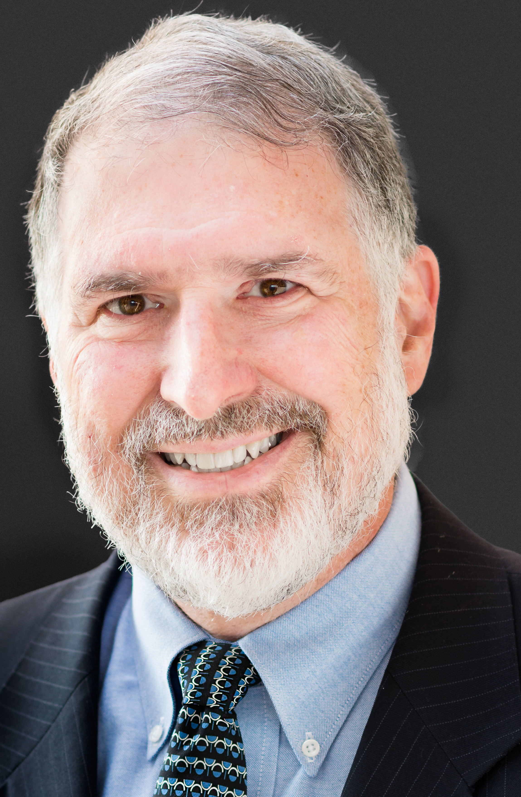
Keynote Speaker
Glenn Ricart, Founder and CTO US Ignite
Accelerating the Smart City Movement
Presenting: ‘'Smart Runs on Data”

Slide 19
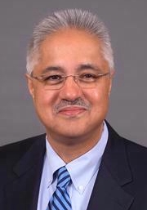
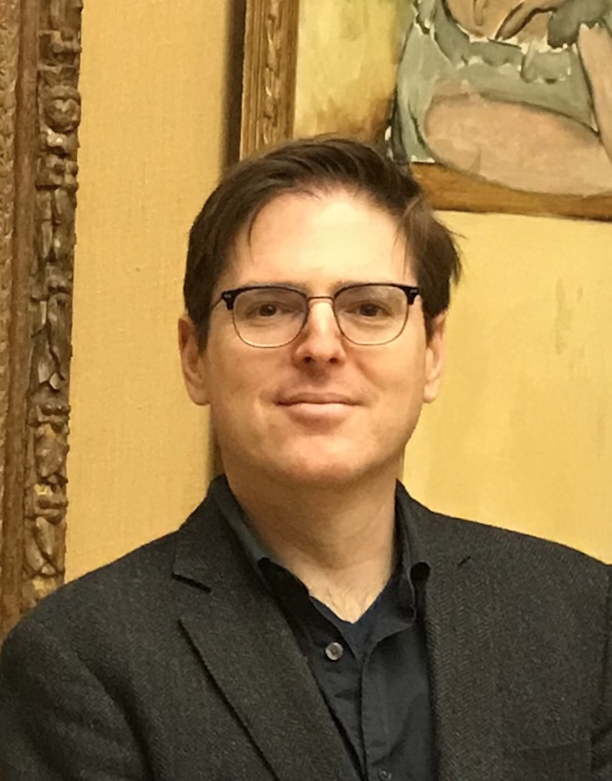
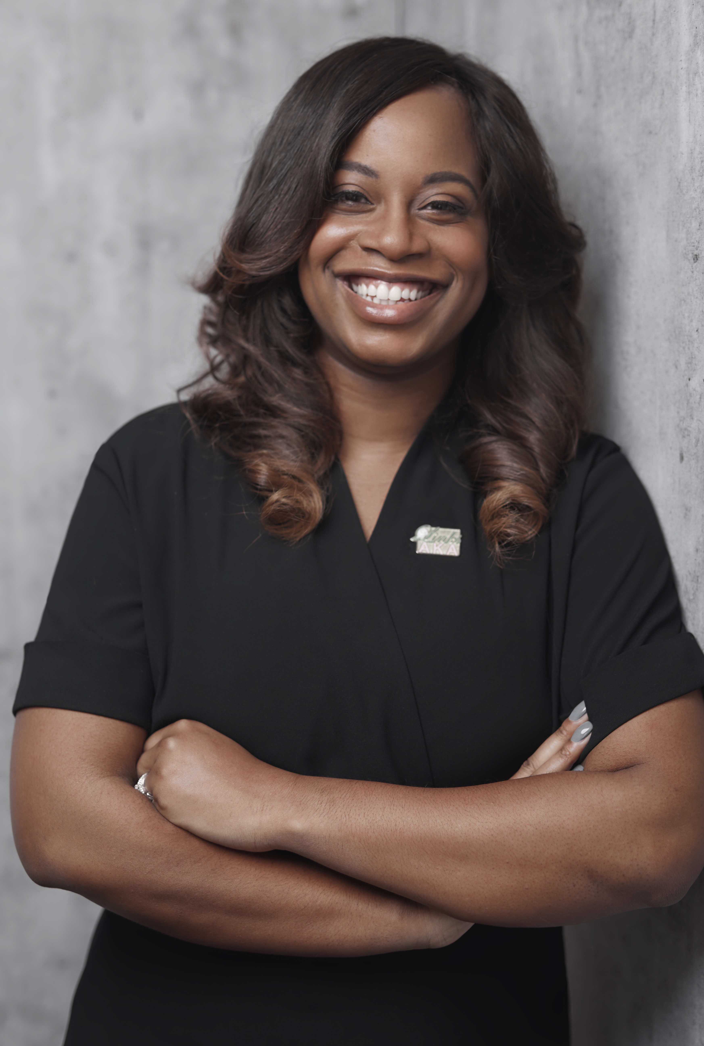
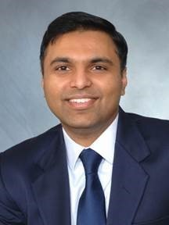
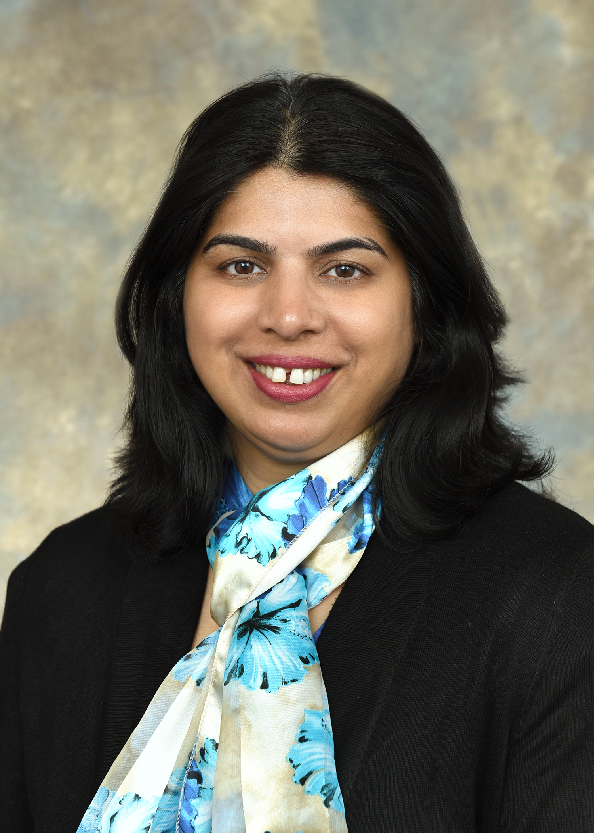
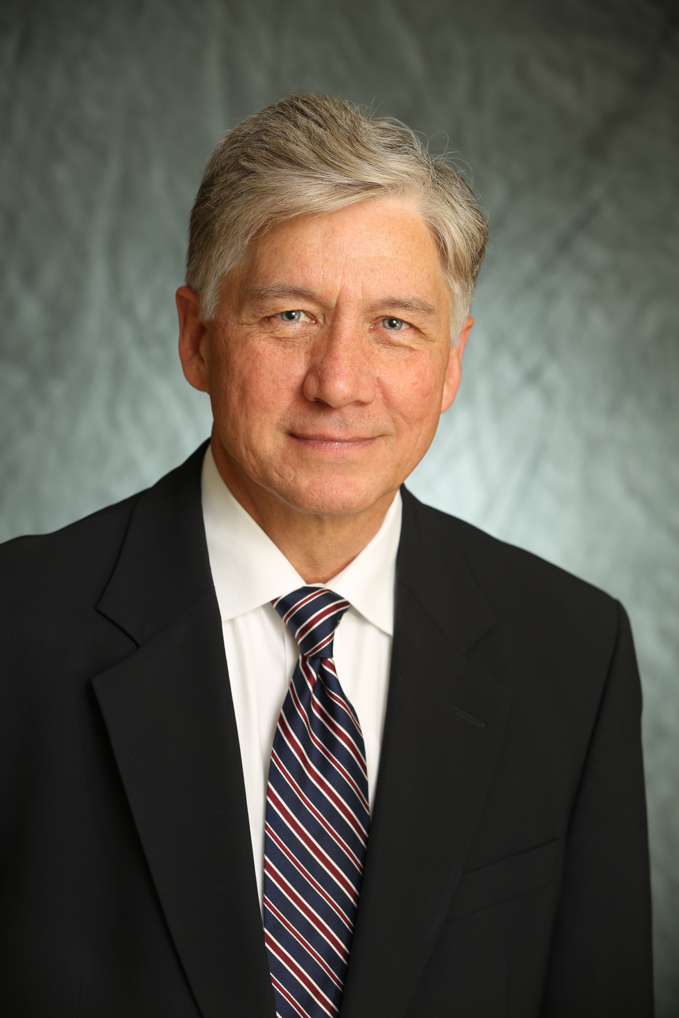
Guiding Questions for the Panel Discussion
How is ubiquitous data changing your work as a Researcher, Educator, and/or Clinician, and its contribution to society?
How is ubiquitous data changing society and shaping our sense of community?
Guiding Question for Audience Participant response
Where should UC focus its efforts in order to prepare students for life in a data-enabled, globally connected society?
Michael Dunaway
Sam Anand
Zvi Biener
Whitney Gaskins
Prashant Khare
Achala Vagal
Glenn Ricart
Michael Dunaway, Moderator

Slide 20
Sam Anand
Educational and Research Interests
Machine Learning, Digital Design and Manufacturing; Digital Thread for Design and Manufacturing; Digital Twin for Manufacturing (Industry 4.0/5.0)
Design, Predictive Modeling and Preprocessing Additive Manufacturing (AM)
Industrial Internet of Things for Manufacturing; Augmented Reality/Virtual Reality for Smart System Manufacturing, Data Acquisition & Interpretation using Mixed Reality
Computer Vision for Smart Manufacturing
Professor, CEAS ME,
Director - Siemens PLM Simulation Technology Center
Question: How do Digital Thread, Digital Twin, Industrial Internet of Things (IIOT), and Smart Manufacturing methods and tools help in the design and manufacture of sustainable, low cost, high-quality consumer products?

Slide 21
Zvi Biener
Educational and Research Interests
Historical Philosophy of Science
Philosophy of Data
Data & Evidence in the History of Science
Knowledge Organization
Loneliness in Older Adults
Assoc. Professor, A&S Philosophy, UC Philosophy Editor-in-Chief, Phil Sci-Archive
zbiener.github.io
Question: Do data-intensive technologies lead to an increase in knowledge? If so, how? If not, should we use a different metric to measure their benefits?

Slide 22
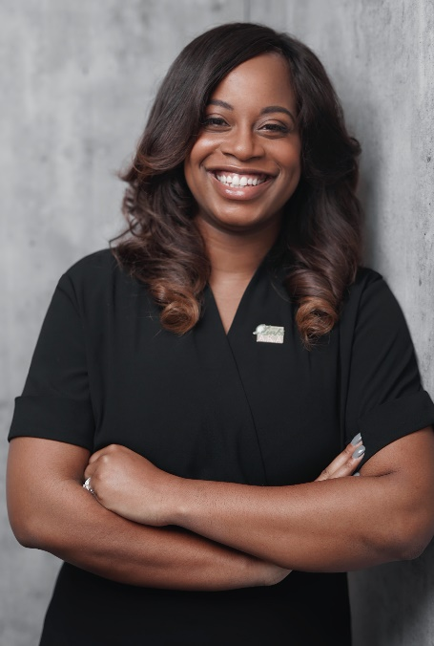
Whitney Gaskins
Research Interests: I approach my research through the lens of cultural climate that has four research streams:
  Professional development of faculty and graduate students
  Assessment of chronic stress and its sources
  Collaborative education models
  Pedagogy
Education Focus: Innovative approaches to courses that incorporate data focused activities to help students develop their data literacy
Assistant Dean and Assistant Professor, CEAS Office of Inclusive Excellence & Community Engagement
Question: How can educators ensure students are becoming more science and data literate?

Slide 23
Prashant Khare
Research Interests
Fundamental processes of atomization, vaporization, and combustion in propulsion systems​
High performance computing
Machine learning applied to fluids​
Education Focus:
Combustion
Thermodynamics
Fluid mechanics
Gas dynamics
High-temperature flows
Asst. Professor,CEAS Aerospace Eng & Eng Mechanics, Chair, Advanced Research Computing (ARC) center
Question: What do we think are the skills needed for “future” engineering jobs?

Slide 24

Achala Vagal
Research Interests
Ischemic stroke and intracranial hemorrhage
Imaging core labs for clinical trials ​
Education Focus
Stroke Imaging​
MD, MS, COM
Radiology Neuroradiology
Question: What are the ethical concerns of using big data and AI solutions in healthcare? ​

Slide 25
Panel Questions with video only – no slide

Slide 26
  (post-panel) WordCloud: What three words do you think UC should focus on when thinking about the future of data?

Slide 27
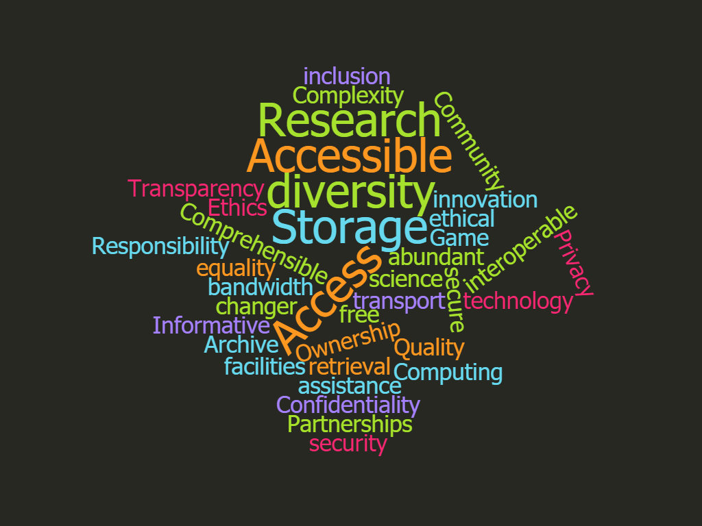
What three words do you think UC should focus on when thinking about the future of data? 1st request
https://www.wordclouds.com/

Slide 28
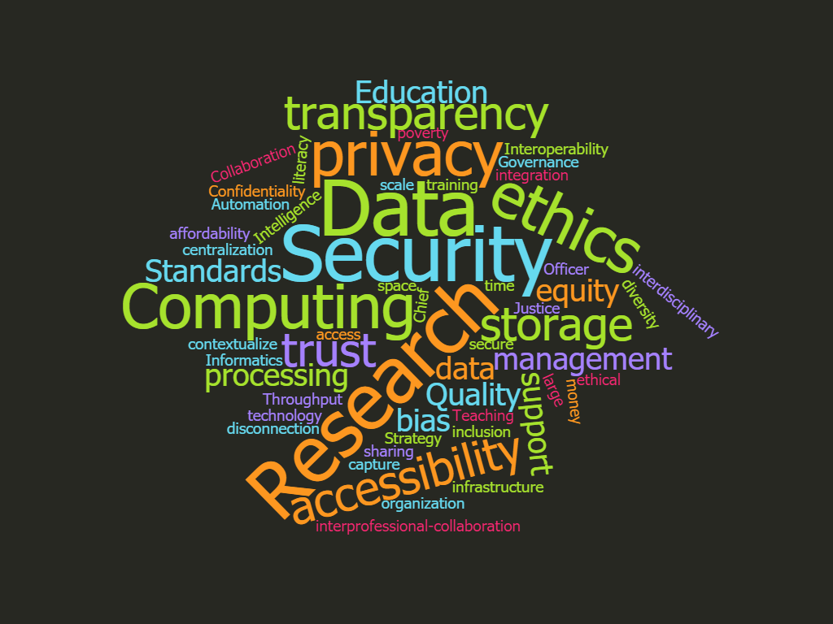
What three words do you think UC should focus on when thinking about the future of data? 2
https://www.wordclouds.com/

Slide 29
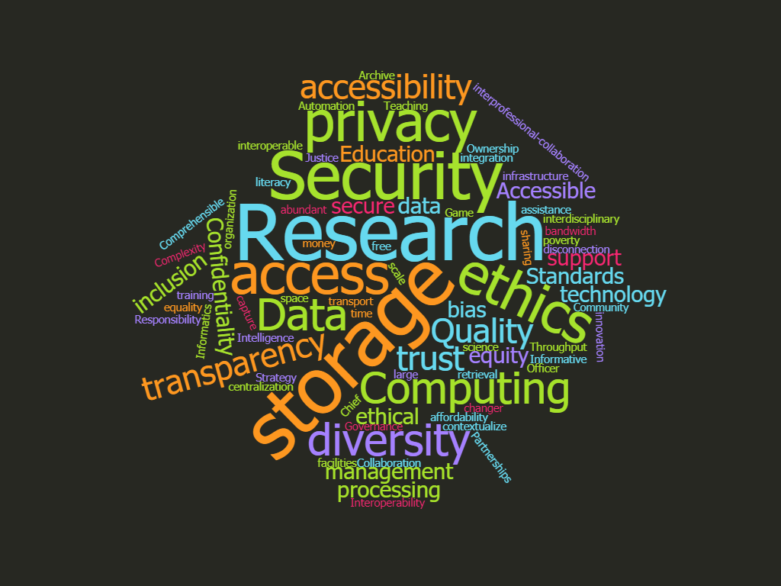
What three words do you think UC should focus on when thinking about the future of data? 1+2
https://www.wordclouds.com/

Slide 30
Thank you!!
Thanks for coming – see you all next year!
Upcoming UC Data & Computational Science Series trainings (free)

Slide 31
Thank you for your support
Planning Committee
Jane Combs (IT@UC) & Amy Koshoffer (UCL) – Co-Chairs
Tiffany Grant (UCL) – Registration
Rebecca Olson (UCL) – Website
Amy Latessa (IT@UC) – Logistical & moral support
Melissa Cox Norris (UCL) – Communications and Promotion
Jay Sinnard (UCL) – Audio Visual support
Research and Data Services (UCL) – promotional support
Research Computing Services (IT@UC) – promotional support
Accessibility Resources – ASL Interpretation

Slide 32
Thank you for your support
Presenters and Panelists
Glenn Ricart (US Ignite) – Keynote
Michael Dunaway (Digital Futures) – Panel session Moderator
Whitney Gaskins (CEAS) – Panelist
Zvi Biener (A&S) - Panelist
Prashant Khare (CEAS) – Panelist
Sam Anand (CEAS) – Panelist
Achala Vagal (CoM) – Panelist
Georger Turner (IU) – Power Session
Kurt Roberts (CoM) – Power Session
Erin McCabe (UCL) – Power Session
Xuemao Wang (UCL) – Welcome

Slide 33
Funding for UC Data Day provided by
UC Office of the Provost Universal Provider grant
IT@UC
UC Libraries
Thank you for your continued support!!

