Slide 1
Transforming Organizations
Welcome!
Partnership · Collaboration · Agile Development

Slide 2
Xuemao Wang
Dean and University Librarian wang2xm@ucmail.uc.edu
Nelson Vincent
Vice President of Information Technology & Chief Information Officer
Nelson.Vincent@uc.edu
Meet the Team
Ted Baldwin
Director, Science and Engineering Libraries
baldwitw@ucmail.uc.edu
Linda Newman
Head, Digital Collections and Repositories
newmanld@ucmail.uc.edu
Josette Riep
Associate Director of Information Technology
riepjr@ucmail.uc.edu

Slide 3



The journey starts here.

Slide 4





Vision
UC’s Third Century
Investing in faculty & staff
Leveraging research
Reimagining the student experience
Excelling in elearning
Building the resource base
Embedded within these areas are cross-cutting themes including diversity, international, mission-based health care, staff development, information technology, etc.

Slide 5
Partnerships
Dean & University Librarian
VP for Research
VP for Information Technology & CIO
    Partnerships and collaborations power the transformation.

Slide 6
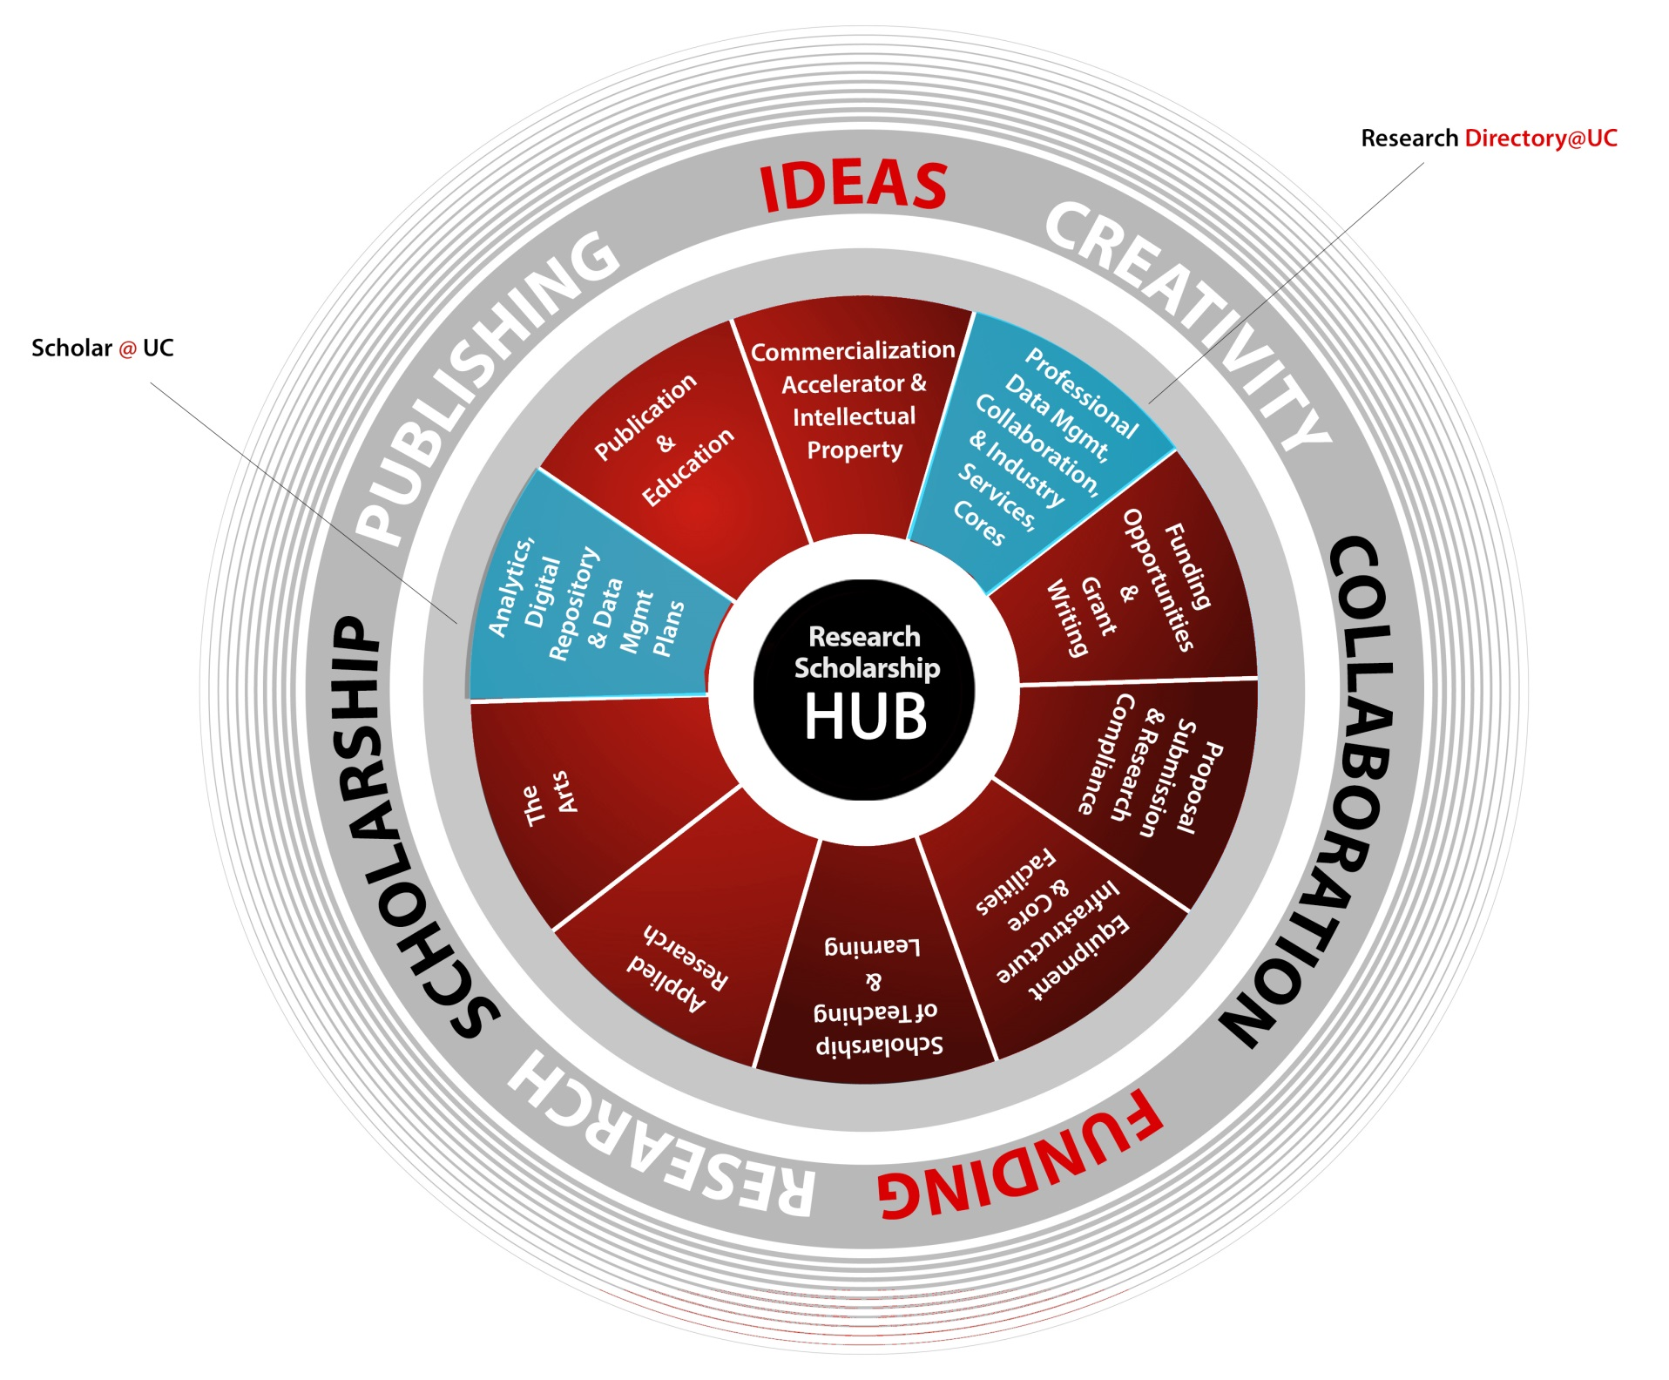
Vision

Slide 7

Research Directory
Integration of system driven and faculty managed research information into a consolidated environment that provides robust searching and reporting across the research enterprise for:
  The individual Researcher
  Research Administrators & Coordinators
  Commercial /Industry
  Leadership

Slide 8

Research Directory
The Challenge
Providing up to date and accurate profile information from multiple sources
Gathering as much data as possible while limiting the need for manual input from faculty
Ability to provide easy and robust searching
Integration with external data sources
Aggregation of information for meaningful reports
Aggregation of information across affiliate institutions
Notes:
8

Slide 9
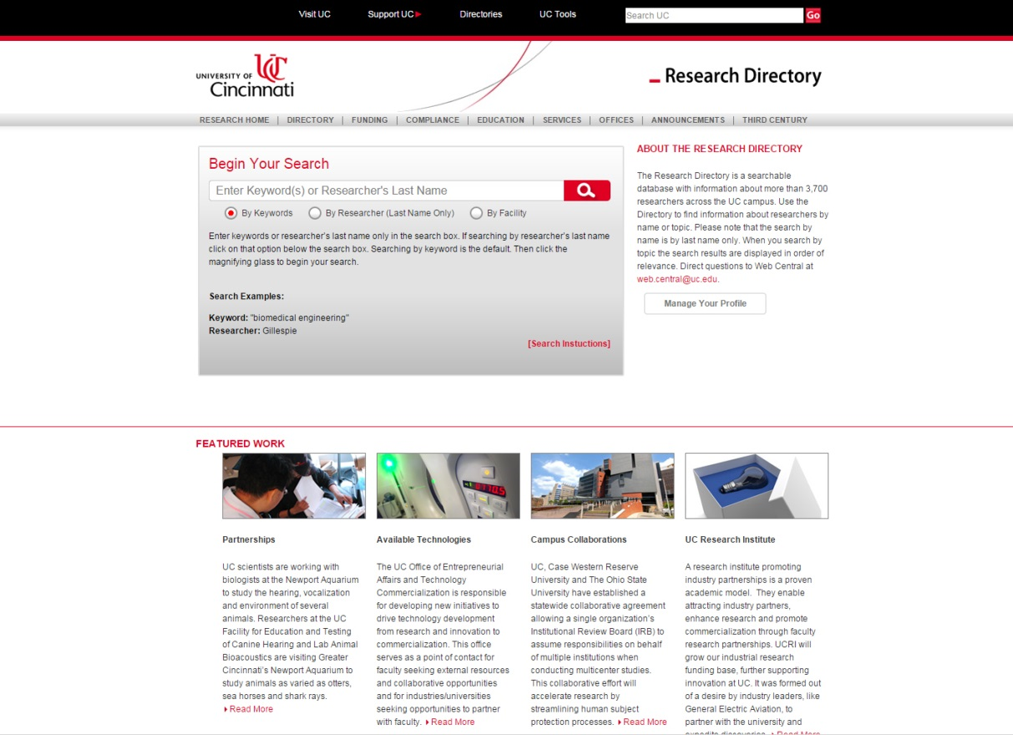
Research Directory
The Solution
Ability to search for experts and areas of expertise by keywords
Promotion of research expertise and facilities for commercial / industry
Single Portal to view expert profiles, grants, protocols, patents, facilities and enterprise wide reports
Automated views, data clusters and reports from a single source
Source expertise for people, grants, protocols, patents and facilities
Single Source multiple outputs to support the individual researcher, administrators, industry and institutional leadership
Notes:
9

Slide 10
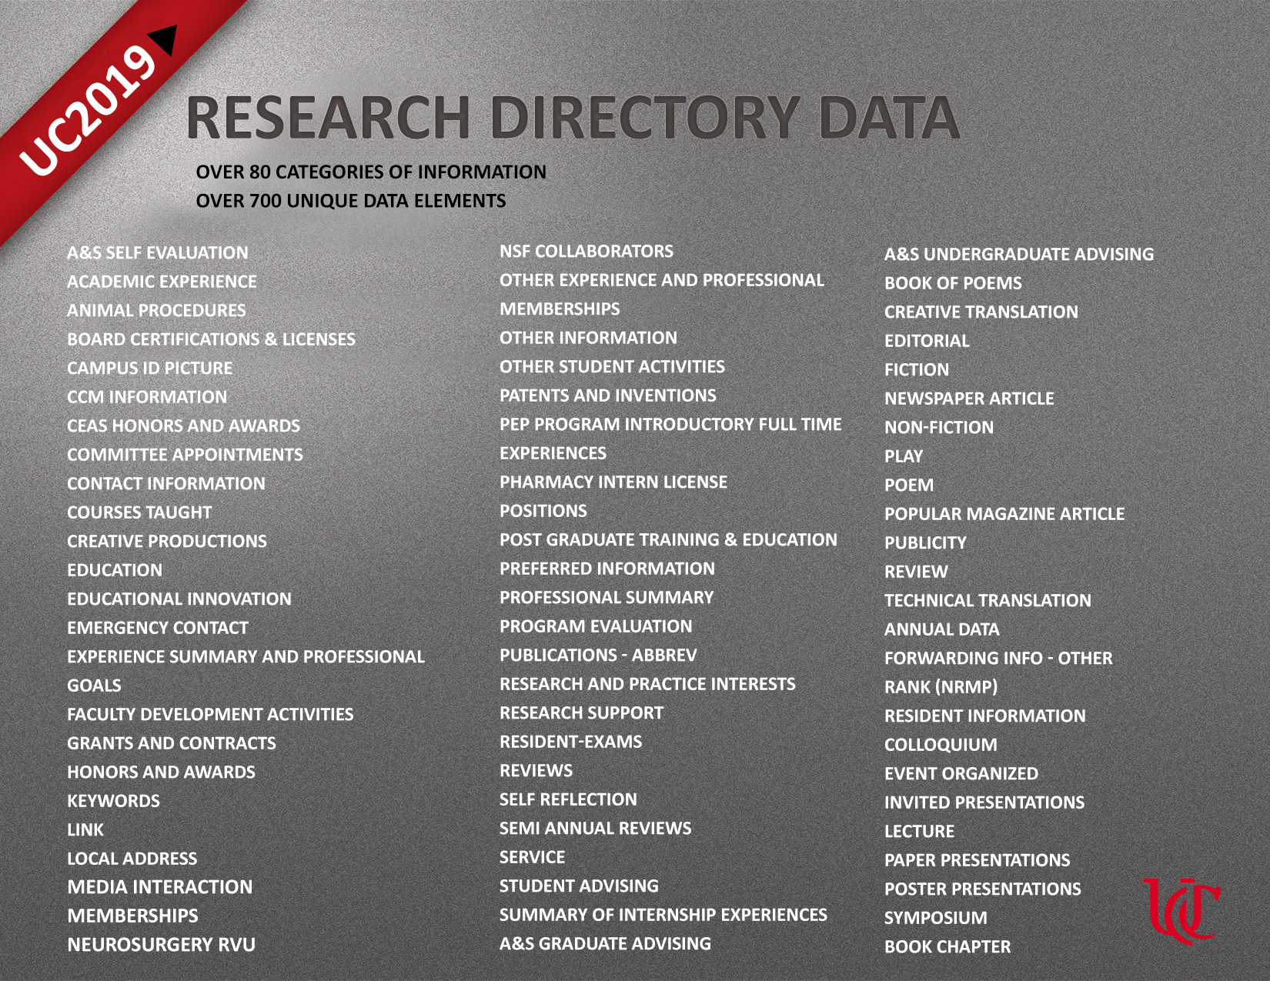
Research Directory
Custom and dynamically defined data elements
Notes:
10

Slide 11
Research Directory
Focus on Knowledge Management
Need: To create a portal for monitoring and aggregating both automated and manually entered information.
Experts and administrators should have the ability to manage all data, control the visibility of data, and aggregate data for various purposes.
Dynamic structure to define data elements, map data elements to existing data sources, show and hide data, filter & sort data, generate reports and export data in various formats including XML.
Automate
Monitor
Control
Aggregate

Slide 12
Research Directory
Automatic population from multiple sources
COEUS
Click Commerce
Intellectual Property
Sirius
PubMed
Enterprise HR
Scopus
RefWorks
Enterprise Finance
Web of Science
EndNote
USPTO Patents
EBSCO
Import API Layer
Enterprise & Custom Apps
Publications
Citations
Publications
Notes:
12

Slide 13
Research Directory
Research Directory Distinguishing Factors
Ability to aggregate information for multiple purposes
Rich Integration to support other systems and services such as:
  Grants dashboard, Electronic RPT, Annual Reporting, Accreditation Reporting
Scalable structure that can be modified to meet institutional needs
Ability to dynamically define objects and elements
Rich security based on roles and controlled visibility
Strong participation based on added value
Research Directory
Notes:
13

Slide 14
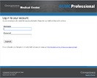

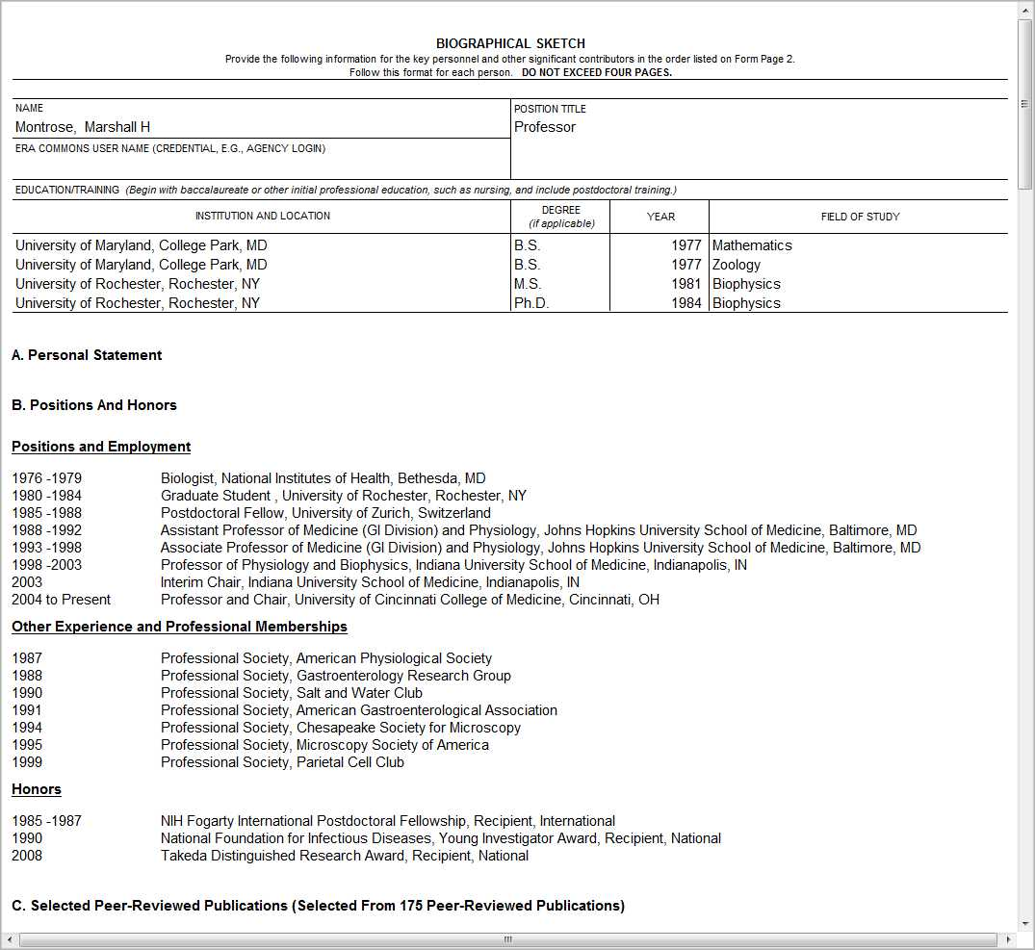
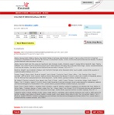


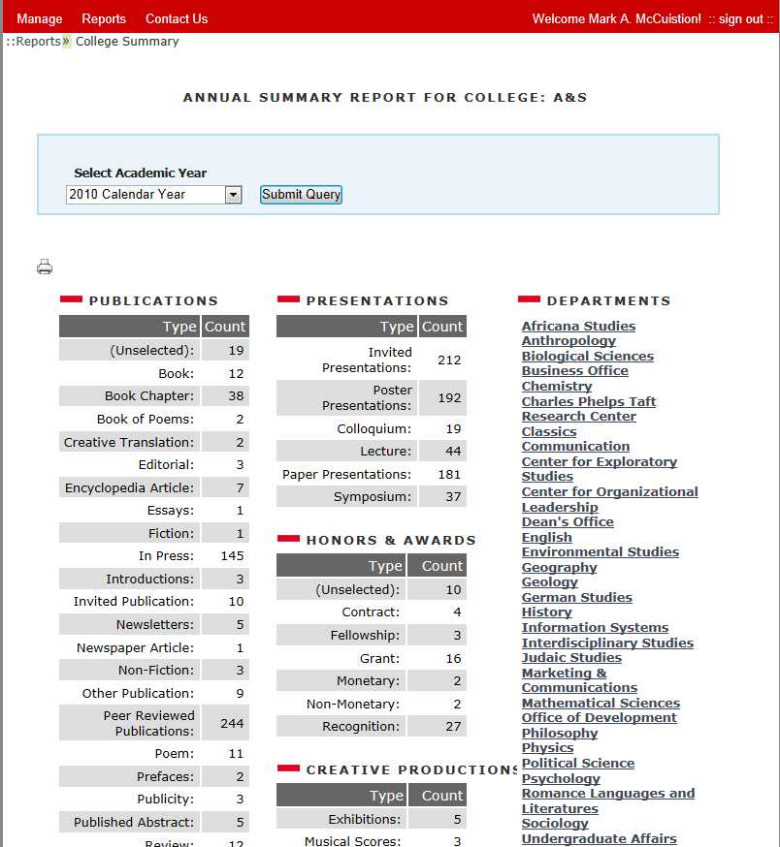
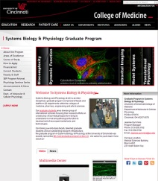
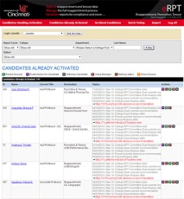
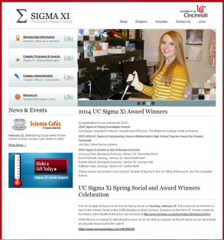
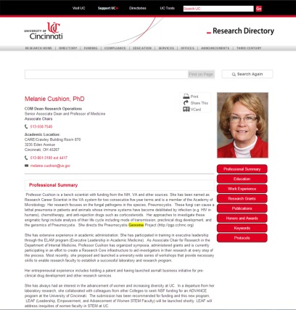
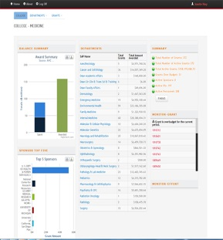
Research Directory
Output Examples: websites, biosketches, annual reports, training grants, interdisciplinary research areas, facilities, grants dashboard, administrative reporting
Georgetown
Facilities
Biosketch
Annual Reivew
Annual RPT
Vorderes Bild am größten
Systems
Biology
eRPT
Outlines sollen Weiß bleiben
Sigma Society
Dashboard
Expert Profile

Slide 15
scholar@uc
    A self-submission digital repository for faculty and researchers. Our mission is broad: “to preserve the permanent intellectual output of UC <….>” https://scholar.uc.edu/about_request
    Supported by a new external partnership with ProjectHydra.org
    Sustained by a new internal working partnership between UC Libraries, UCIT and the UC Office of Research.

Slide 16
scholar@uc
– agile and open source
    Agile, open source development – new to UC Libraries and in general to UC.
    Agile speaks to risk taking – release early, release often.
    Our code development is directly driven by the feedback from our Early Adopters – select faculty and researchers.

Slide 17
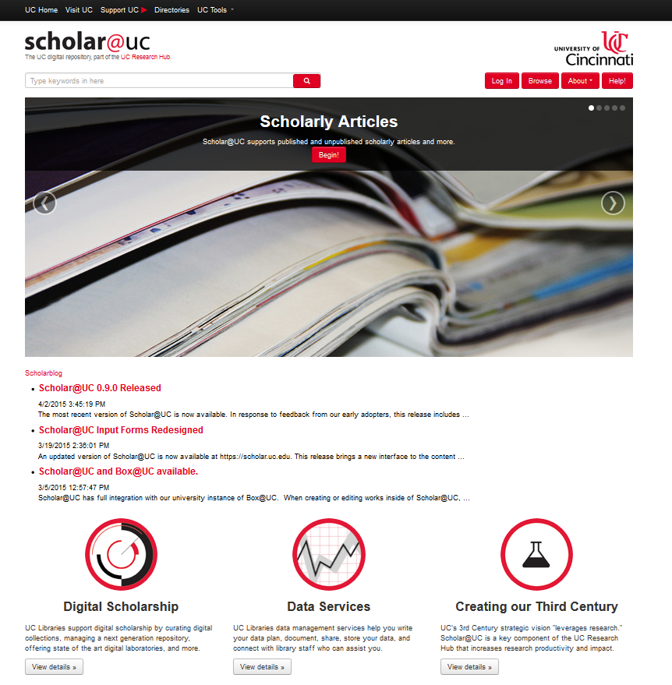
scholar@uc
Now in Beta at:
https://scholar.uc.edu
Code found at:
https://github.com/uclibs/scholar_uc
https://github.com/uclibs/curate_fork
https://github.com/uclibs/scholar_use_cases
https://github.com/uclibs/scholar-puppet

Slide 18
scholar@uc
– part of the UC Research Hub
    Scholar@UC presents integration opportunities with Kaltura (video encoding and delivery system), the Research Directory and other systems – Scholar@UC is one of the building blocks of the Research Hub.
    Along with support for data management, the Libraries are now visible in the infrastructure for research.

Slide 19
scholar@uc
– changing culture at UC Libraries
    Scholar@UC is the first open source project in UC Libraries. It is changing our culture from ‘buy and acquire’ to ‘create, innovate, steward.’ It is elevating the stature of development and technology skills among our faculty librarians.
    We have a small development team also supporting other production systems, but our success to date is encouraging a multiplicity of potential projects in the digital humanities, open access publishing, digital archives and linked data – our challenge today is to continue to be strategic with what we take on.

Slide 20
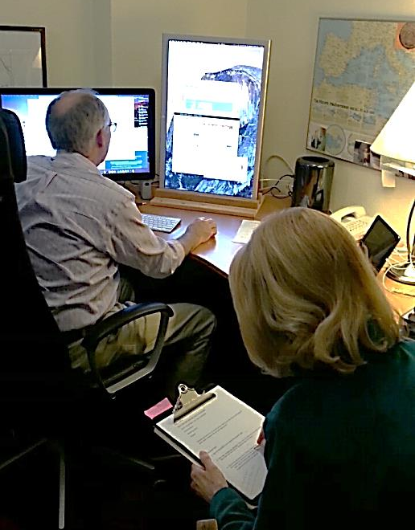
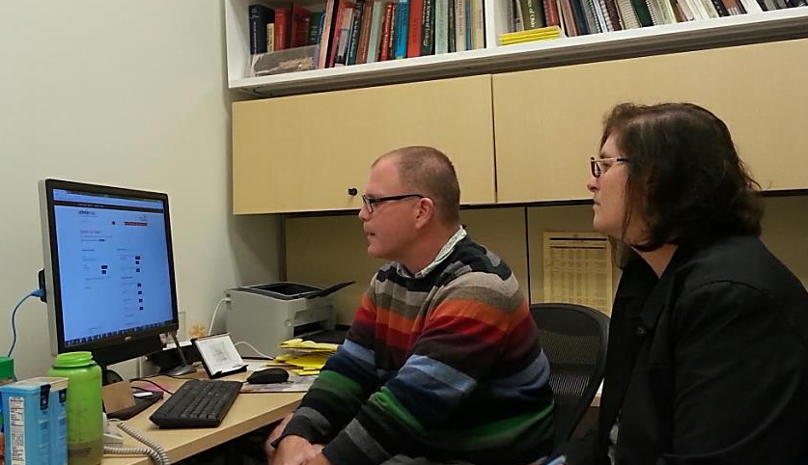
Engage with Researchers
  18 months of stakeholder engagement and face-to-face discussions to establish and nurture a diverse pool of Early Adopters (EAs) for Scholar@UC.
  ~24 faculty & graduate student EAs at present, across all disciplines.
  Self-submission repository = respect users’ time, focus on what creates a positive first impression and adoption.
  Rounds of structured feedback sessions on Scholar@UC functionalities with each EA, their assigned EA “liaison” and a development team member.
  Updates based on early adopter feedback & associated use cases:
  Revamped input forms
  Revised terms of use
  Author rights guidance

Slide 21
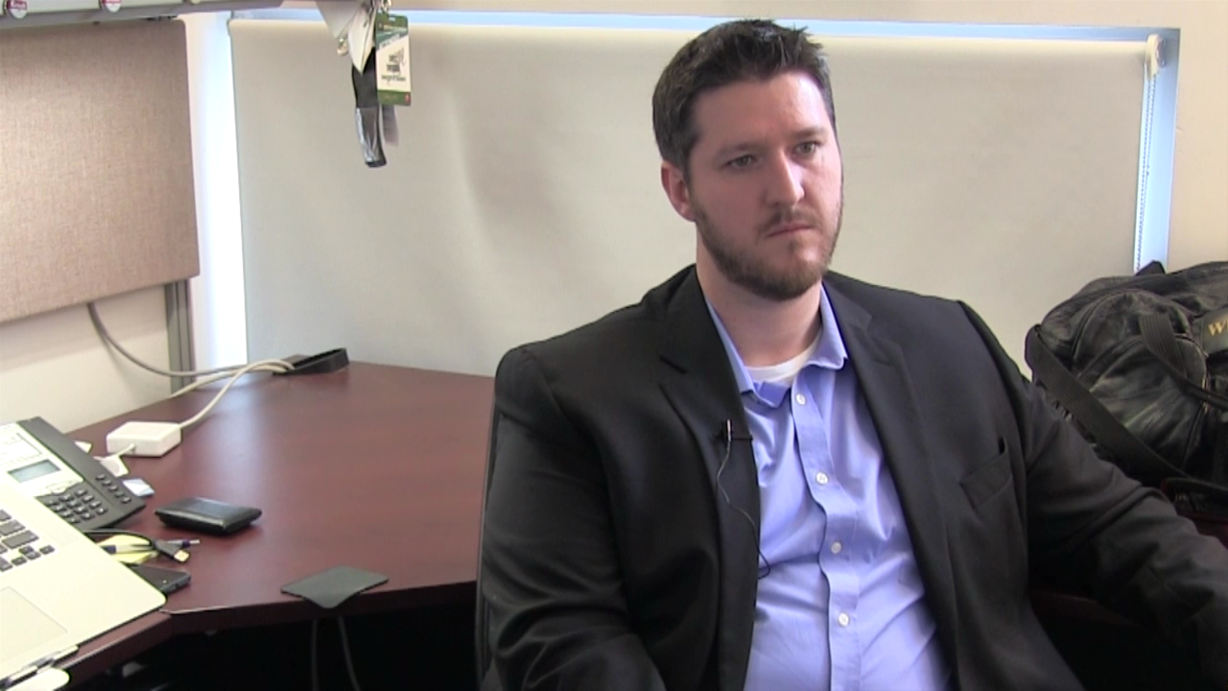
Engage with Researchers
  EAs as evangelists and ambassadors:
  Scholar Stories (written & video testimonials)
  EA engagement is changing the culture of UC Libraries:
  Developing models for repository services and training
  Subject librarians and all staff: many new conversations with researchers, greater awareness of researcher outputs and disciplinary practices
  Defining roles for new positions, including our team of informationists
Scholar Story Excerpt - Education faculty member Chris Swoboda speaks on the benefits of Scholar@UC for sharing & documentation of research

Slide 22
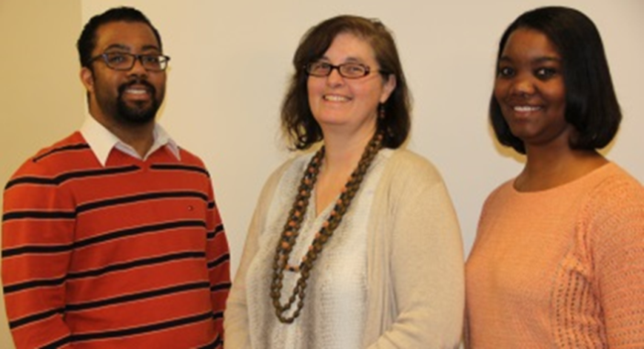
Researcher Support
  Scholar@UC is one example of our expanding suite of programs to support researchers.
  Strategic initiatives now underway to research and develop integrated services across the Research Hub, including
    research data consultation, data management curriculum
    GIS and visualization
    health informatics and analytics
    digital humanities
UC Libraries’ new informationist team
(see description of an informationist)

Slide 23
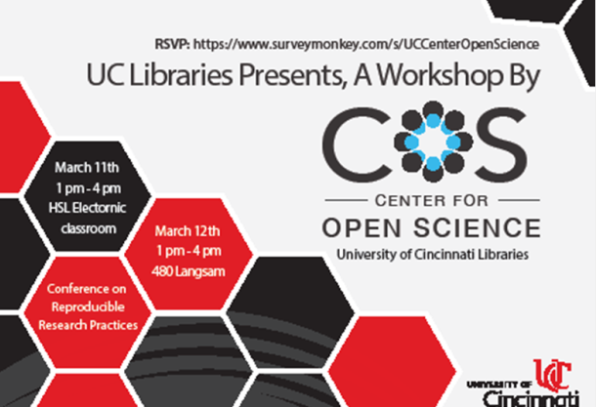
Researcher Support
  Strategic positions < 1 year old
    Informationist Team (STEM fields), Digital Humanities Strategist
    Cross-campus, cross-discipline, building trust with researchers
    Will host a THATCamp (humanities + technology camp)
    on May 4-6
    Hosted workshops from the
    Center for Open Science in March
  Strong collaborations with UCIT
  and academic departments to foster
  relationships, build capacity, and
  deliver new programs to researchers.

Slide 24
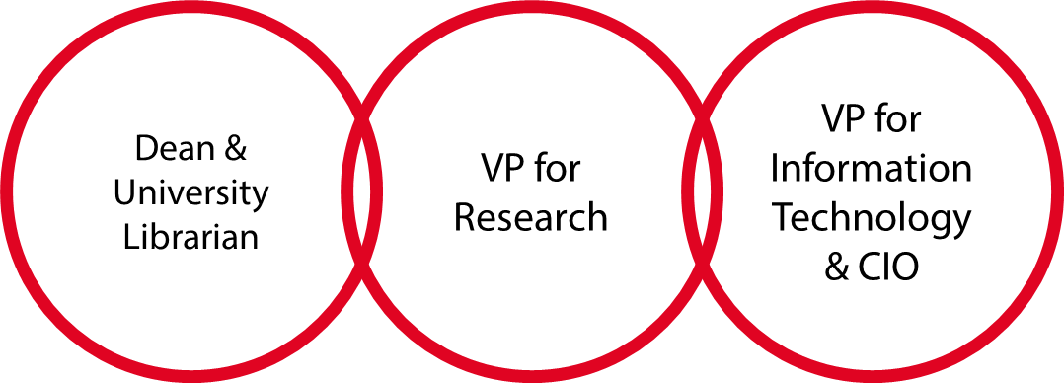
Conclusions
  Challenges and conclusions:
  Sustainability – campus politics and university priorities
  How do we keep Libraries, IT and Office of Research at the table together?
  How do we continue organizational transformation at the rate that is correct for our organizations?

