Slide 1
Identifying Print/Microfiche Holdings for Online Resources
Lorna Newman
University of Cincinnati
Ohio Valley Group of Tech Services Librarians
Terre Haute, Indiana
May 19, 2015

Slide 2
History
  Need to create space
  Weeding government documents – initial steps
    Duplicated by online
      Create lists of items with both print/fiche holdings and URL
      If item is in print/fiche and bib record has a URL, tangible format withdrawn
    Selector review
      Selectors reviewed remaining items

Slide 3
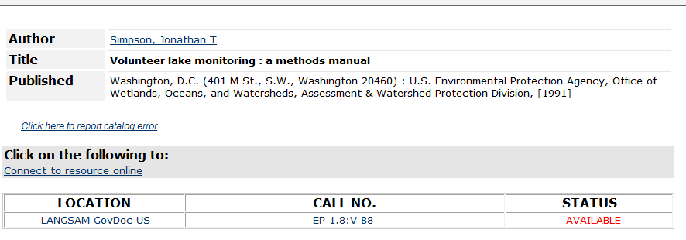
Example: Print bib w/PURL

Slide 4
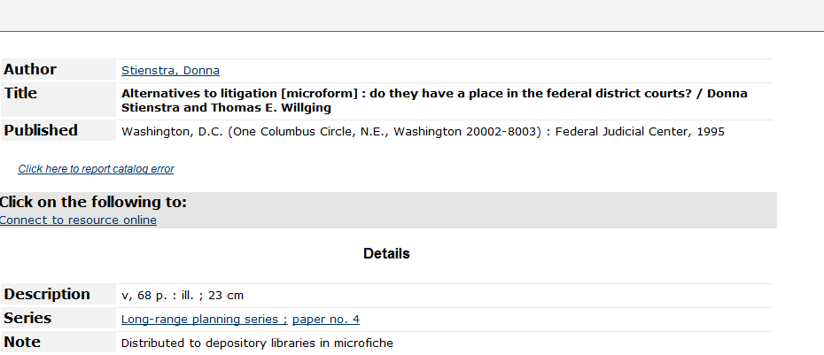
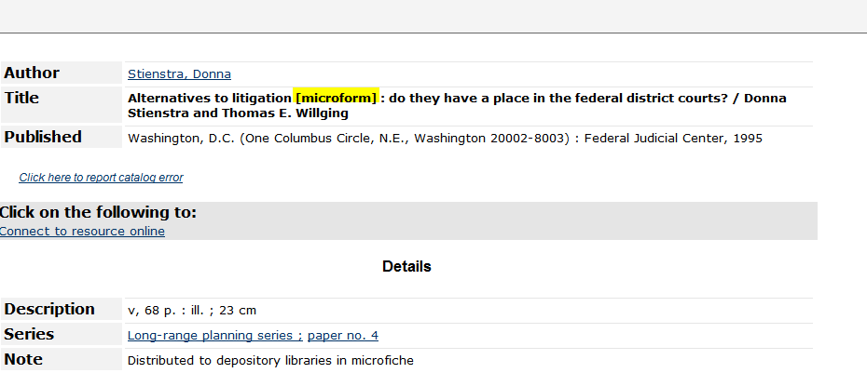
Example: Fiche bib w/o tangible holdings

Slide 5
Future
  GPO changed cataloging to separate record cataloging in November 2008
    http://fdlp.gov/cataloging/121-separaterecordcataloging
  Continue to withdraw print/fiche as GPO catalogs older content as online resource
  How to identify holdings?
Solution
  Use monthly Marcive full bib files to identify online resources

Slide 6
Initial Process
List already created in Sierra
  Export the 776 |w subfields from the 856 list from the Marcive monthly load
(Bib has 856, other local customizing processing already completed)
Open exported .txt file

Slide 7
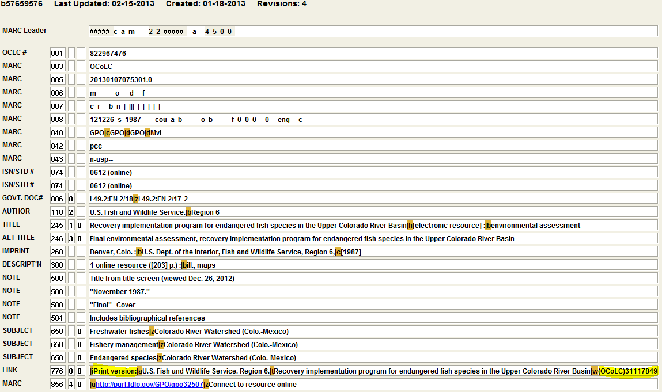

Slide 8
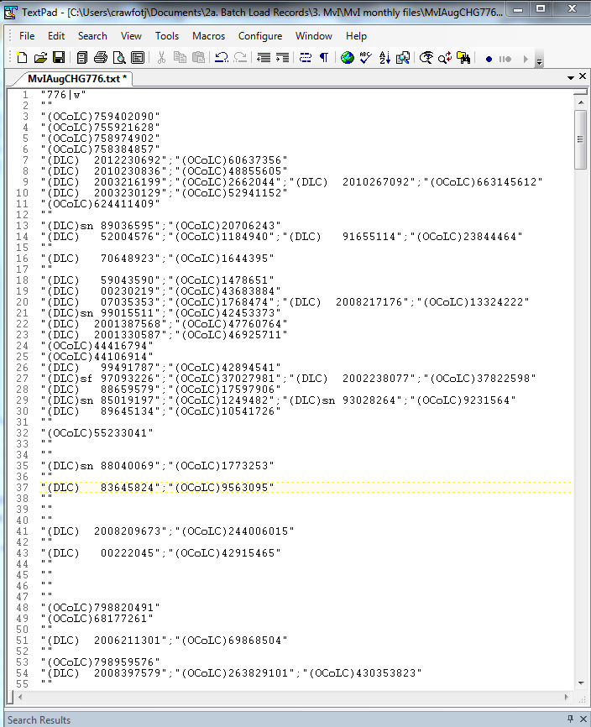

Slide 9
Use Text editor's features to edit to
  one subfield per line: change ";" to line break, remove " from beginning and end of lines
  sort and dedup so that all DLC numbers are grouped together, followed by OCoLC numbers

Slide 10
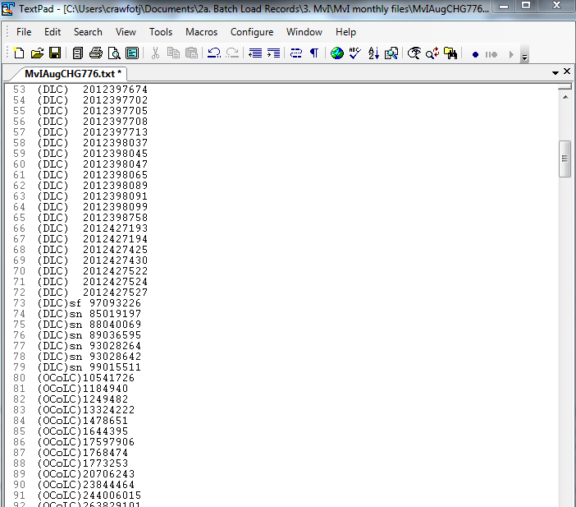

Slide 11
Remove the DLC lines from the file
Remove (OCoLC) from the file
Sort again
Enter the OCLC numbers into a web form that performs a PostgreSQL query
  Searches the database
  Returns the bib record numbers for matching records
  Receive email with bib record numbers
Invoke script, to apply to specified file

Slide 12
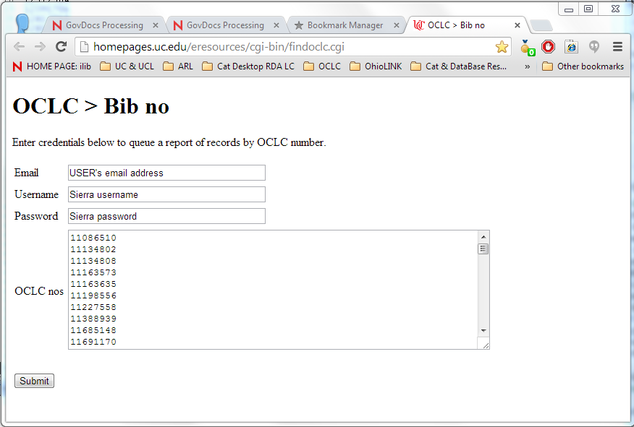

Slide 13
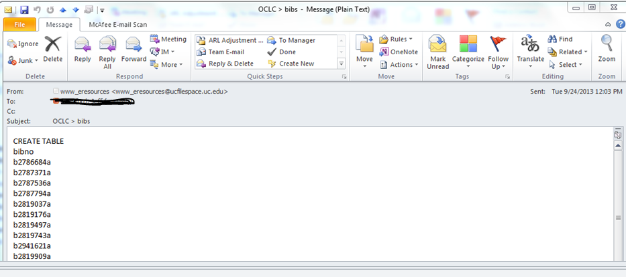
Email of Bib Record Numbers
List of bib record numbers automatically sent via email

Slide 14
Review File in Sierra
Create a list of bib record numbers
  AutoHotkey macro created that works with Sierra list creation to create a list review file from a text file of record numbers
  Script “appends” bib record numbers to review file
Export desired fields and email to government documents librarian

Slide 15
LOCATION = CHEMBIOL.
TITLE = A systematic and ecological study of Nearctic Hydrellia (Diptera:
Ephydridae) [by] D. L. Deonier.
OCLC # = 148139.
RECORD # = b25383632. BCODE3 = DIS LOC&CENT.
Located at our Chemistry/Biology library – contact librarian to see if interested in withdrawing.

Slide 16
GOVT. DOC# = C 55.13/2:NMFS-NE-111.
LOCATION = LANGSAM.
TITLE = Review and evaluation of the 1994 experimental fishery in Closed Area II
on Georges Bank [microform] / Patricia Gerrior ... [et al.].
OCLC # = 39116325.
RECORD # = b31828449. BCODE3 = DIS LOC&CENT.
Located in the gov docs fiche collection - withdraw

Slide 17
GOVT. DOC# = HE 20.8309:
LOCATION = INTERNET.
TITLE = Alcohol research & health : the journal of the National Institute on
Alcohol Abuse and Alcoholism.
OCLC # = 42453373.
RECORD # = b56961753. BCODE3 = DIS LOC&CENT.
No print holdings, had already withdrawn print because was available online. GPO has now cataloged online version so we can remove this particular bib record from our catalog.

Slide 18
Projects
Locate online records that have not been part of the new process
  Create a list of records with:
    Marc field 245 [electronic
    Marc field 856 not blank
    Marc field 776 not blank
    Marc tag 086 starts with (enter a SuDoc stem)
  Run the script to locate additional items to withdraw

Slide 19
Projects
Non-cataloged titles
  Search for online version
  If found, ask GPO to catalog online and tangible
  Example:
  I 49.70:90-91 (distributed in fiche)
  OCLC #832368550 microfiche
  OCLC #832349902 online

Slide 20
Contact Information
Lorna Newman
University of Cincinnati
513-556-1885
Lorna.newman@uc.edu

